Slide 1

ADMI’s Role as an Intermediary

Slide 2

ADMI Introduction
The Africa Digital Media Institute (ADMI) based in Nairobi, Kenya is Eastern Africa’s premier creative media and technology training institution offering programs at certificate and diploma level.
Together with the Africa Digital Media Foundation and Africa Digital Media Studios, the Group forms an innovative career accelerator where creatives and techies get the training, mentorship, and platform to turn their passion into a profession.

Slide 3
Supporting Interventions & Programs by ADMI
Curriculum development
Knowledge transfer
Training Programs
Apprenticeship
Incubator programs

Slide 4
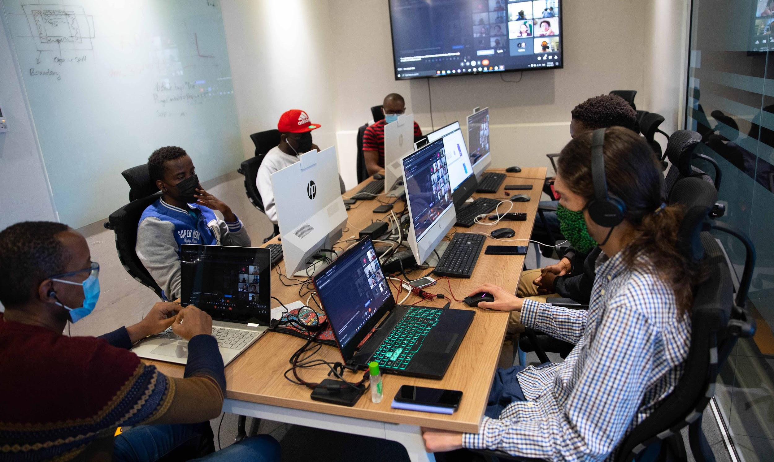
Curriculum Development
Knowledge Transfer
We developed programs in the 2D Animation and Video Game fields, in collaboration with the industry, and tailored to the local audience and market.
In partnership with Rubika, training institution in France, we have delivered knowledge transfer programs through training of trainer sessions with faculty from Rubika.

Slide 5
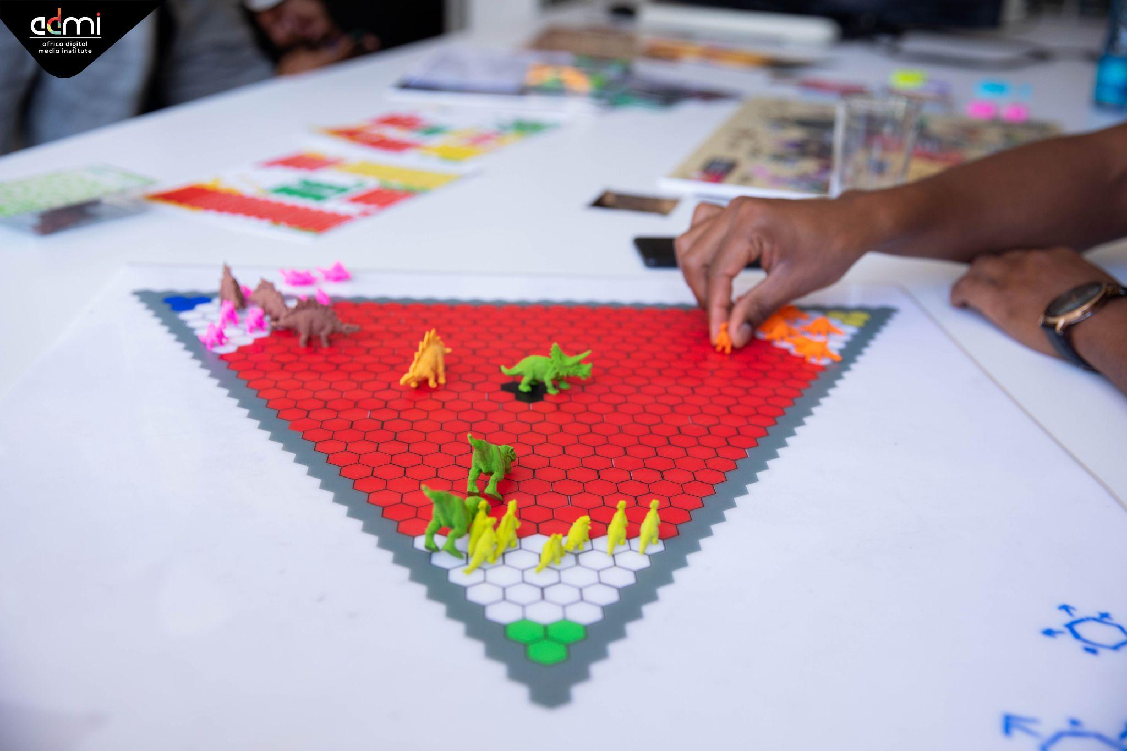
Training Programs
We offer training programs in 2D Animation and Game Development programs at certificate and diploma levels.

Slide 6
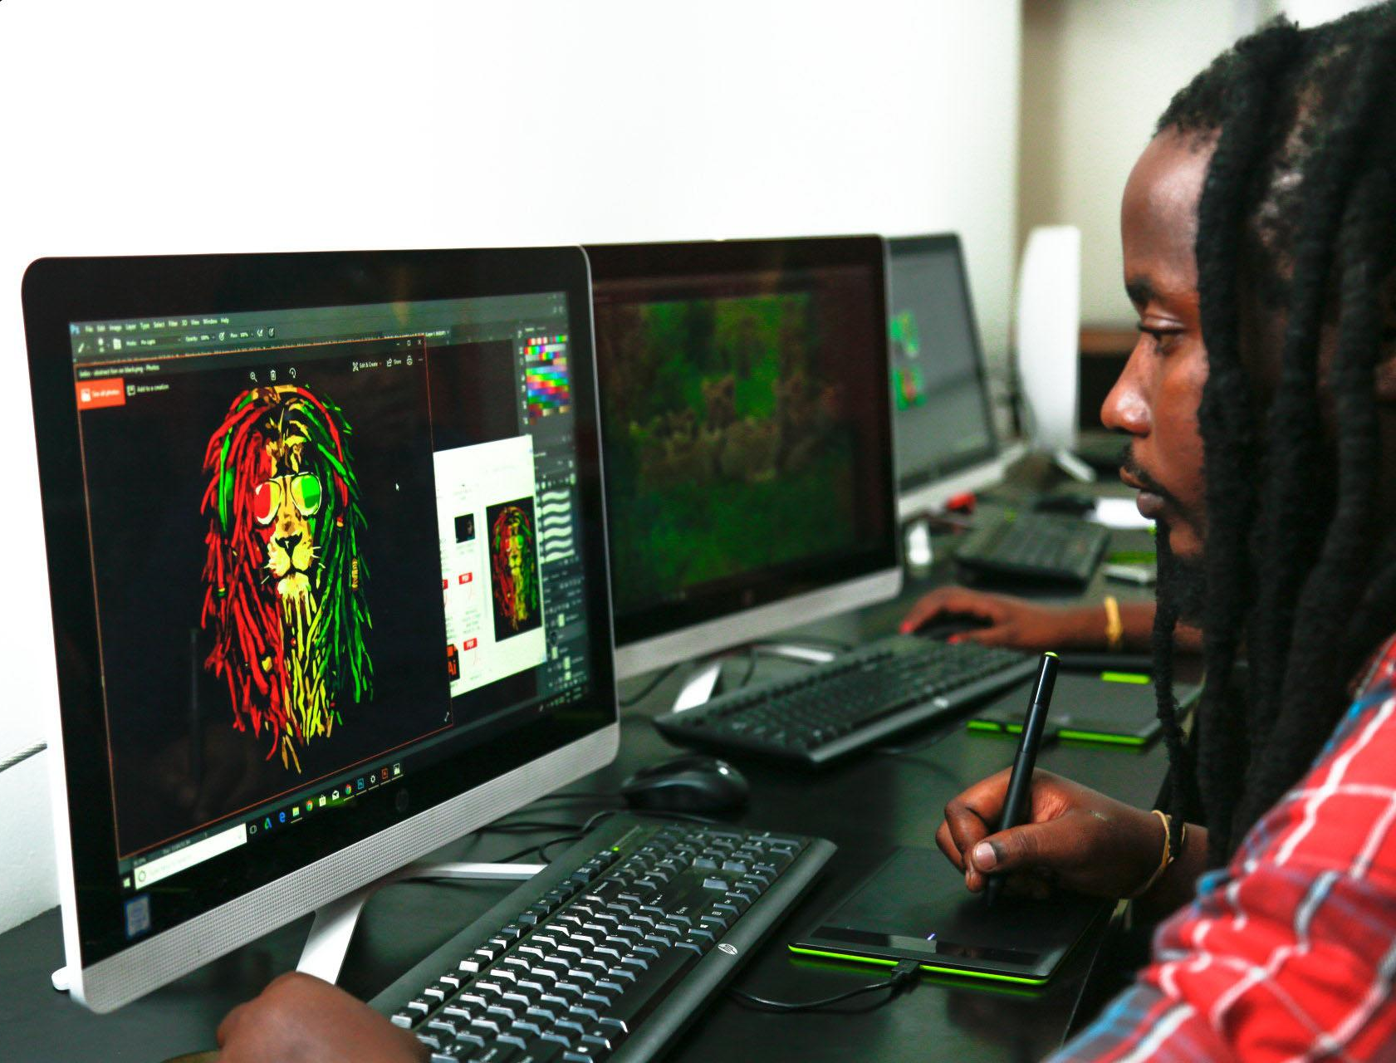
Rubik’s Digital Apprenticeship
In partnership with Rubik’s Digital, a Kenyan organization involved in esports and mobile-based video games, we created an apprenticeship opportunity to create work opportunities for early stage game developers.

Slide 7
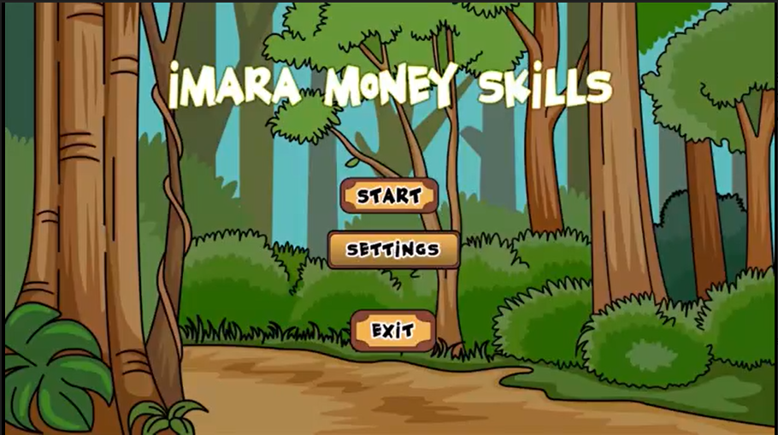
Young Savers Apprenticeship
The Young Savers apprenticeship program took place in 2020, in partnership with I&M Bank. Apprentices in the game development and animation fields, collaborated to create an application targeted at a younger audience to foster financial management skills. Imara Money Skills was presented to I&M Bank after 4 months of the immersive apprenticeship program.

Slide 8
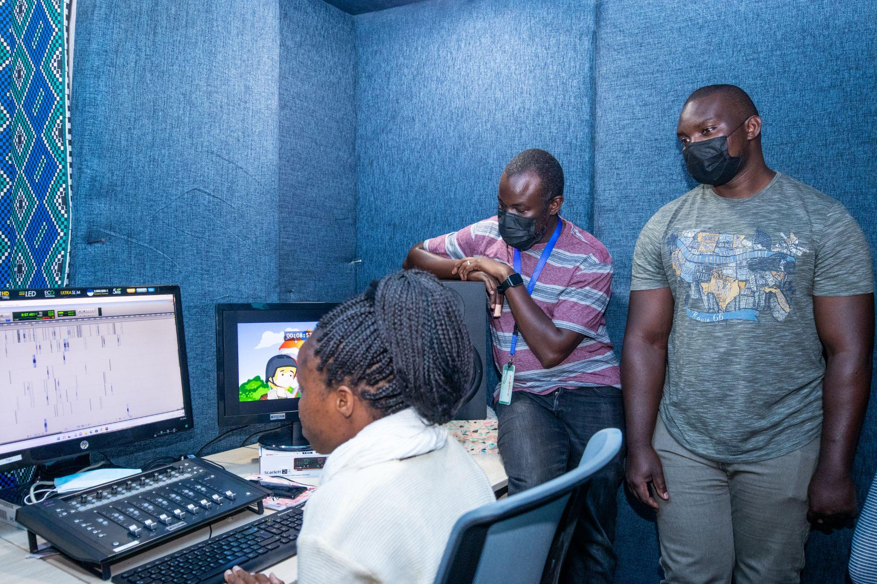
2D Animation Cohort Digital Media Incubator
The Digital Media Incubator ran from October 2021 to May 2022.
2D Animators as one of the cohorts.
The animators were guided through the development of original African inspired animation projects for kids.

Slide 9
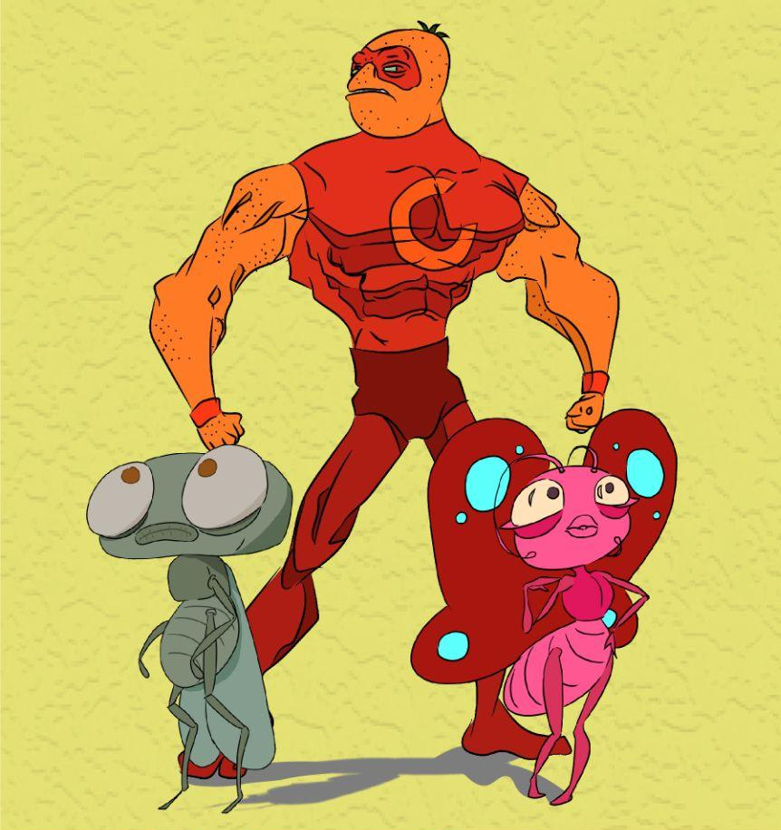
CreaTech Animation Incubator
The CreaTech Animation incubator was launched in 2020, to develop the animation industry through mentorship and guidance to create investor-ready pitches that they can also use to compete in international festivals and competitions. There is a cohort currently running, until the end of November 2022.

Slide 10
Thank You!

