Slide 1


Slide 2
Idea
Product
Value
Action

Slide 3
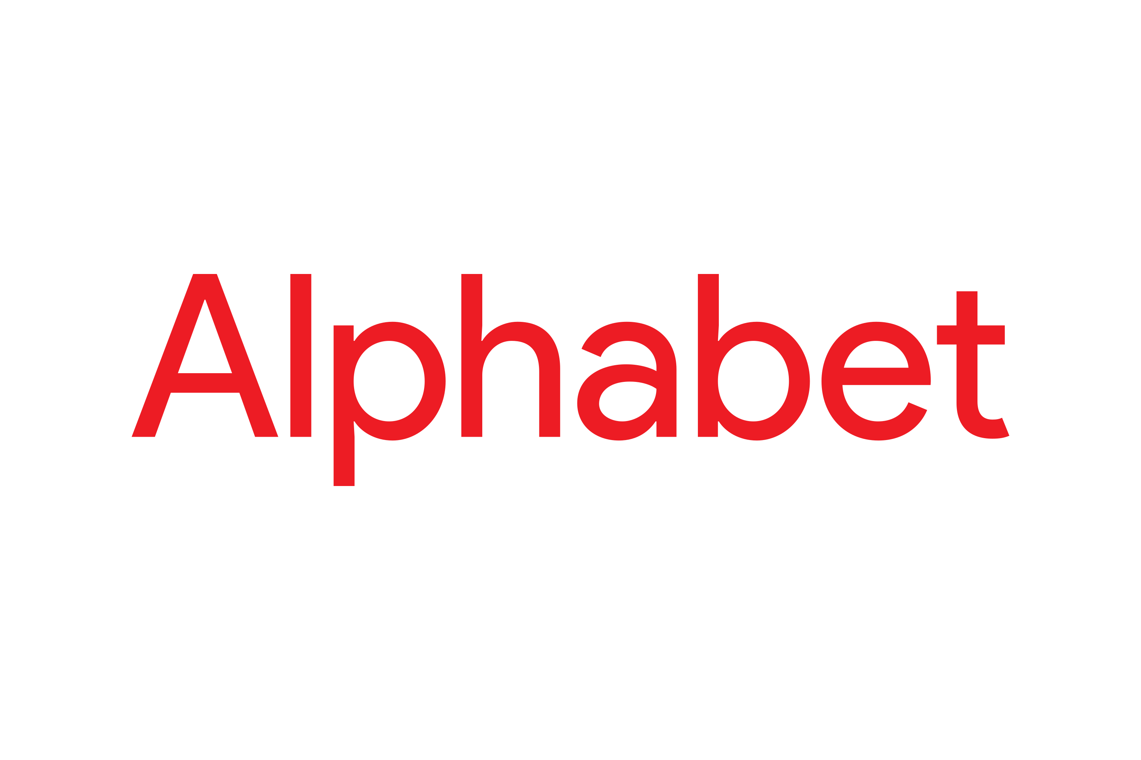





Slide 4


Slide 5
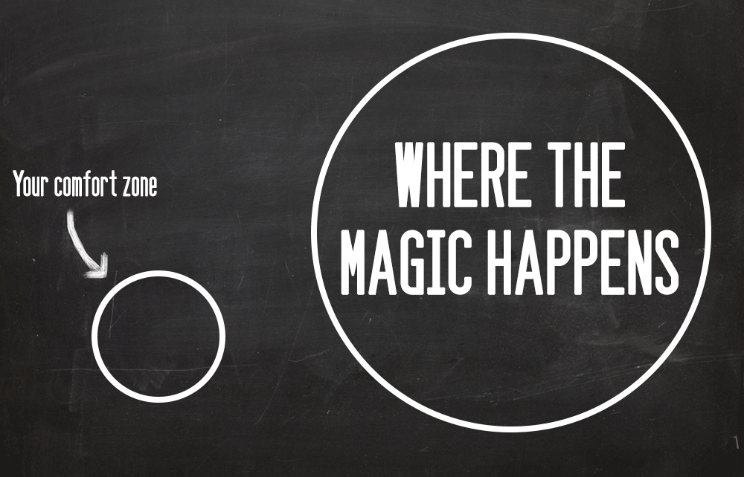

Slide 6


Slide 7

Record labels pay up front
Galleries pay to feature artists
Art work tracked to reward creator
Budgets to find NEW solutions
Free education for all

Slide 8
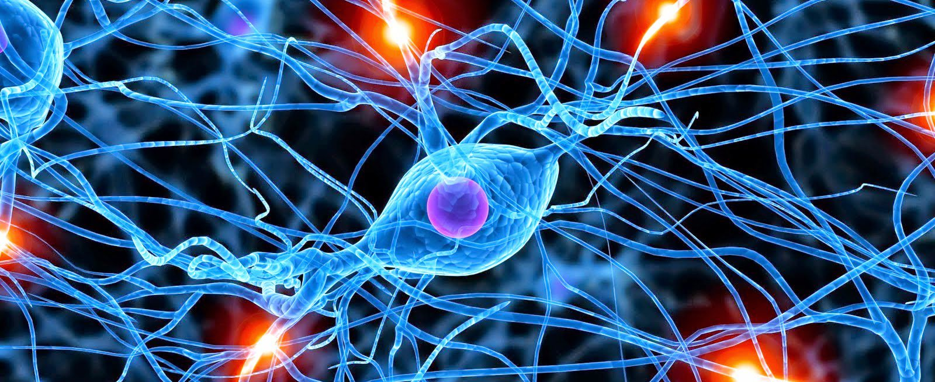
QUIET
INWARD LOOKING
SLIGHTLY HAPPY
NOT EFFORTFUL
Notes:
Neuroscientists have done a great job of finding out what happens in your brain when creativity happens… and also what the conditions are under which CREATIVITY can happen
(HAND OUT)
Conditions
QUIET
INWARD LOOKING
SLIGHTLY HAPPY
DON’T TRY TOO HARD
That ‘aha’ moment when you get an idea uses only a few hundred neurons. Most thinking uses hundreds of thousands. If you don’t take time to be quiet, you can miss it!
Essentially, thsoe ‘Aha’ moment, when you realise something new, important or suddenly realise the answer to a problem that has been bugging you, these moment occour when these 4 conditions are met.
Where, for example: on your smoke or lunch break, in the shower, going for a walk, riding your bike. What do these actions have in common? Well, you’re not directly thinking about your work or your problem. Your body is kind of on auto pilot and SUDDENLY the ideas come.
IN other words, if you CONSCIOUSLY recreate these 4 conditions, you WILL get more creative ideas.

Slide 9


Slide 10

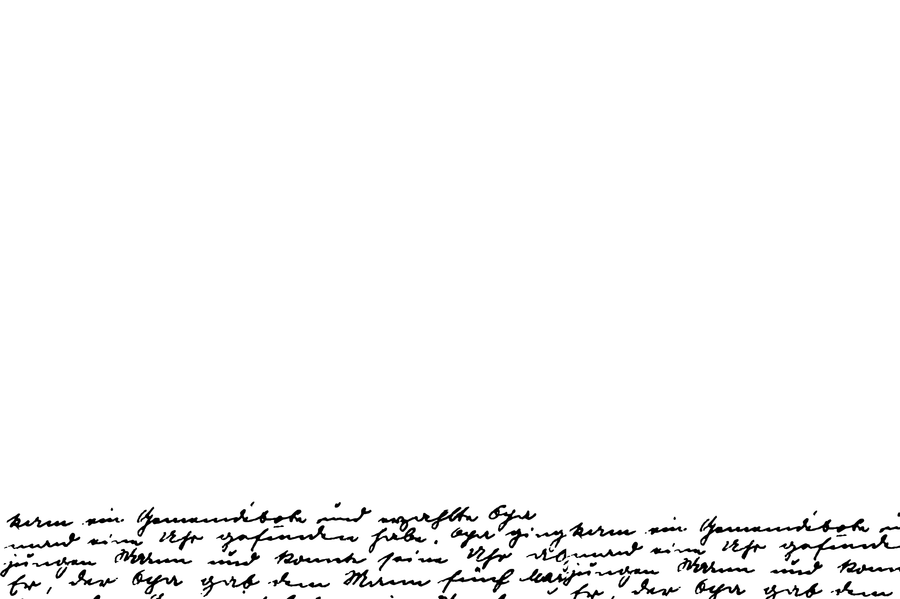
Ambiguity
Complexity
Novelty
Notes:
Open to ambiguity: vagueness, uncertainty,
Open to complexity: not binary, many moving parts, works in progress
Focus on the new: Old ways don‘t open new doors
To help you in doing this, there are also a few things you can focus on actively doing:

Slide 11
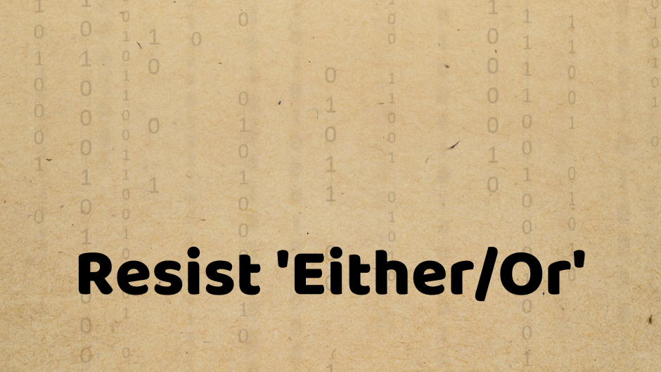

Slide 12

The difficulty lies not so much in developing new ideas as
in escaping from old ones.
- John Maynard Keynes

Slide 13


