Slide 1
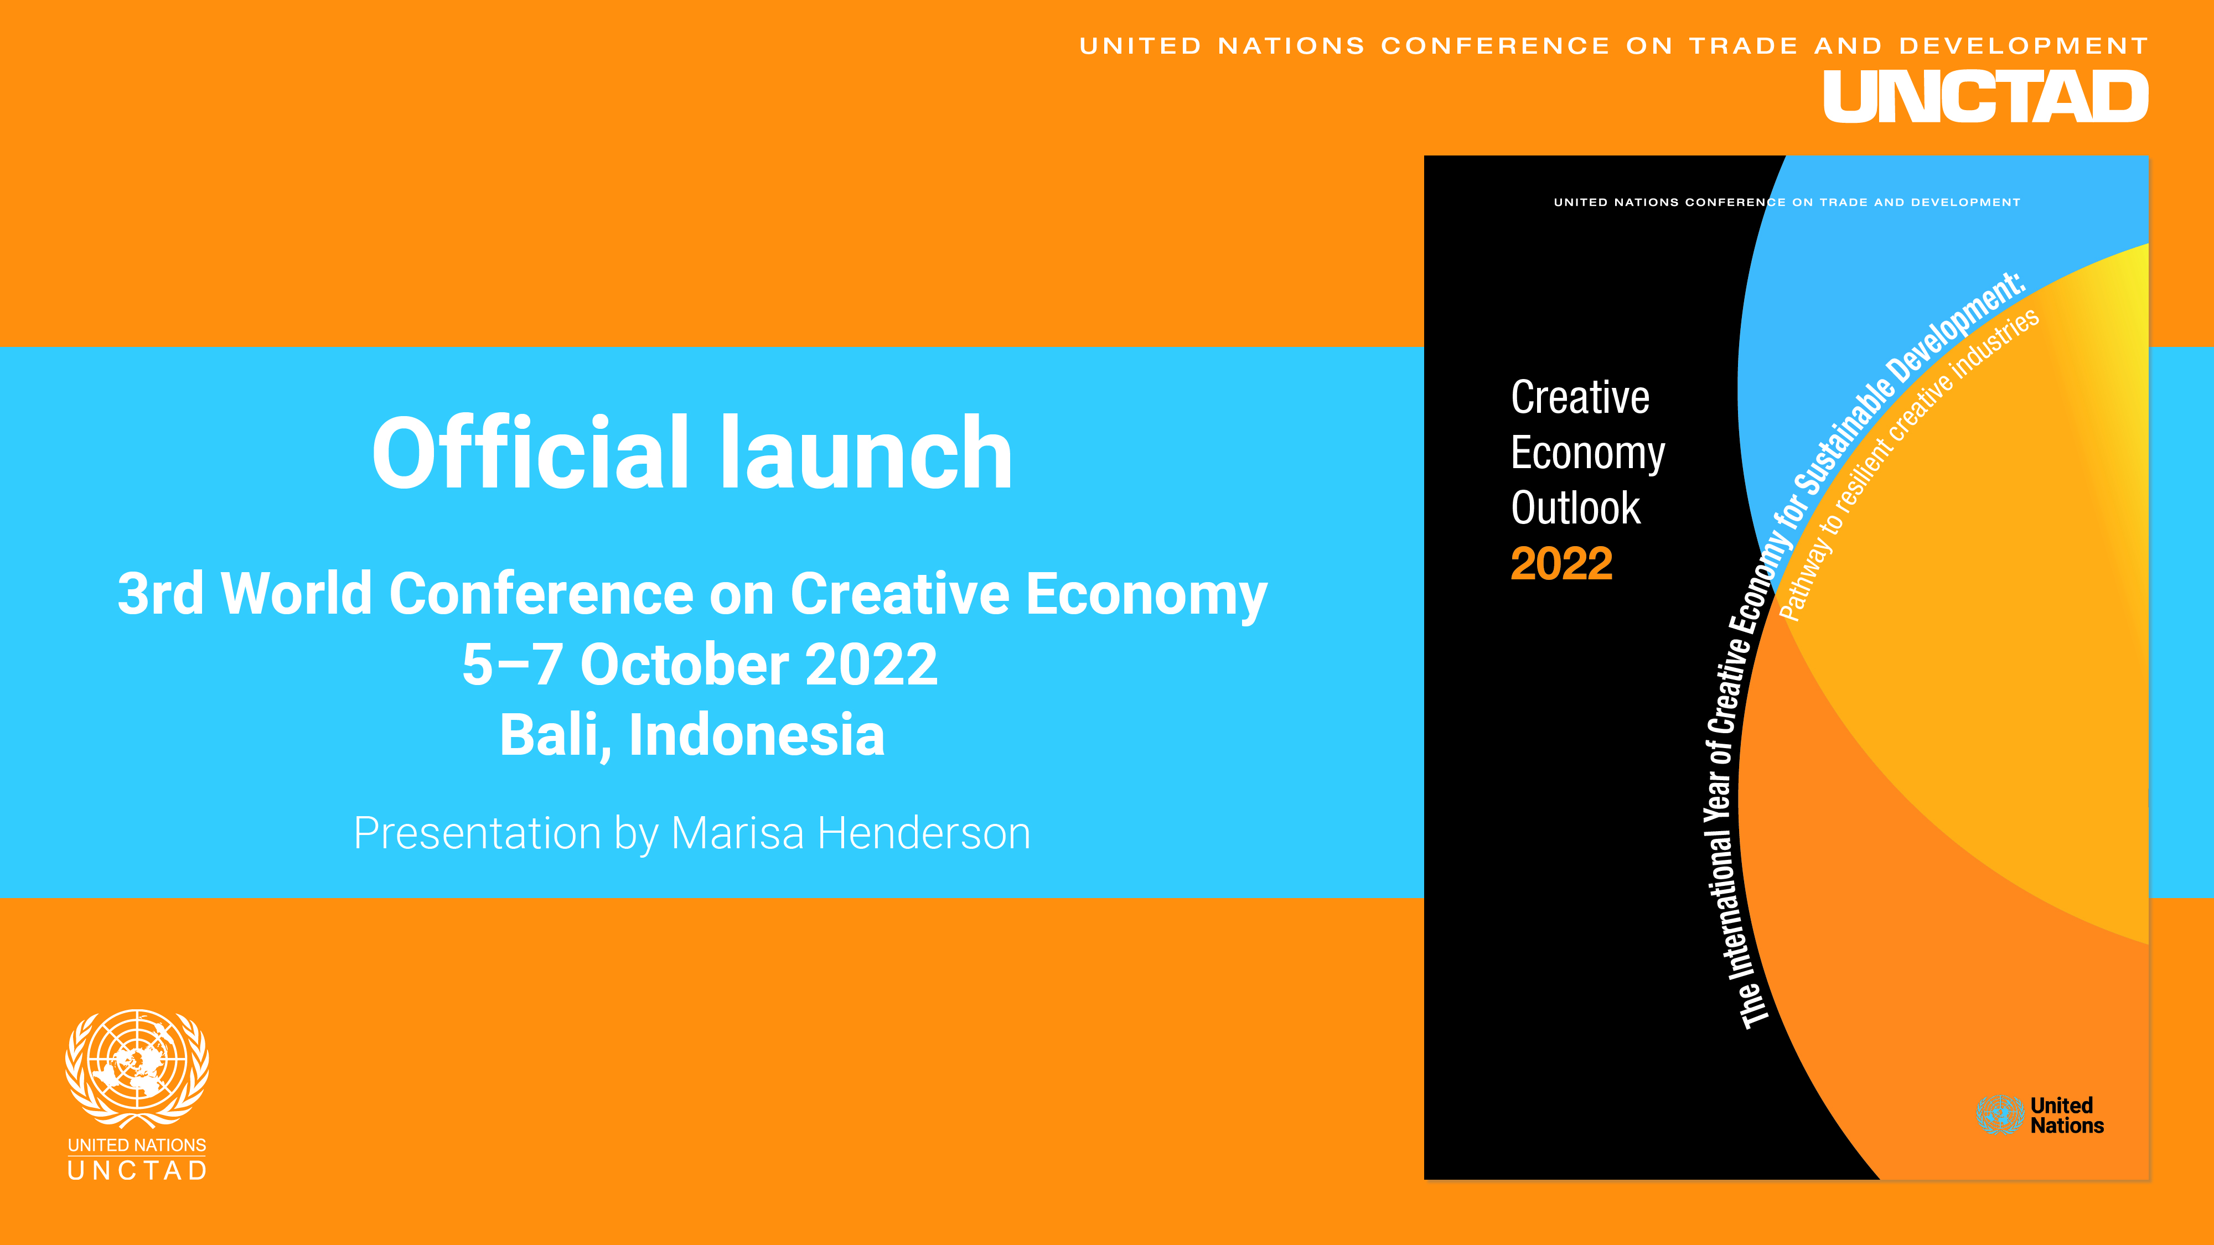
UNCTAD Creative Economy Outlook 2022
November 2022
South Africa
Presentation by Marisa Henderson

Slide 2
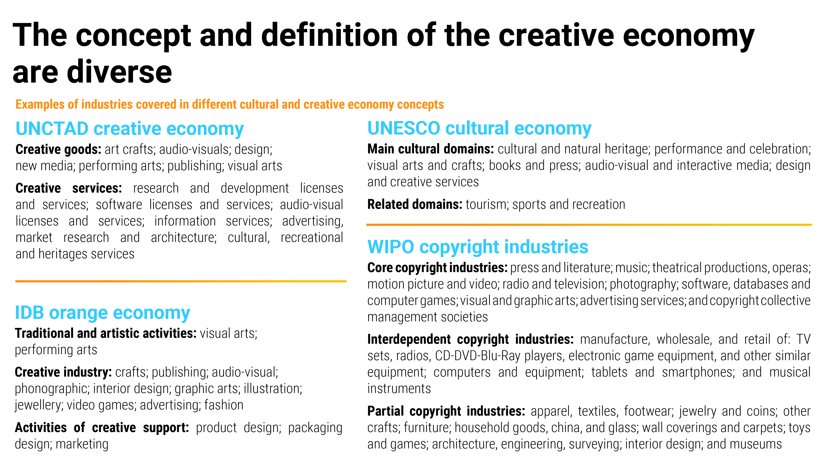

Slide 3
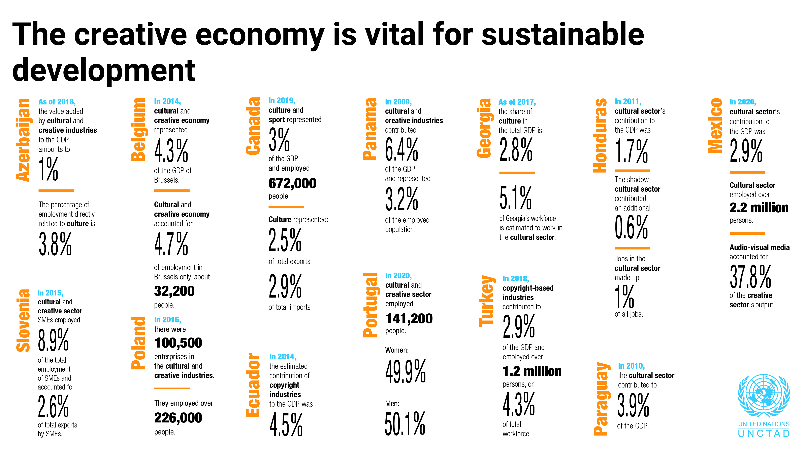

Slide 4
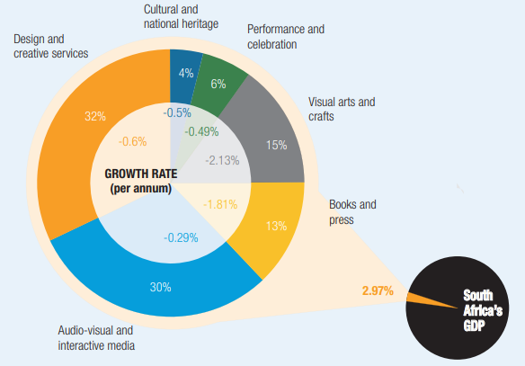

The creative economy is vital for sustainable development: case of South Africa
Contribution of creative industries to South Africa’s GDP, 2020
(percentage)
In 2020, cultural and creative industries
contributed to nearly 3% of GDP and
provided employment for nearly a million people (6% all employment in South Africa)

Slide 5

UNCTAD survey shows that countries apply different approaches to support their creative economy
UNCTAD survey of 33 countries on the creative economy
Almost all countries have at least one entity in charge of the creative economy
Most countries split duties for the creative industries across multiple ministries and agencies
The issuance of national strategies, policies and regulations of the sector has rapidly spread throughout the developing world
Several countries made progress in measuring the economic contribution of creative industries
Priority creative industries in terms of their
international trade potential

Slide 6
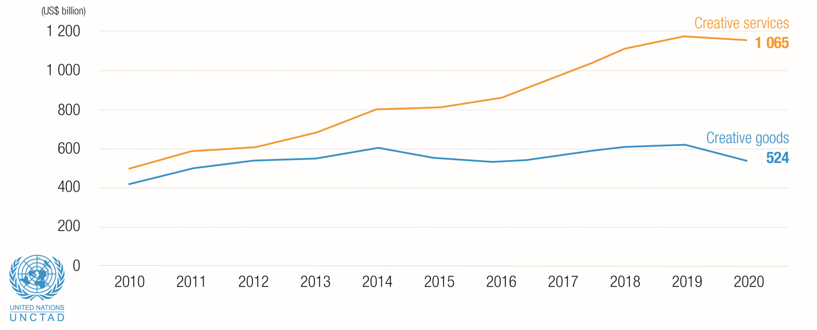
Trade in creative goods and services generates increasing revenues for countries
Creative services esports increasingly exceed those of creative goods

Slide 7
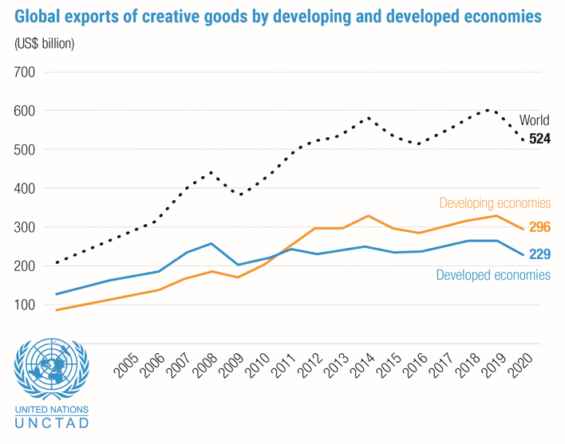
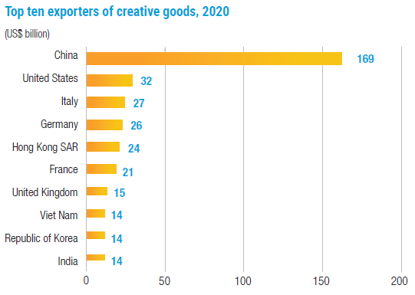
Main trends: global exports of creative goods
Developing economies export more creative goods than developed economies
Exports of creative goods is largely dominated by China

Slide 8
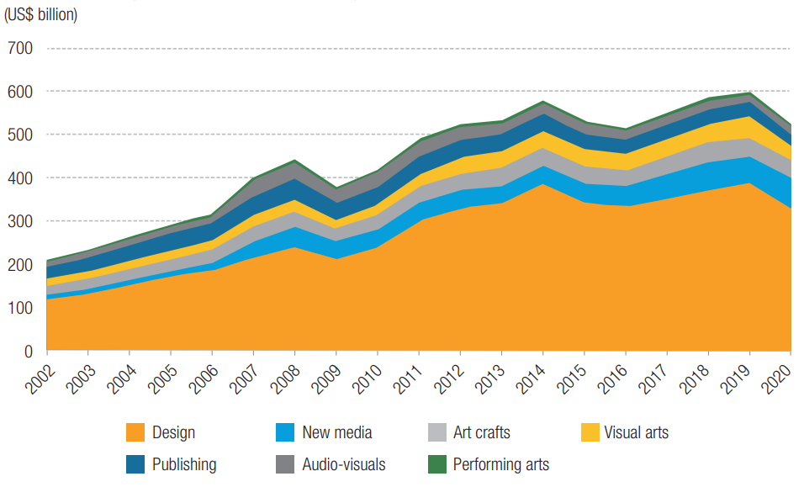
Design products dominate global trade in creative goods
Creative goods exports by product groups

Slide 9
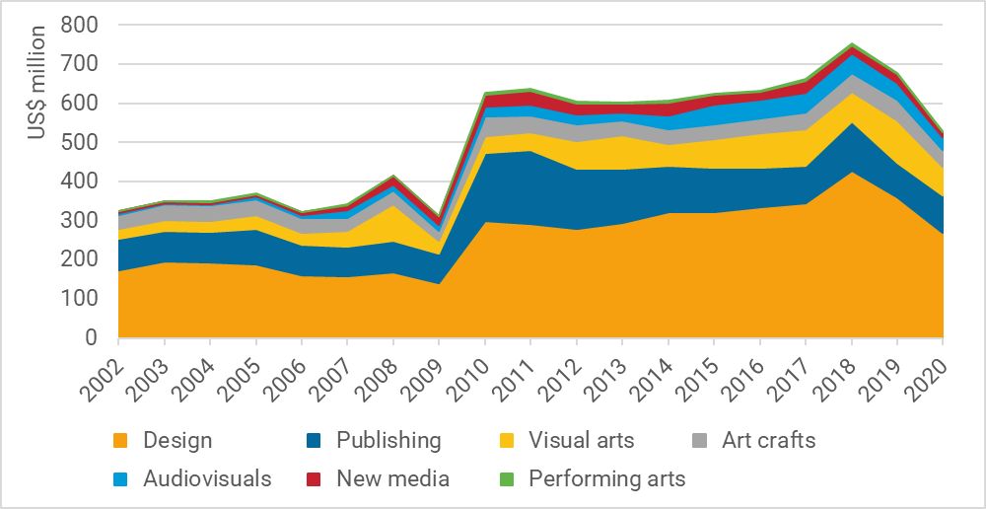
Main trends: exports of creative goods by South Africa
South Africa: creative goods exports by product groups
Exports of creative goods by South Africa
reached US$ 529 in 2020
In 2020, South Africa was:
  the world’s 48th largest exporter of creative goods
  Africa’s 2nd largest exporter of creative goods (after Egypt)
Main exported products:
  Design
  Publishing
  Visual arts

Slide 10
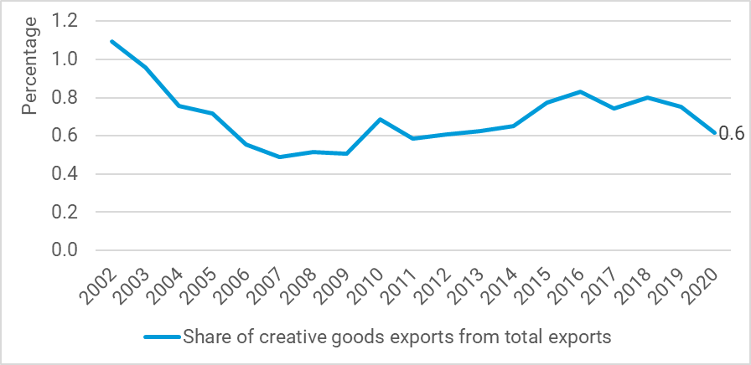
Main trends: exports of creative goods by South Africa
Creative goods represent 0.6% of total merchandise exports in South Africa
Possible reason behind declining trend: certain creative goods increasingly become creative services
South-South trade is critical as shown by list of largest export destinations:
  United States of America
  Namibia
  Botswana
  Angola
  Lesotho
South Africa: Share of creative goods exports from total exports

Slide 11
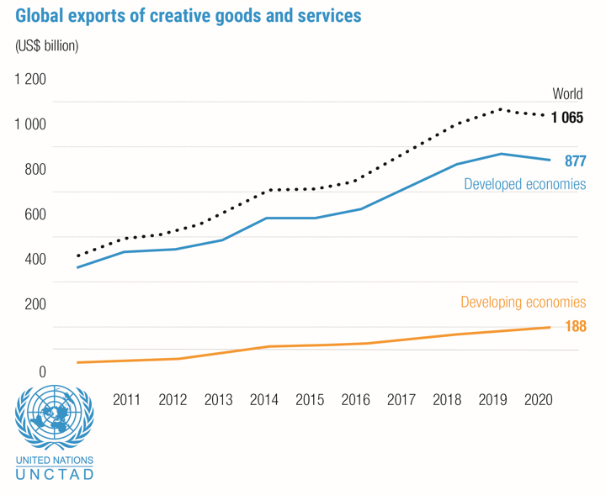
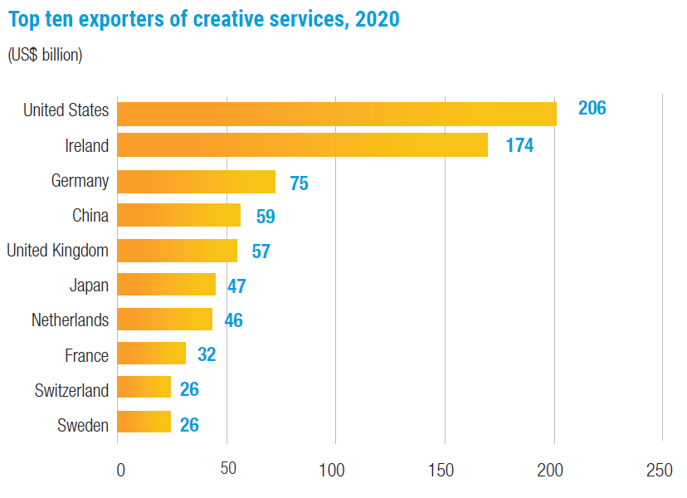
Main trends: exports of creative services
Developed countries have been exporting significantly more creative services than developing economies
In many developing countries, including South Africa,
statistics on international trade in services are not detailed enough to estimate trade in creative services

Slide 12
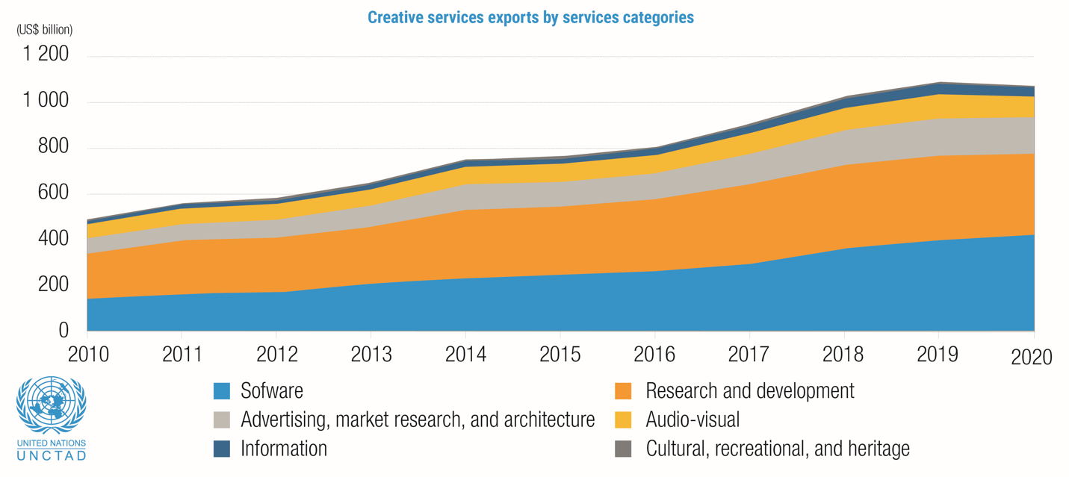
Software services and R&D are the most exported creative services

Slide 13
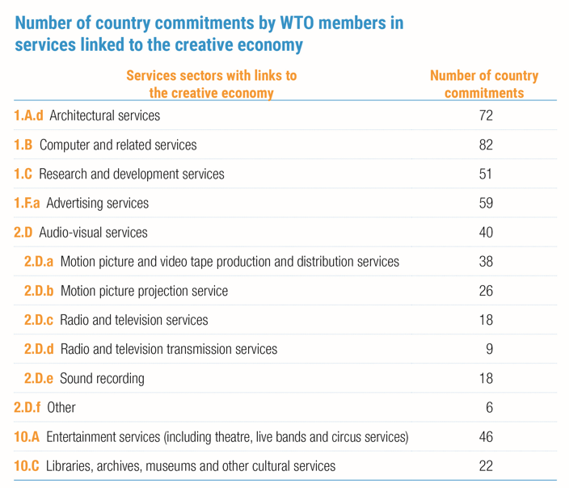
Developing countries face several barriers to participate in creative services trade
Developing countries
lack of fundamental skills and infrastructure to become competitive players in creative services
face services trade restrictions
  access to the most important creative services markets remains governed by commitments in the WTO’s General Agreement on Trade in Services (GATS)

Slide 14
Measuring the creative economy: lack of harmonised definitions, methodologies and data remains a challenge
Several frameworks exist to measure the creative economy
  Patterns of common industries and products covered
  But also differences due to national or regional classifications; activity or product coverage; methodology and guidelines; and types of activities and products covered
Developing countries measure the economic contribution of their creative sector in diverse ways
  Case studies from Argentina, Indonesia, Mexico, and South Africa
Current definitions may not capture fully goods and services with actual creative content
Better and more disaggregated data is required to gain more insights into the role of services in economic transformation and their potential for developing economies for services-led diversification
Challenges in developing countries:
  Lack of data
  Lack of appropriate statistical infrastructure, including business registers to compile data
  Inadequate institutional arrangements
  Lack of financial resources, IT infrastructure, and trained experts

Slide 15
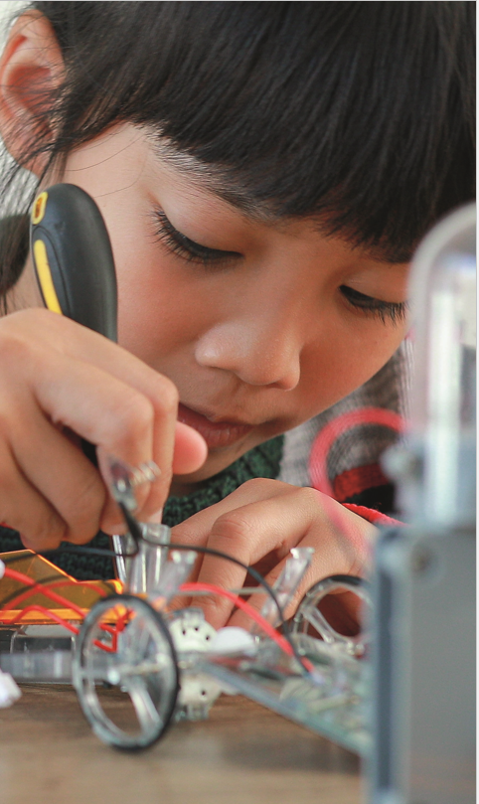
New and emerging technologies are fundamentally changing some creative industries
Industry 4.0 technologies opens new opportunities for the creative economy
The COVID-19 pandemic accelerated the shift towards e-commerce and digital platforms and the scope for the transformation of the creative economy
Global digital divides persist with repercussions on the creative economy
Producers of creative products, especially MSMEs, face several hurdles in accessing global markets
The scope and application of intellectual property rights in the digital environment are unclear
Policy areas that could contribute to developing creative economies through new and emerging technologies:
  Human capacities
  Infrastructure barriers to digitalization
  Enabling environment for creative industries

Slide 16
It is essential to map and measure the creative economy and industries
Key recommendations
Recognise the importance of the creative economy by building on definitions and classifications of international and regional organisations and conceptualising creative industries in ways that consider national and regional economic structures
Work with international organisations like IDB, UNCTAD, UNESCO, and WIPO towards a more harmonised concept of the creative economy and industries
Benefits of mapping:
Provide evidence and insights for policy makers to design, plan and implement policies targeting the creative industries and inform investors
Maximize job creation opportunities
Identify critical clusters that can lead to economic growth and increased export revenues
Identify the spatial characteristics of the creative industries
Foster cultural and creative tourism

Slide 17
More and better data is needed to measure creative industries’ economic contribution
Key recommendations
Involve authorities and institutions working in the cultural and creative sector, national statistical offices, etc. to identify already existing data sources and compile data about the economic contribution of the creative economy
Build statistical capacities to measure international trade flows in creative goods and services
For inclusive policies, collecting and analysing data on women, youth, informal workers, and other marginalised groups working in the creative sector is essential
International organisations can contribute with
    knowledge sharing
    statistical guidelines
    joint studies to measure countries’ creative sectors
    capacity-building activities
    mobilising resources
Some countries have made significant progress in measuring the economic contribution of the creative economy
Lack of data may lead to some creative industries and activities being overlooked by analysis, policy design, and development
Trade classification systems not always helpful in capturing cultural and creative value
Significant creative trade data gap between developed and developing countries
Lack of statistical capacities in developing countries and LDCs

Slide 18
Services, creative and non-creative, are potent enablers for economic diversification
Key recommendations
Create and modernize the legal framework related to the creative economy
Strengthen institutional capacities of government agencies in charge of promoting the creative economy
Identify and address challenges that hinder entrepreneurs and MSMEs from participating in digitally deliverable services
Provide a copyright regime that balances the protection of copyrights and the right of access to culture and creative products and services
Improve developing country service providers’ access to creative services markets
Creative services represent an increasing share of global services exports and generate substantial export revenues
Services have the potential to generate more significant income, productivity, employment, investment, and trade
Servicification, represents opportunities for developing countries to join global value chains and generate export revenues
With technological innovation, there is an accelerating shift from producing creative goods to delivering creative services
Developing countries are vastly under-represented in the exports of creative services

Slide 19
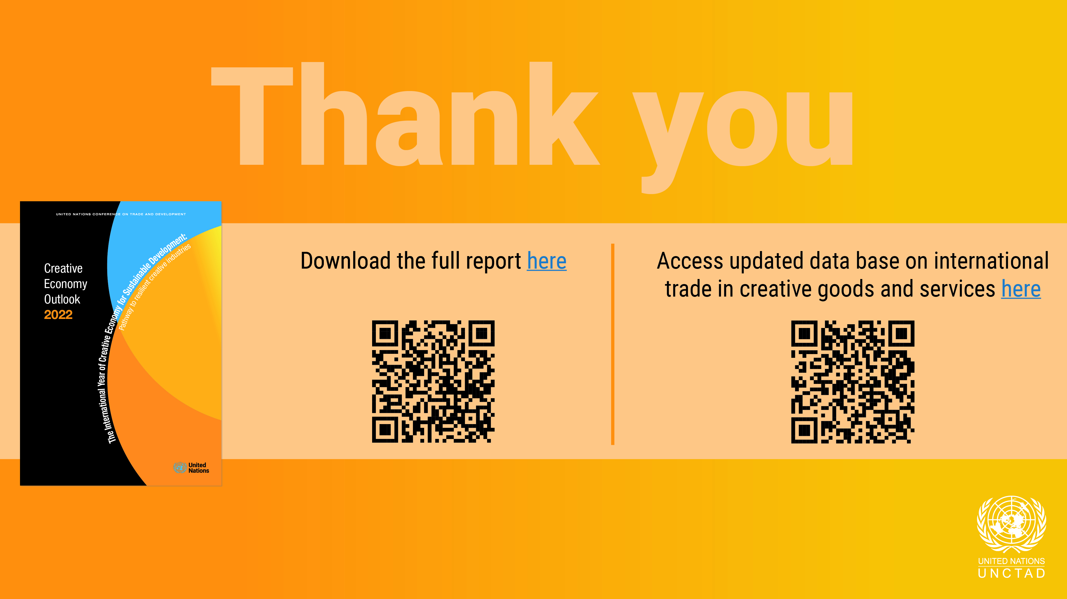
here
here

