Slide 1





Thinking about different modalities for jobs and enterprises in the Creative Industries
#SACOConf2022 CreativeEconomyReset

Slide 2
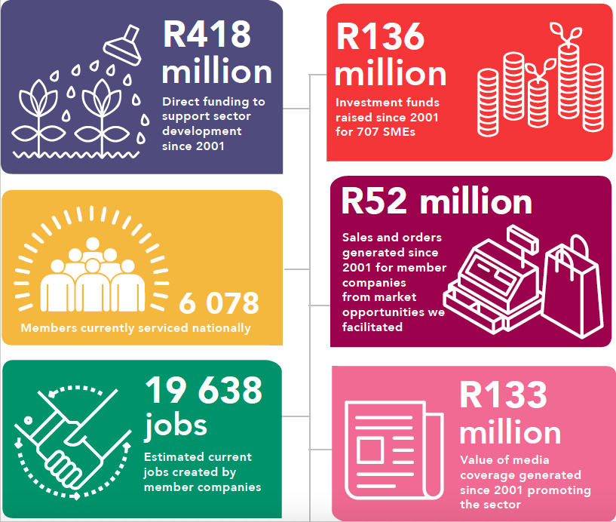
Twenty years of investment
Notes:
So we have been working in this space for 20 years … that is the growing SMMEs space; the informal economy space; the township (under resourced) and marginalised from mainstream space…
I’m not going to talk about that… I’m going to talk about our experience with providing catalytic support to CDI member companies to drive business growth and jobs… and how that necessitates that we think differently about the jobs and enterprises and how we may help them…

Slide 3
The Problem statement
We need to create jobs ... a lot of them and quickly …
To do so, we need to grow the economy …
SMMEs seem to be the preferred solution … these days …
And growing recognition – thanks to Covid – of the extent and scale and importance of the ‘informal and township economies’
Notes:
So we have been working in this space for 20 years … that is the growing SMMEs space; the informal economy space; the township (under resourced) and marginalised from mainstream space…
I’m not going to talk about that… I’m going to talk about our experience with providing catalytic support to CDI member companies to drive business growth and jobs… and how that necessitates that we think differently about the jobs and enterprises and how we may help them…

Slide 4
The Projects
PROJECT | VALUE | TIMEFRAME
JOBSFUND
JF 1 (2) | R14.5 m | 2012-2015
JF 2 (6) | R27 m | 2018-2023
JF 3 (10) | R10 m (plus R5 m MF) | 2022-2024
INNOVATION SUPPORT
Design Innovation Seed Fund - Rounds 1-5 | R20.7m – incl SMME contribution | 2014 to current
Better Living Challenge | R150k | 2014-2015
Re:Solve Innovation Challenge | R200k | 2020-2022
YOUTH EMPLOYMENT
Youth LaunchPad Pilot | R4 m | 2018-2020
Accelerator | R15 m | 2021-2023
Youth LaunchPad NPMIF | R10 m (plus R5 m MF) | 2022-2023
COVID RELIEF
JF Covid Relief | R8.5 m | 2020-2021
DSBD/DSAC Covid Relief | R3 m | 2020-2021
PRESIDENTIAL STIMULUS
NAC PESP 2 | R1.1 m | 2021
IDC / SEF | R1 4m | 2022-2023
 | R136 million
Notes:
For first decade all services non-financial … until I was cajoled into putting in an application to the JF… this has led us on a journey over the last 10 years where financial product offerings have become a big part of our support offering … to the point that we have raised R135m of funding directly for individuals/ideas and SMMes in our sector… and this is the story I’m going to tell today …

Slide 5

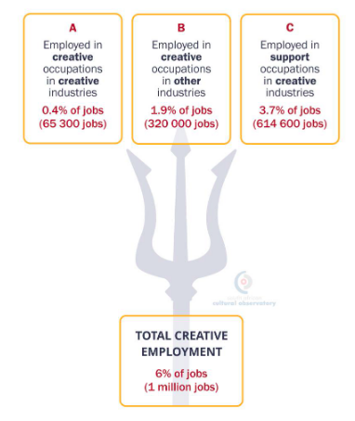
The SACO Employment Trident
South African Cultural Observatory Mapping Study 2021
Notes:
Most of our support instruments and financial institutions focus on the creative…. Most NB… but not the biggest segment… this is where I am going to focus on…

Slide 6
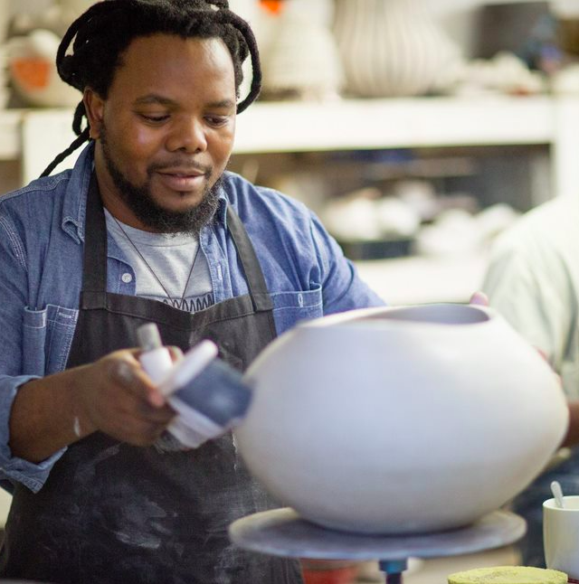
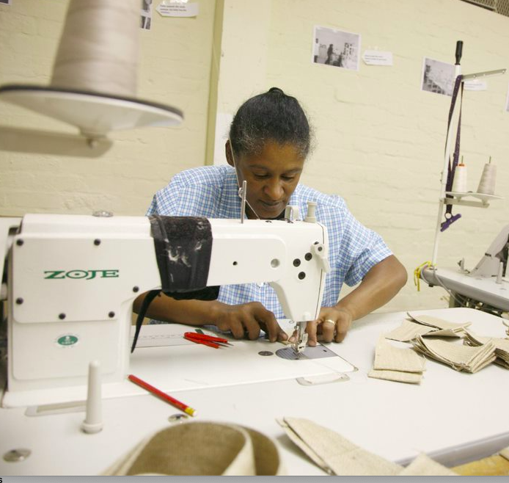
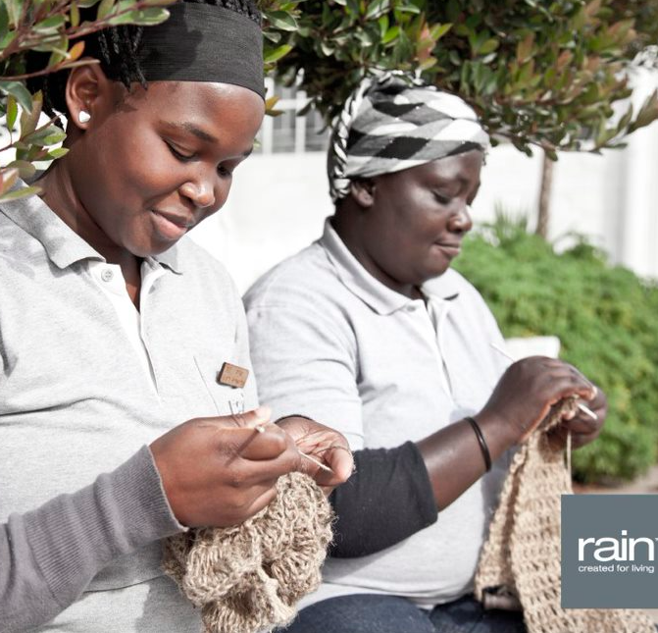
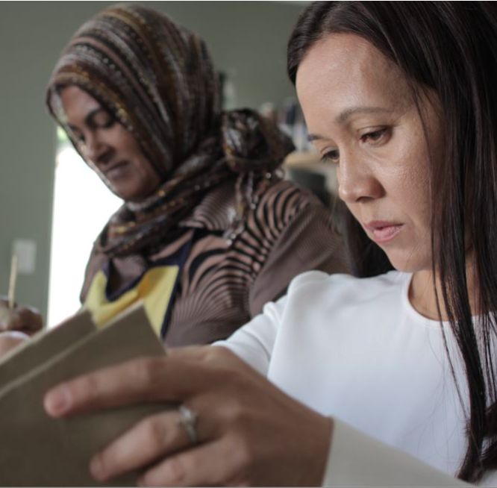



JobsFund 1 + 2 | project design
PURPOSE
To provide catalytic grants, to SMMEs with growth potential, to stimulate sustainable business growth that leads to sustainable new jobs.
TARGET
JF1 > R14.5m to create 450 jobs in 25 SMMEs
JF2 > R32m to create 600 jobs in 60 SMMEs
NATURE OF SUPPORT
Catalytic grant to fund activities that will stimulate business growth
on an 80 : 20 basis
Development of Intervention Plans and Mentoring
APPROVAL PROCESS
Application to Growth Fund Investment Committee (JF2)
Development of Intervention Plan and Contracting
Payment of grant (mostly to 3rd party suppliers) on milestones subject
to 20% contribution from SMME
Monthly/quarterly reporting
Notes:
First 10-12 years all our services and support were non-financial … view is that the need for finance hides a lot of problems which you are often – especially in emerging businesses – best to sort out first … so our First financial product was piloted in 2012
Was very instructive and we learnt a lot…

Slide 7
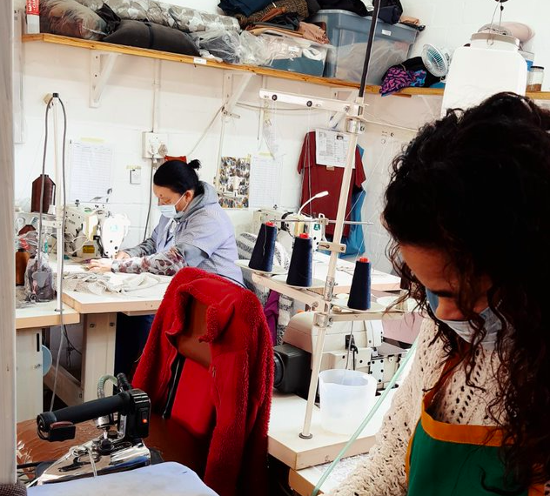
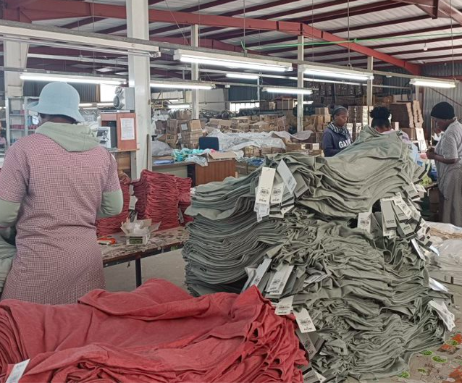
JobsFund 1+2 | project outcomes
TIMEFRAME
JF1 > 3 year project – 2012 to 2015
JF2 > 5 year project – 2019 to 2023 plus 2 years impact reporting
OUTCOMES
JF1 > 45 SMMEs created 457 new jobs
JF2 > 32 SMMEs created 639 new jobs
GRANT SPEND
Grants were spent on a variety of activities including equipment, infrastructure, technical expertise,
marketing.

Slide 8

JobsFund 1 + 2 | project learnings
JF 1 > Overall Project ToC proven to work
80:20 split of grant very important
Intervention plan and payment to 3rd party suppliers on milestones
Working capital requirements of growing enterprises change
and need attention
Mentoring / coaching of business owners essential
JF 2 > Overall Project ToC plus innovations proven to work
R1m turnover criteria made a difference in recruiting
right SMMEs (not necessarily in their systems)
Working Capital fund was valuable; hybrid even better
Mentoring, under specific conditions, very helpful

Slide 9
JobsFund 2 | commercial results
Benchmark of 15% year on year growth - achieved / exceeded 45 times (51%) out of the 86 reports. The benchmark of 10% net profit was achieved/exceed 35 times (32%) against 108 reports.
Growth in turnover – grew by R111m (61%) since start; average turnover per SMME at R13.3m.
Year-on-year growth in context of Covid-19 - the portfolio grew by 15% in 2019; 13% in 2020; declined by 11% in 2021; rebounded with growth of 40% in 2022; 24% growth between 2020 and 2022 implies real growth in the last 18 months and not just recovery to pre-Covid-19 levels.
Gross profit - 41% in 2018 with growth of 23% to R93m and was up at 44%.
GP in context of Covid-19 - In 2020 GP grew by 19% to R111m and represented 47% (up from 44% in the previous year); during 2021 (Covid-19) GP dropped by 11% (same as turnover drop in the same year) but stayed at 47%. GP rebounded by 33% in 2022 to R132m but lost 2% to 45%.
Notes:
Not going to say much except that these businesses actually grew – despite Covid and are profitable – they are able to sustain the new jobs they created.

Slide 10
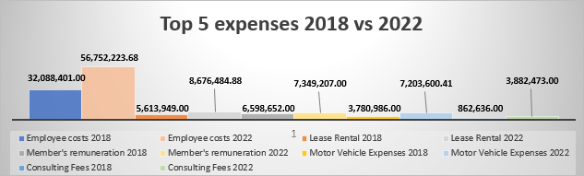
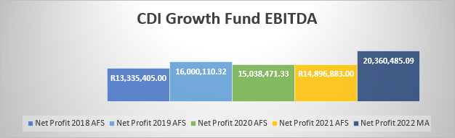
JobsFund 2 | commercial results
Top five business expenses between FYE 2018 and 2022.
Salaries: Started at R32m to R56m up 43%. An expected outcome, given the creation of 524 new jobs in the period
Rent: Started at R5.6m and increased by 35%.
Other costs: Members, directors, owners’ remuneration only increased by 10% to R7.3m; motor vehicle expenses increased by 48% to R3.4m; consulting fees increased by 78% - the greatest margin to 3.9m
Earnings before ITDA
The portfolio grew by 20% in 2019; lost 6% in 2020 and 1% in 2021. Given that turnover growth was down 11% in 2021 this seems to indicate the businesses implemented cost cutting measures and shows business owners will adjust operations to ensure short-term survival and long-term sustainability. Their year-on-year EBITDA bounced back with 37% in 2022.
EBITDA was identified as an important indicator of the sustainability of the business and the permanent jobs created. It would be useful to explore the portfolio’s priorities/ sentiments of job creation verses profit, and whether other factors influence profitability, such as tax.
Notes:
Highest business expense – salaries – as one would expect … NB to note the grant is not for salaries and overheads…

Slide 11
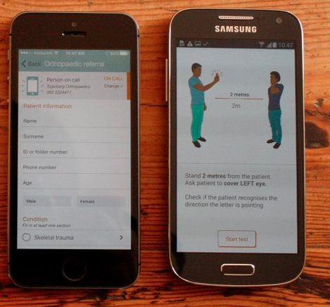
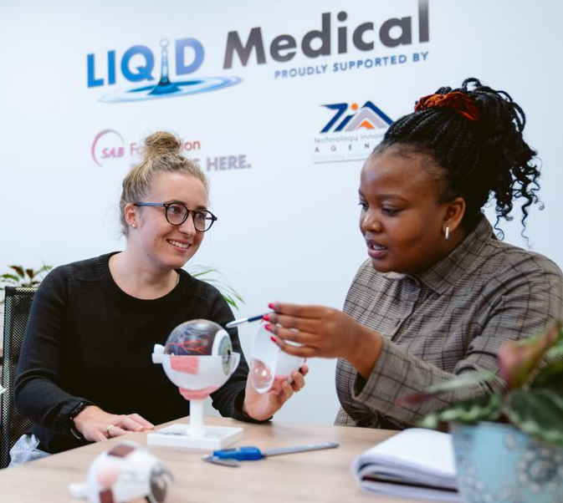
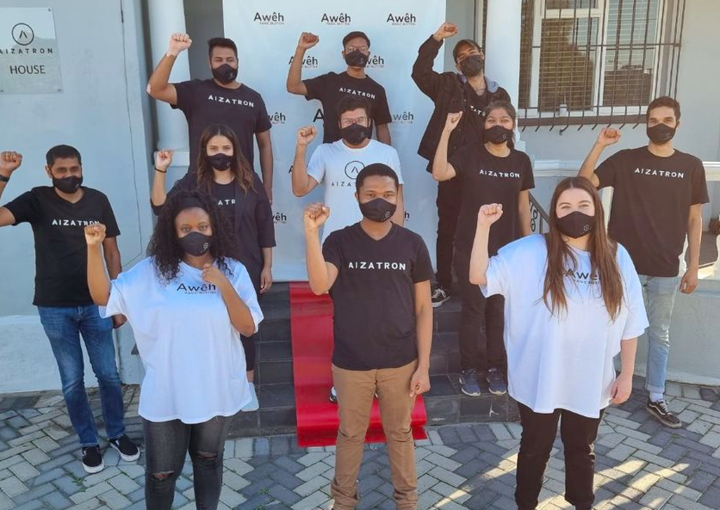
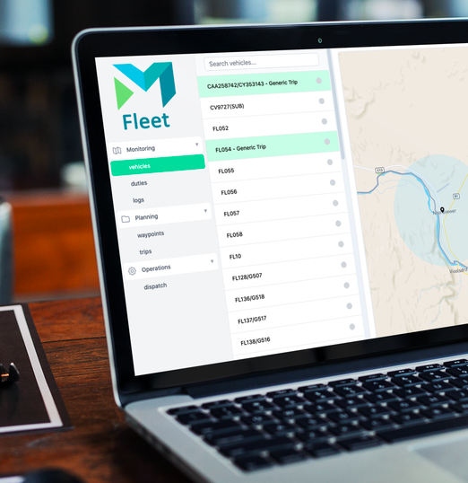



Innovation Fund | project design
PURPOSE
To provide grant funding to designers, inventors, entrepreneurs and product developers with pre-revenue innovative technologies and tech-enabled ideas and products, to help them take the next step towards commercialisation. Targeted at innovations between TRL 3-7.
These individuals/businesses are not able to raise funds easily from traditional banks or funding agencies because of the risks involved.
The grant funding assists recipients to understand their opportunities by designing and building prototypes; and validating their assumptions around the technical and market-related challenges.
NATURE OF SUPPORT
Grants of R500k to R800k to fund activities that support proof of concept to
commericialisation (80:20 basis)
Grant tied to milestone based intervention plan
APPROVAL PROCESS
Application to DISF Investment Committee
Due Diligence conducted
Intervention plan, payment milestones and contracting

Slide 12

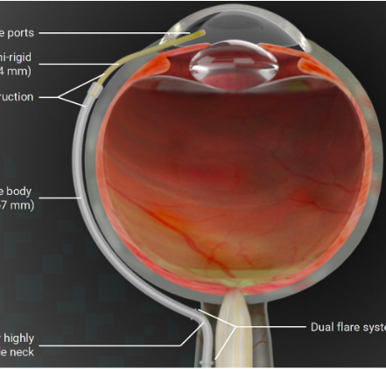
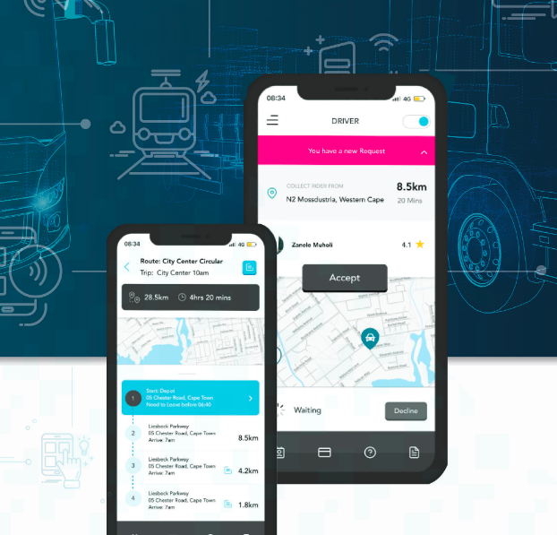
Innovation Fund | project outcomes
TIMEFRAME
Launched in 2014
5 Funding Windows to-date
35 supported to date
R20.7m committed or disbursed
OUTCOMES
Impact assessment out of 12 participants since 2014:
Grant disbursed R20.7m
Average start at TRL 3.5 and end on 7.1
Unlocked R150m in further investment finance
52% successfully commercialised or still active
256 new jobs (162 permanent)
R72m turnover generated (annually)

Slide 13
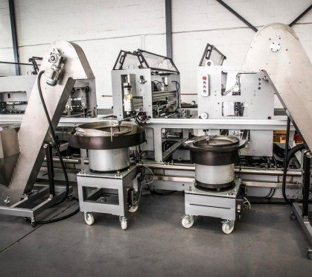
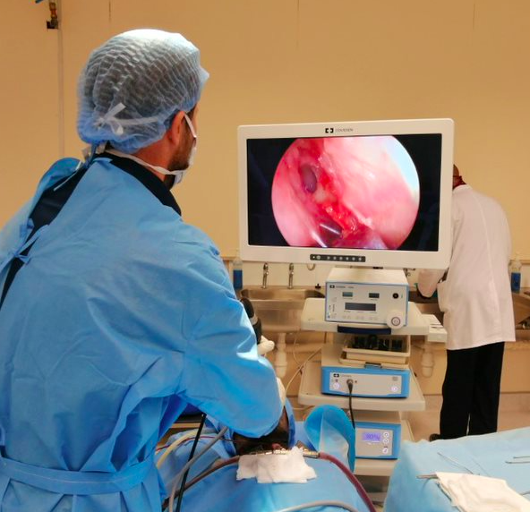
Innovation Fund | project learnings
Discipline of systems
Innovation is high risk and needs space
Backing the right horse and jockey
Skin in the game
There are no shortcuts
It takes a village
Leveraging
Innovation can lead to jobs and growth
Building brand SA and social good

Slide 14
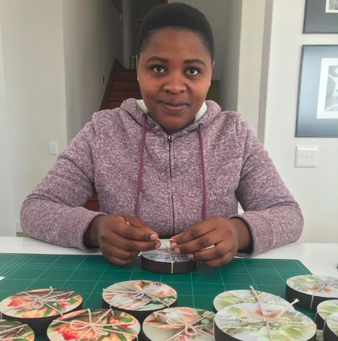



Youth Launch Pad | project design
PURPOSE
To prepare SMMEs who need additional capacity, to create a new job within their business and support them through the initial phases with training and absorb some of the initial risk through workplace subsidies.
TARGET
YL Pilot > 50 youth in 40 businesses over two phases
YL Clothing Accelerator > 200 young women complete internships over three years
YL/NPMIF > 328 youth in 100 enterprises
NATURE OF SUPPORT
HR Training (8 modules)
Subsidised intern / workplacement with co-funding
Business development support
APPROVAL PROCESS
Application followed by light due diligence / site visit and contracting
HR training and other BDS

Slide 15
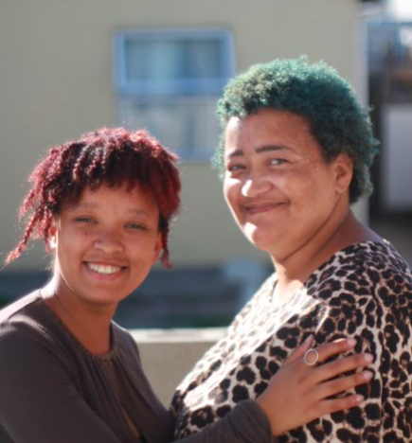
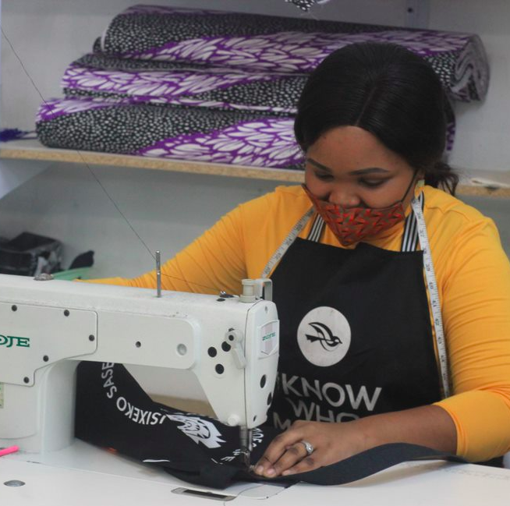
Youth LaunchPad | project outcomes
TIMEFRAME
YL Pilot > May 2018 – May 2020
YL Clothing Accelerator > July 2020 – June 2023
YL/NPMIF > Jan – Dec 2022
OUTCOMES / TARGETS
YL Pilot > 80 youth in 40 SMMEs
Clothing Accelerator > 200 black women in 60 SMMEs
YL/NPMIF > 373 youth in 60 SMMEs

Slide 16
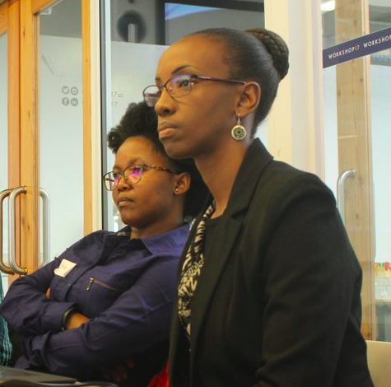
Youth Launchpad | project learnings
Small businesses have a demand for additional capacity but not necessarily the income to support additional staff
Small businesses can provide quality youth work-placement opportunities
Financial and HR support are important catalytic inputs
Sustainable business development: Keep the person / Keep the job
Youth can learn more in an small business environment
Youth can identify career paths through the experience
The programme can help businesses recover in a COVID economy
This model is scalable and transferrable to SMMEs in other sectors.

Slide 17
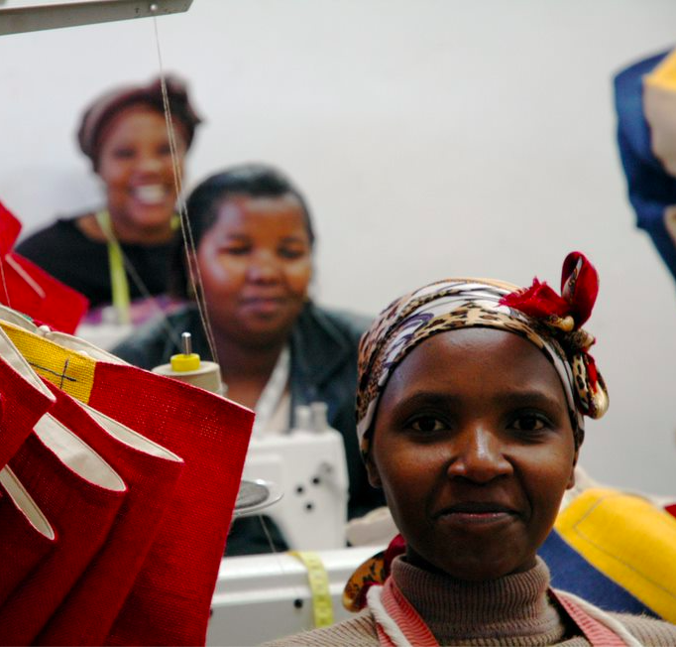

JF Covid Relief | project design
PURPOSE
To save jobs and firms (already invested in), during Covid-19
TARGET
R8.5m fund disbursed over 6 months
To support 20 firms to save 550 low-income job
NATURE OF SUPPORT
Hybrid grant (30%) and soft loan
(70% no interest; 1yr holiday; 24 months to repay)
Non-financial support (over 6 month period)
  22 hours of business turnaround / business
  growth commercial expertise
  R1m Technical Service Fund
APPROVAL PROCESS
Application to the CDI GF Investment Committee.
A rolling application window with weekly IC meetings
Disbursements on a monthly basis on retrospective reporting.
IC met quarterly to review performance

Slide 18
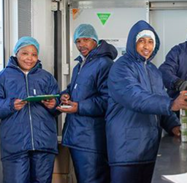
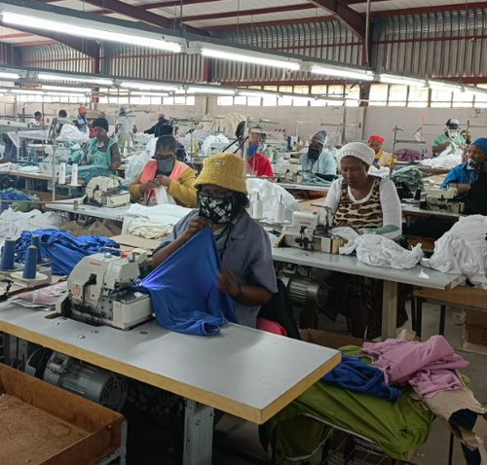
JF Covid Relief | project outcomes
TIMEFRAME
Application opened mid-June 2020 (to participants in CDI Growth
Fund project)
1st GFIC meeting 17 July; weekly, until 14 SMMEs approved
Parallel to this fund disbursements began on 28 August 2020
GFIC approved 14 applications (568 jobs) for hybrid product.
Plus 9 for technical service grants only.
By 31 March 2021, R8,362,000 + R1m technical service grants disbursed.
OUTCOMES
23 SMMEs
Retained 903 jobs (target of 550)
866 (96%) were low-income employees <R29k
423 (47%) were youth <35 yrs

Slide 19
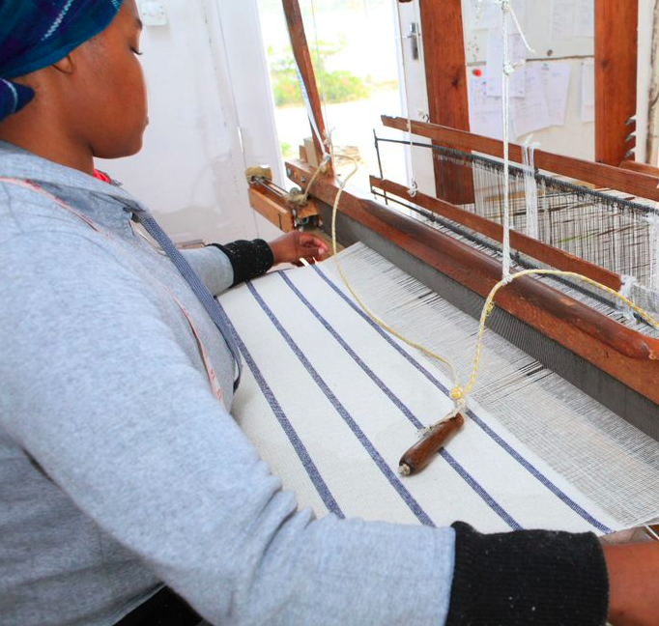
JF Covid Relief | they say
The whole team (23 staff members) here at Barrydale Hand Weavers are so grateful for the CDI Covid Funding we have received since August 2020.
It has enabled us to work efficiently through an exceptionally tough time. Personally, and as an owner / manager, it relieved so much stress from my life and weight from my shoulders.
Prior to the funding I had to scrutinise our cash flow every day to ensure we
could get through each week. However, with the funding in place everything
changed as I had a guaranteed minimum income each month to pay our
monthly costs such as rent, water, electricity, couriers, etc.
This gave me time to focus on marketing and sales, allowing me to launch our
ecommerce site and develop bespoke ranges for key customers.
In turn this funding has allowed our business to not just survive but grow through the pandemic.
Our turnover has increased 35% since last year, despite the harsh lockdown through April, May & June. This enabled us to increase wages in October and create 5 new jobs in 2020. We are looking forward now to 2021 which has started very positively. We anticipate further growth in revenue and expect to create 3-5 additional jobs this year.
We cannot thank the CDI and its partners and supporters enough, it has been so positive for our business, thank you.”
Arron Bastable, owner of Barrydale Hand Weavers,

Slide 20
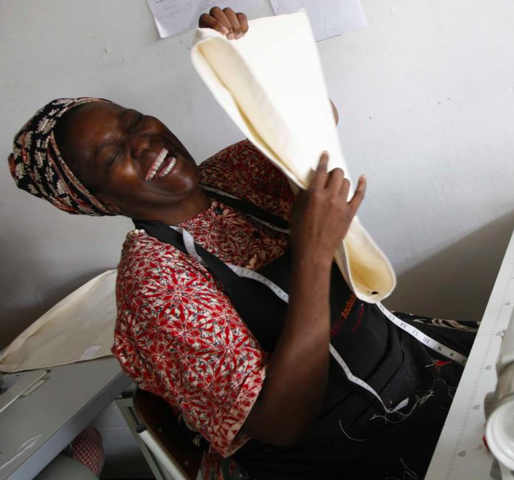


DSBD/DSAC Covid Relief | project design
PURPOSE
Financial support to individual creative practitioners and
businesses in Visual Art, Craft, Design and Audio Visual
domains, to help manage the impact of Covid-19
TARGET
R2.7m disbursed over 3 months (x 9 provinces)
As many as possible given limited budgeted
NATURE OF SUPPORT
R15,000 to individuals and R30,000 to businesses
APPROVAL PROCESS
Application through CDI to an independent committee
(multi-domain reps plus a CCT arts + culture official)
Valid TCC + other docs (CIPC, Portfolio, Motivation for funds)

Slide 21



DSBD/DSAC Covid Relief | project outcomes
TIMEFRAME
Nov 2020 kick-off with payments to be made Dec/Jan
OUTCOMES
76 Individuals supported (R7,500 – R15,000)
105 Companies supported (R15,000 – R30,000)
Payments continued into February 2021
80% reporting rate from beneficiaries
GRANT SPEND
Grants were spent on a wide variety of things including
personal items such as rent, debt repayment, food,
medical aid and business items such as rent,
software, materials etc.

Slide 22

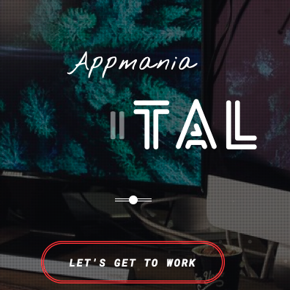
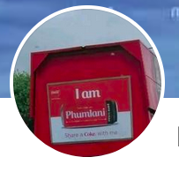
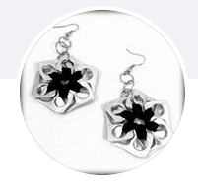
DSBD/DSAC Covid Relief | they say
Through the funding of program and by public demand we extending it for 8 months. It helped create work for the actors and crew. Theo Davids, Bridgetown Theatre Company
This grant has assisted us in ensuring there is enough cashflow in the business to continue paying office rental for a period of 2 months. We managed to cover other business expenses such as the office internet for a period of 3 months. Other funds were used to pay for design tools such as Adobe and Beautiful. We are extremely grateful to have received this grant payment and it has truly been beneficial to our business. Thokozani Zuma, Appmania
Enkosi, dankie & thank you, for your generosity. Your financial support have a tremendous impact on this NU HOME ENTERTAINMENT and continue to allow us to share our culture, history, successes and experiences as a community with other nations residing in our city and the country as a whole. This would go a great way in creating a lasting legacy for the Arts and Culture industry as a whole, including for your organization as well. Phumlani Vokovi, Nu Homes Entertainment
Cool Tabs Accessories is grateful for the support given, we understand that it’s trying times for everyone and that government is doing their best to support us. CDI did an amazing job by making sure we got the funding as promised. My wish will be for government to always let CDI deals with these kind of funding as they know us and I believe they know our needs. My stressing was, I couldn’t be at the Watershed everyday myself, had to be in the Eastern Cape with family due to covid related issues. I paid salaries for 2 assistants working at the Watershed from December 2020 till February 2021. The rental for the Watershed stand is been coming from the funds. Aretha Doyle, CoolTabs Accessories

Slide 23
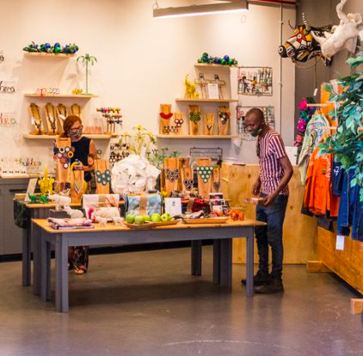


PESP 2 | project design
PURPOSE
To support craft/design SMMEs with technical expertise from other skilled creative
professionals, in turn creating work opportunities for them and stimulating
economic recovery of the individuals and enterprises and the sector.
TARGET
102 work opportunities – 6 month timeframe
NATURE OF SUPPORT
Financial Assistance Fund (fixed rate per opportunity) to buy additional
support / expertise for the SMME.
APPROVAL PROCESS
Application from SMMEs in the need of support to stimulate their recovery.
Focus on 160 SMMEs participating in strategic projects with the systems and capacity to identify, source and manage short-term work opportunities that will add value to all parties. Necessary given short timeframes.

Slide 24
PESP 2 | project outcomes
TIMEFRAME
January 2021 – March 2021
OUTCOMES
CDI + 46 SMMEs hosted work opportunities
112 work opportunities created
Work opportunities supported
  Graphic designers, product photographers, web developers who supported the marketing and innovation in digitisation and ecommerce efforts of some of the businesses;
  financial, business and marketing advisers supported the enhancement of the financial, sales & marketing systems of creative SMMEs;
  product designers or consultants who helped the small businesses explore new ways of developing, promoting, selling, and creating products.
  The CDI itself hosted work opportunities within our various programmes (product, market, business, design, communications and administration) that will enabled the CDI to better support and service its members – in turn for their recovery

Slide 25
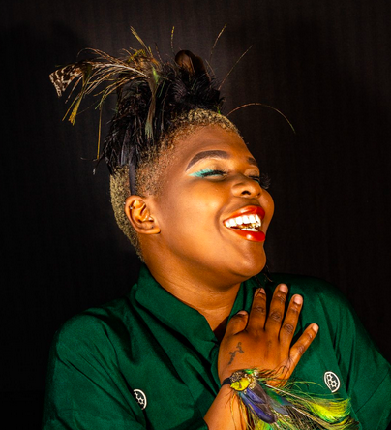

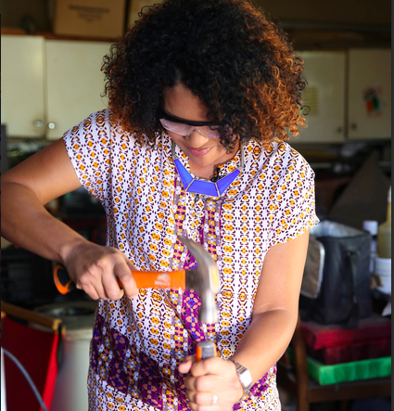
PESP 2 | they say
Jennifer Carbutt, Studio Kasuga
Firstly, my appreciation to the NAC Stimulus Fund for awarding me this grant, and to the CDI for facilitating. It is with gratitude that I write this first report….
Through an Instagram contact, Iselwa Designs, I met with Sivuyile Kilani, of Blackchild Photography, and he agreed to be the photographer for this project.
My website is up and running since early April (2021), so I am posting on Facebook and Instagram very regularly, so I need a good supply of images for these posts, as well as photos for the website as products change.
Ashley Heather, AuTerra Jewellery
This grant has positively impacted both my company, AuTerra Jewellery, as well as Peanut Butter Visuals, in these challenging times for small businesses and we thank the CDI and NAC for making this initiative available to us.
Lizl Naude, Lilly Loompa
The grant couldn't have come at a better time. The last year has been exceptionally hard and we tried our best to stay afloat. The business suffered many losses, but we remained and still remain optimistic.
With this grant money I have employed a marketing agency to market our services to the broader South Africa. Our on-line campaign has been seen by over 31 000 people in our target audience and about 40 people have contacted me and of those we have converted 3 to sales.
Marketing is an important aspect that any business should prioritise, and for the first time, I have had a dedicated budget to market my services to a broader audience. This has also allowed me to build up a database of new clients to target in the future.

Slide 26
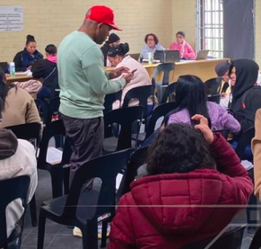


SEF | project design
PURPOSE
Provides income opportunities for creative practitioners in under
resourced communities while supporting them to play a role in
community building through cultural mapping, art-making, art-showcasing.
[The Presidential Employment Stimulus seeks to use direct public
investment to support employment opportunities, counteracting job
losses due to Covid-19, and creating an opportunity for growth and renewal.]
TARGET
1080 work opportunities for unemployed creative practitioners over 12 months
NATURE OF SUPPORT
2 paid work days/week over 6 months (fixed rate/minimum wage as prescribed)
Training in cultural mapping methodologies including use of an online App
Support to create new work
Showcasing of new works
APPROVAL PROCESS
Application via arts-based community organisations in 6 areas.
NEW

Slide 27
Work in Progress
JF3 (10) | project design
NEW
PURPOSE
Provides income opportunities for creative practitioners in under resourced communities while supporting them to play a role in community building through cultural mapping, art-making, art-showcasing.
[The Presidential Employment Stimulus seeks to use direct public investment to support employment opportunities, counteracting job losses due to Covid-19, and creating an opportunity for growth and renewal.]
TARGET
1080 work opportunities for unemployed creative practitioners over 12 months
NATURE OF SUPPORT
2 paid work days/week over 6 months (fixed rate/minimum wage as prescribed)
Training in cultural mapping methodologies including use of an online App
Support to create new work
Showcasing of new works
APPROVAL PROCESS
Application via arts-based community organisations in 6 areas.

Slide 28
Key Lessons
Importance of the business owner (the jockey) and the business (the horse)
Importance of a good recruitment process (criteria, process, agency)
The value of ‘skin in the game’
Services to support the business manage the impact of the intervention
(working capital, HR advice)
Crowdsourcing other support, partners, incentives
Its not just about the money; but the money is an important catalyst
Mentorship vs coaching (needs at different business stages)
Its all about the market (and the product/service)
Project admin and the role of the intermediary to ‘protect’ businesses from most of the pain
External factors (economy, covid-19, July unrest, load shedding, war in Ukraine etc)
High quality SMME for sustainable job creation: human capital, growth ambition, Innovativeness, (opportunity vs necessity), and market orientation
Creating jobs in SMMEs through ESD: takes time, capacity-building for smallest firms, support customised, unique constraints faced by women, robust monitoring and evaluation system, target groups and the main barriers, and private sector in delivery

Slide 29
Funds spent on
Growth Fund DISF​ | Growth Fund | DISF
Advertising, marketing & communication​ | 1%​ | 4%​
Building & other fixed structures​ | 5%​ | 2%​
Equipment & Machinery​ | 10%​ | 57%​
Material​ | 6%​ | 12%​
Market research and testing​ | 8%​ | 1%​
Professional Services​ | 57%​ | 2%​
Software and other intangible assets​ | 7%​ | 7%​
Samples​ | 2%​ | -
Training​ | 0%​ | 1%​
Transport​ | 0%​ | 13%​
Salaries for key personnel ​ | 1%​ | 1%​
Production Process Efficiency ​ | 1%​ | 1%​

Slide 30

Kinds of jobs and services (PESP2)

Slide 31


Funders and partners

Slide 32
Key Takeouts
KEEP THE CREATIVE AT THE CENTRE
but think about what they need to support their creative and ‘business’ journey
WHOLE ‘ORGANISATION’ / ‘FIRM’ APPROACH
in the context of a supply- and demand- value chain
INFORMALITY / FORMALITY as a continuum
  the nature of work opportunities
  the nature of firms
JOB RETENTION AND NEW JOB CREATION
growth not necessary always in size but depth is also important
KEY THEORY OF CHANGE:
  Strengthen the business and the business is in a better position to
  create jobs
  Business functions in an eco-system of service providers
  (who are also creative firms – the interconnectedness of the creative industry domains)
  Strengthen the eco-system to strengthen the business

Slide 33
THANK
YOU

