Slide 1
Cultural information systems as strengthening tools for cultural and creative industries (CCI).
The SICSUR case as a resource for regional integration in South América.
Karina Scherer
Co-director of the Master in Cultural Management, University of Buenos Aires.
Daniela Yamashita Unzain
Anthropologist and Master in Environmental and Territorial Policies.
Notes:
This presentation is about the:
Cultural information systems as strengthening tools for cultural and creative industries (CCI).
In particular, we will present the SICSUR case as a resource for regional integration in South América. And the strategies of production of cultural information in the context of COVID-19
And how this emergency context evidenced the relevance of cultural information generation and post-pandemic challenges.
Excuse me, I will use a paper support to presentation OD1oxYOc/edit?usp=sharing

Slide 2
Cultural Information Systems
SICSUR, Cultural Information System of the South
Strategies for the production of cultural information in the context of COVID-19
Some thoughts and challenges
Notes:
This presentation is about the:
Cultural information systems as strengthening tools for cultural and creative industries (CCI).
In particular, we will present the SICSUR case as a resource for regional integration in South América. And the strategies of production of cultural information in the context of COVID-19 (covid nineteen)
And how this emergency context evidenced the relevance of cultural information generation and post-pandemic challenges.
Excuse me, I will use a paper support to presentation

Slide 3
Cultural Information Systems
In the last few decades, cultural information systems have established themselves as tools for generating information about cultural and creative areas, useful for the design, development and evaluation of cultural policies.
An information system is a set of diverse, related and ordered information that contributes to the knowledge of a certain object. This type of approach makes it possible to construct an object of analysis from the multiplicity of available information.
Notes:
Before we begin, what are cultural information systems?
An information system is a set of diverse, related and ordered information that contributes to the knowledge of a certain object. This type of approach makes it possible to construct an object of analysis from the multiplicity of available information.
In the last few decades, cultural information systems have established themselves as tools for generating information about cultural and creative areas, useful for the design, development and evaluation of cultural policies based on evidence.

Slide 4

Cultural Information Systems
SInCA (Argentina's Cultural Information System)
Cultural Information System of Argentina is a program from the Ministry of Culture, that produces, systematizes and publishes information related to the cultural activity from 2006.
It’s both a public policy’s tool and a public information instrument.
Based on three main projects: Cultural Satellite Account, Cultural Consumption Survey, and Mapping Cultural Environment.
sinca.gob.ar
Notes:
We are researchers of the cultural information system of Argentina -SINCA. Cultural Information System of Argentina is a program from the Ministry of Culture, that produces, systematizes and publishes information related to the cultural activity from 2006.
It’s both a public policy’s tool and a public information instrument.
Based on three main projects:

Slide 5
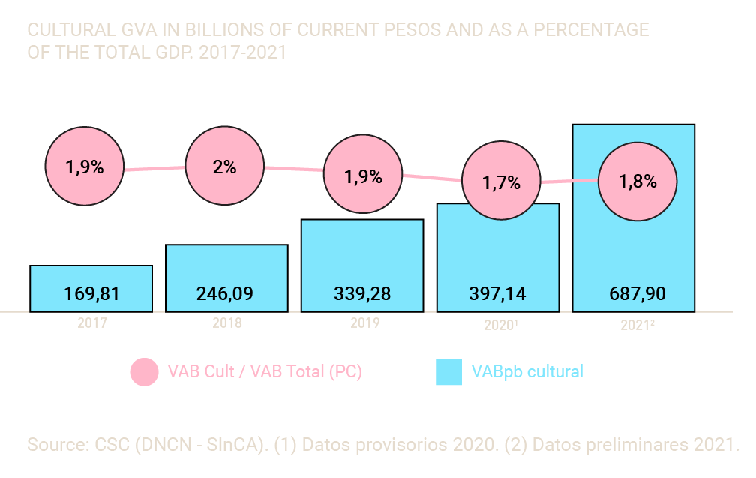
Cultural Information Systems
Cultural Satellite Account (CSA)
It generates economic indicators of the contribution of culture to the economy.
Notes:
Mencionar en qué se basa la información que general slide 14,
Systematizes statistical information for the estimation of economic indicators to analyze several economic dimensions of culture.
Cultural Satellite Account (CSA). That generates economic indicators of the contribution of culture to the economy. And creates information like Cultural GVA (gross value added) and the percentage of the total GDP; employment in cultural activities; foreing trade in cultural products and services, government spending and non-monetary information.

Slide 6
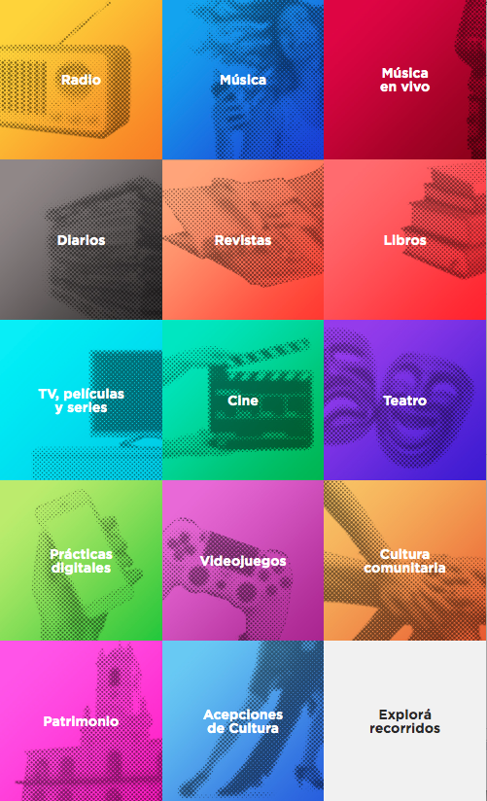
Cultural Information Systems
National Cultural Consumption Survey
Main instrument to know about consumption, opinions and cultural practice.
Provides deep knowledge about new cultural habits and consumption in the country.
Personal home interviews
117 questions
2800 cases
12+ years
Probabilistic, multistage
Stratified simple
National & Regional
Notes:
Another project is the National Cultural Consumption Survey. Measure the scope of the main cultural consumptions and digital practices at the federal level. Is done every four years, actually the third edition is underway.

Slide 7
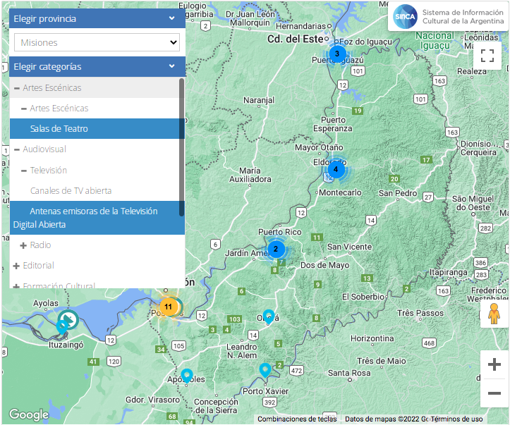
Cultural Information Systems
Cultural Map
Provides a geographic description of the cultural institutions, actors and practices across the country, displaying data in a dynamic and interactive interface.
Information comes from different sources - both public and private- institutions and collaborative work from users.
Notes:
Provides a geographic description of the set of cultural institutions, actors and practices in the country, displaying data in a dynamic and interactive fashion.
Information comes from different sources as public and private organisms and collaborative work from users.
We did not stop at each one because it is not the main topic, but we just wanted to mention the projects from which culture is approached. Each one presents data and information about the culture from different methodologies.

Slide 8
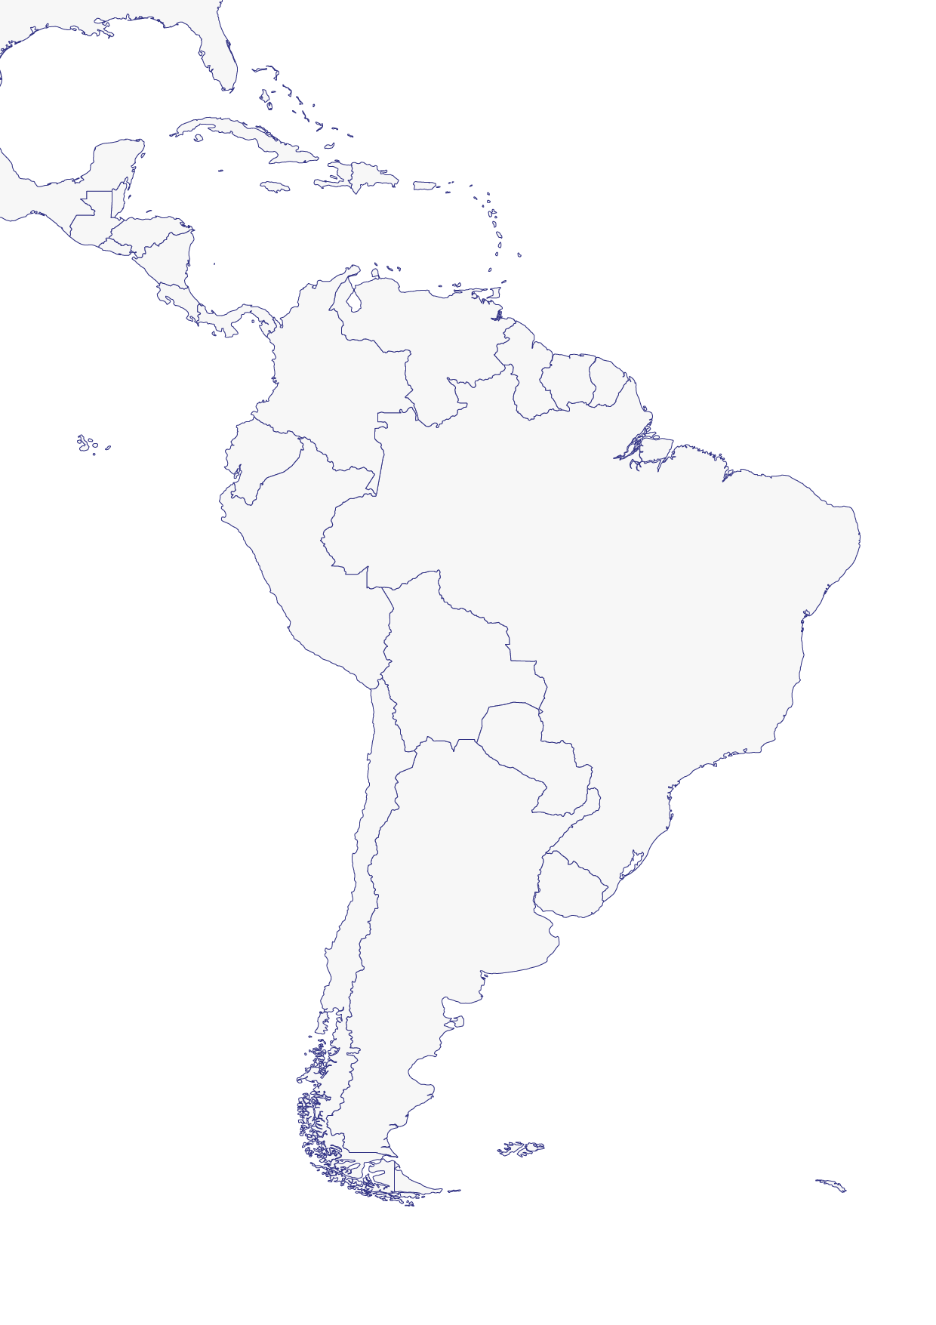
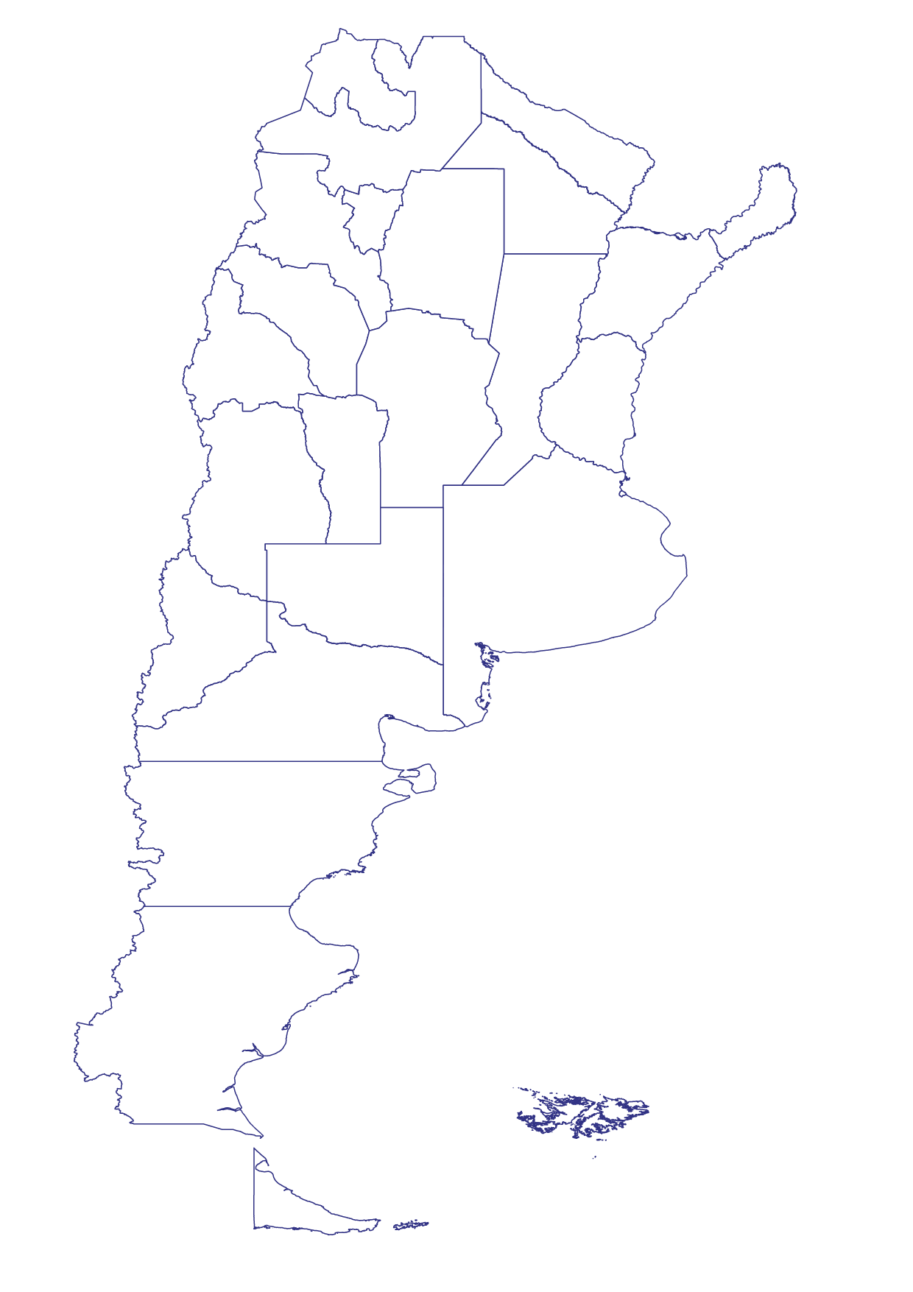
Cultural Information Systems
Red de Enlaces Federales
Internal networks
SICSUR
Cultural Information System of the South
Cross-country networking
Notes:
Argentina´s territory is divided in provinces (24 administrations). the SInCA works on building networks between all these provinces for the production of cultural information.
SINCA promotes and is part of two networks for the generation of cultural statistics. One is within the country called "Provincial Links Network" and the other is a link with the region called "SICSUR" which is the case we are going to be presenting now:

Slide 9

SICSUR, Cultural Information System of the South
Regional cultural information system composed of 10 countries. It was created in 2009.
Main purpose of SICSUR is to produce cultural information and indicators that contributes to the development of cultural public policies in the region and to reverse a historical shortcoming of cultural institutions and management in the region of lack of valid data on the cultural field.
After more than 12 years, all the countries have their own project, with different complexities and developments, but which allow for effective comparability among them.
SICSUR is part of MERCOSUR Cultural, that addresses cultural issues of the Southern Common Market (MERCOSUR for its Spanish initials) and is integrated by Culture Ministers of member and associated states.
SICSUR
Notes:
Que es el SICSUR?
SICSUR is a regional cultural information system composed of 10 countries that was created in 2009.
Main purpose of SICSUR is to produce cultural information and indicators that contribute to the development of cultural public policies in the region and to reverse a historical shortcoming of cultural institutions and management in the region of lack of valid data on the cultural field.
After more than 12 years, all the countries have their own project, with different complexities and developments, but which allow for effective comparability among them.

Slide 10
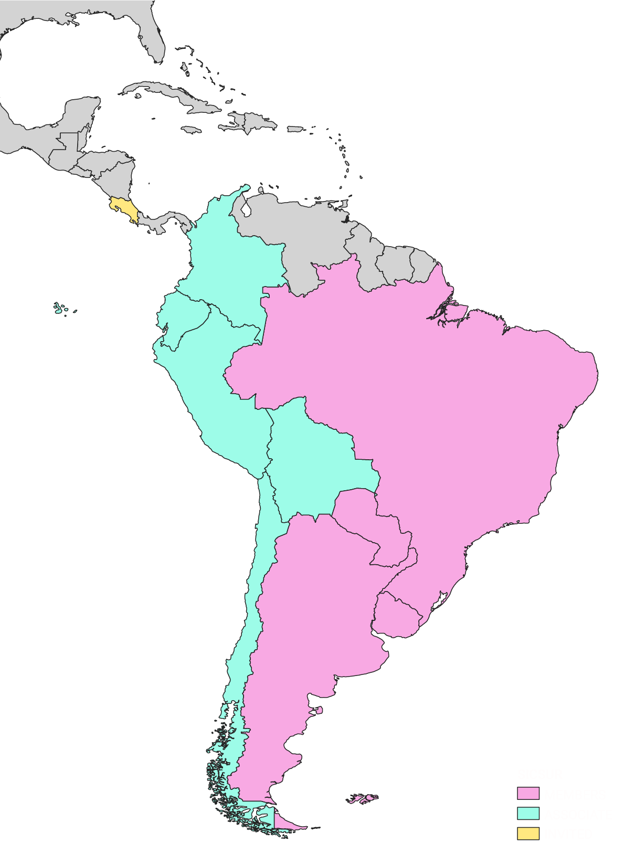
SICSUR, Cultural Information System of the South
Current Countries
Member countries
Argentina
Brasil
Paraguay
Uruguay
Associate countries
Bolivia
Chile
Colombia
Ecuador
Perú
Invited Country
Costa Rica
It is organized in temporary presidencies of 6 months, which alternate between the member countries.
Notes:
The forum includes the following countries // which countries participate in the forum
It is a forum composed of 10 countries.The type of participation corresponds to the Mercosur organization.
It is organized in temporary presidencies of 6 months duration, that alternate among member countries.

Slide 11
SICSUR, Cultural Information System of the South
Work areas
Cultural and creative industries indicators
Methodological
contributions
Cultural map
Special projects
Notes:
Sicsur is organized in the following work areas:
The working areas of SICSUR are: Cultural and creative industries indicators, Cultural Map and Special projects organized by permanent working groups that meet virtually every two months. A general work agenda is established and led by the temporary presidencies.
In each working group, the aim is to seek the sharing of methodologies, construction of common methodologies, production of cultural information on the region, and development of technical capabilities.

Slide 12


SICSUR, Cultural Information System of the South
Cultural and creative industries indicators
Publishing Industry.
Access to data through the ISBN registry of each country.
Main indicators:
Books titles registered at the ISBN agency.
Books titles registered at the ISBN agency per 10.000 inhabitans.
Books titles registered at the ISBN agency by type of format (printed, digital).
Printed copies for titles registered at the ISBN agency with paper support.
Film Industry.
Access to data through the local films institutes.
Main indicators:
Film viewers.
Film viewers of domestic production.
Movie theatres.
Movie screens.
Films released.
National films released.
Main challenges in constructing datasets and indicators at the regional level:
Sector formalization and access to the data
Statistical harmonization
It is necessary to work on methodological references
Notes:
For example, Cultural and creative industries indicators working area, allows us to build regional information about the different sectors of the cultural and creative industries. We are currently working on indicators for the publishing and film industry. The main challenges in constructing datasets and indicators as a regional level is the access to the data and the statistical harmonization in this sense it is necessary to work on methodological references. In this case, both sectors are formalized sectors with access to the data through ISBN registry and film public institutes.

Slide 13
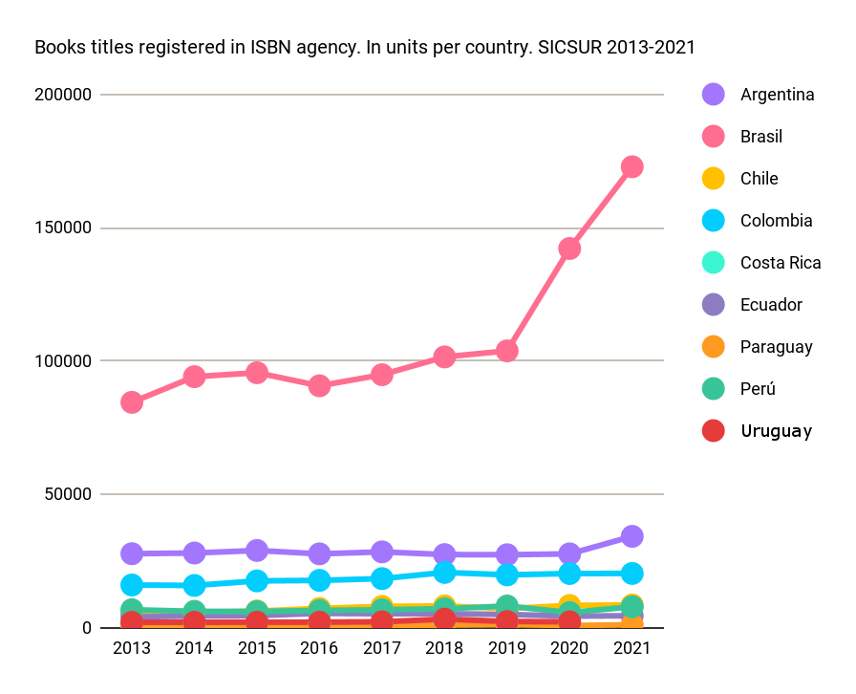
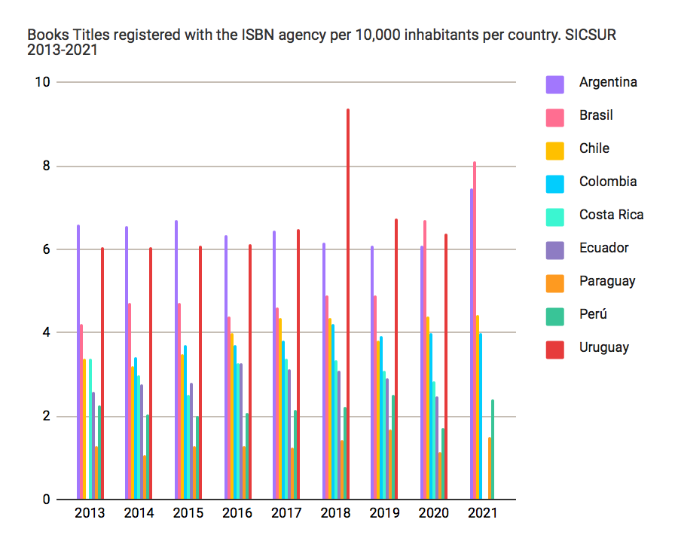
SICSUR, Cultural Information System of the South
Cultural and creative industries indicators. Publishing industry
Books titles registered in ISBN agency. In units per country. SICSUR 2013-2021
Notes:
Some examples of publishing sector indicators is Books titles registered in ISBN agencies per country allows us to make an approach to biblio diversity in the region, total and per population.

Slide 14
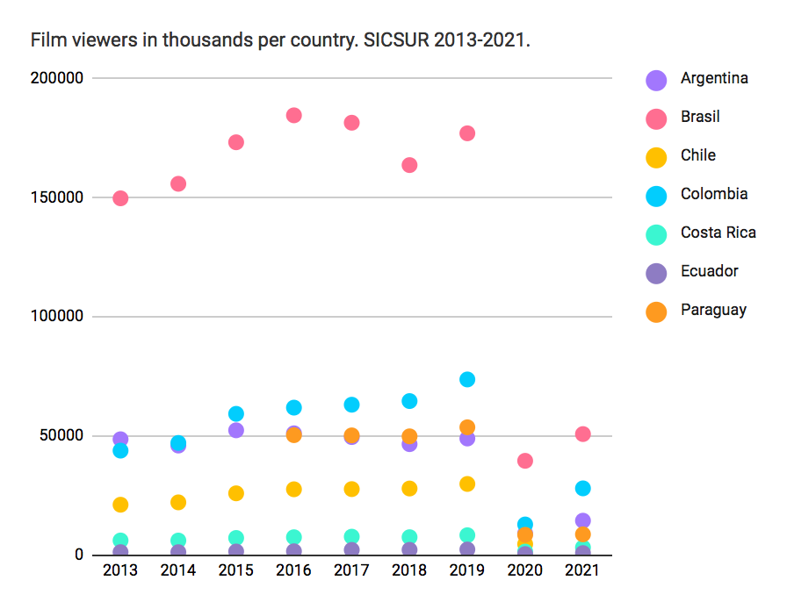
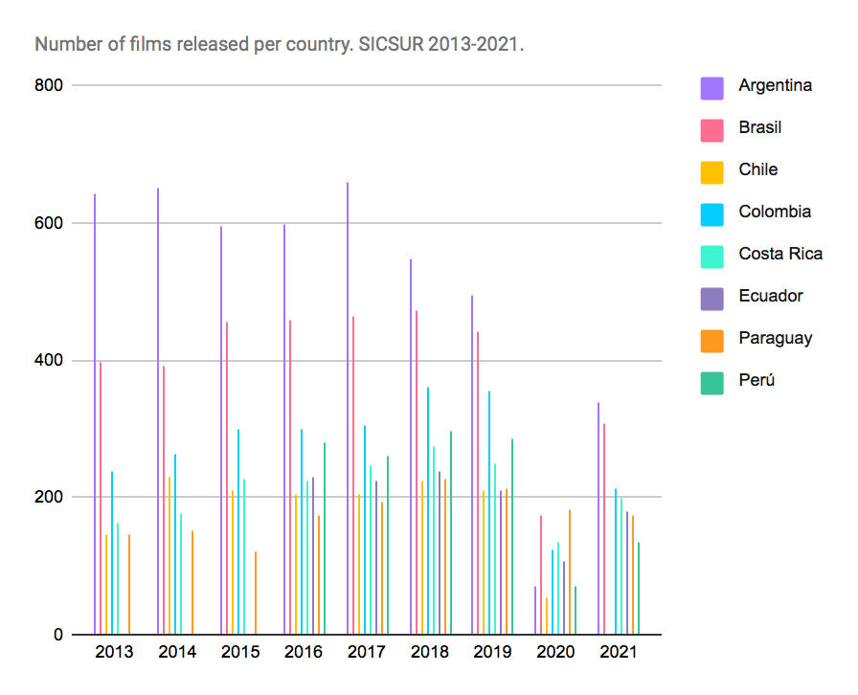
SICSUR, Cultural Information System of the South
Cultural and creative industries indicators. Film industry
Notes:
Here we can see some examples of film industry datasets built at a regional level like Number of Film viewers and Number of films released. These examples from the film industry allow us to see the drop in economic activity in the context of the pandemic (both in production and demand).

Slide 15
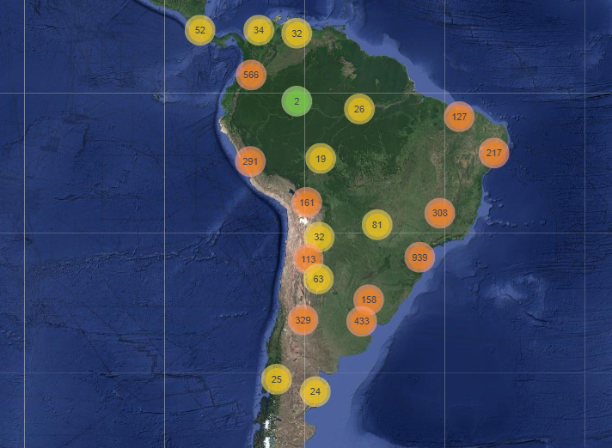
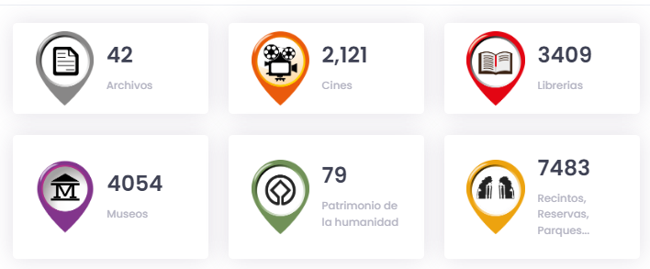
SICSUR, Cultural Information System of the South
Cultural map
The map is an interactive cartographic tool that geo-references cultural spaces at the regional level.
It brings together data related to the cultural sector and socio-demographic data -analphabetism or population density- and shows how the cultural spaces are distributed in the region.
Methodological Manual
Notes:
Cultura Map – YAMA
I will talk about cultural map
The map is an interactive cartographic tool that geo-references cultural spaces at the regional level.
It brings together data related to the cultural sector and socio-demographic data (analphabetism
or population density) and shows us how the cultural spaces are distributed in the region.
The map shows the following cultural points: libraries, museums, movie theaters, archives, UNESCO World Heritage Sites, reserves, parks and archaeological sites.
All Information is updated to 2020.
The new viewer allows select categories, apply subcategory filters, create filters by country and up to two administrative sub-levels.
New navigation tools were incorporated (center map, geolocation, measure distance, zoom in and zoom out). All this development was done with free software (open source): the Linux operating system, the Geoserver map server and the Leaflet API.
In addition, the map has a methodological manual that contains the definitions of the categories
represented on the map. The definitions were agreed upon by consensus among countries
http://www.mercosurcultural.com/index.php/2015-09-30-12-49-44/205-mapa-del-mercosur-cultural-nuevo-visor

Slide 16
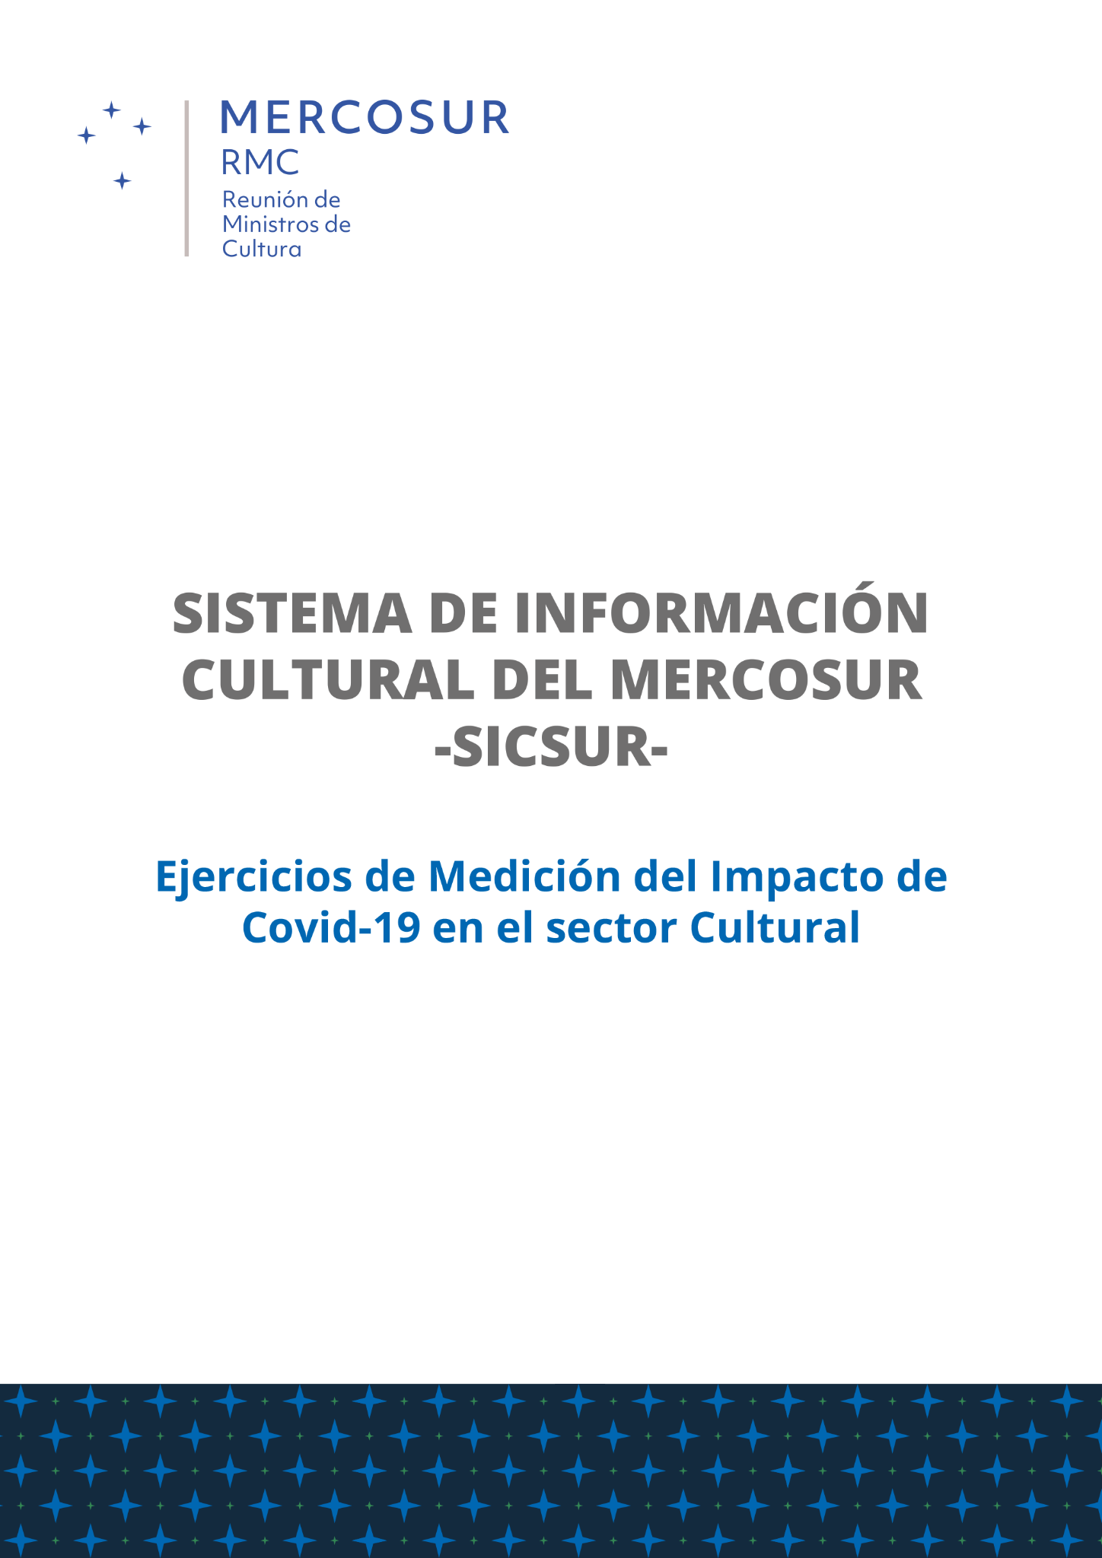
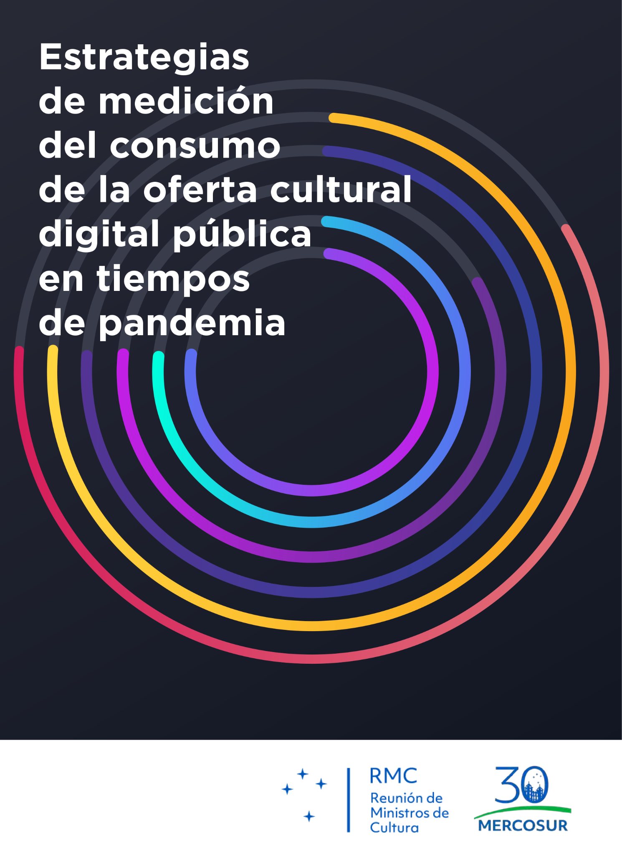
SICSUR, Cultural Information System of the South
Special projects
The COVID-19 pandemic has had dramatic effects on cultural and creative industries (CCIs).
MERCOSUR and Latin American countries, traditionally linked to self-employed workers with little economic and social protection.
At the same time, these sectors are experiencing an accelerated digitalization of their goods and services and the introduction of new business models.
Covid-19 Impact Measurement Exercises in the Cultural Sector (2020)
Strategies of measuring
Consumption of the digital public cultural offer in times of pandemic (2021)
Notes:
The Covid-19 pandemic had dramatic effects on cultural and creative industries, production and employment. In this sense, the information systems collaborated in the generation of information for state measures to mitigate the economic impact of the pandemic.
In this context SICSUR's special projects work area have focused in the last two years on systematizing regional information in the context of the pandemic.
Two exercises were carried out:
-Covid-19 Impact Measurement Exercises in the Cultural Sector in 2020
-Strategies of measuring Consumption of the digital public cultural offer in times of pandemic in 2021
The articulation work that has been carried out for several years within sicsur has made it possible to generate documents that systematize the experiences of each country at this juncture.

Slide 17
SICSUR, Cultural Information System of the South
Impact Measurement Exercises of Covid-19 in the Cultural Sector
Surveys:
The surveys were addressed to cultural agents and organizations -without sample design.
Self-administered. Available through a
web site.
Culture register -self-administered.
Surveys of national statistics institutes.
Pre-Temporary Presidency Uruguay (2020)
Objective: systematize all strategies related to the collection and processing of cultural information in the context of the pandemic.
Economic measurement:
Production
Revenues
Exports
Consumption
Employment
Result
2 common strategies:
Survey
Economic measurement
Notes:
Impact Measurement Exercises of Covid-19 in the Cultural Sector.
This publication was coordinated by Uruguay during its temporary presidency in 2020.
Its objective was to systematize all strategies related to the collection and processing of cultural information in the context of the pandemic.
In the analysis of the methodological tools implemented, we found 2 actions in common: surveys and macroeconomic measurements.
The surveys were addressed to cultural agents and organizations.
In most countries, the survey did not have a sample design. The questionnaires were self-administered and were available through a web page for a few weeks.
It was supported by a dissemination campaign by public agencies.
Another tool was cultural registers. Unlike the surveys, these tools are permanent and are intended to generate updated databases of cultural agents and organizations.
Other countries analyzed and estimated the impact in cultural activities through surveys developed by national statistical institutes.
Regarding economic measurements, the countries made estimates based on available methodological exercises. Like Argentina, Ecuador and Colombia.
These measurements showed possible losses in production and employment in the cultural and creative industries. These were expected to be a higher percentage in presidential activities (such as theater, cinema, live music, etc.)

Slide 18
SICSUR, Cultural Information System of the South
Impact Measurement Exercises of Covid-19 in the Cultural Sector Covid-19 in the Cultural Sector
COUNTRIES | ARGENTINA | BRASIL | CHILE | COLOMBIA | ECUADOR | PARAGUAY | PERÚ | URUGUAY
Survey / registers | Encuesta Nacional de Cultura. Caracterización de personas y organizaciones de la cultura en el contexto de COVID-19. | Percepção dos impactos da covid-19 nos setores cultural e criativo do Brasil | Catastro de estado de los agentes culturales y artísticos / COVID-19 |  |  | “TERA”, registro único para artistas, gestores y organizaciones culturales del Paraguay | Encuesta sobre el impacto del estado de emergencia por el COVID-19 en el sector de las artes, museos e industrias culturales y creativas | Relevamiento de los efectos del COVID-19 en sector cultural de Uruguay
Economic measurement | Medición del Impacto el Covid-19 en las Industrias Culturales |  |  | Aproximación al impacto macroeconómico generado por la COVID-19 en los sectores culturales y creativos a nivel nacional. (Uso interno) | Impacto del Covid-19 y reactivación del sector artístico y cultural del Ecuador
Notes:
For example,
Argentina, Brazil, Chile, Paraguay, Peru and Uruguay have implemented surveys to determine
the situation of workers in the cultural and creative industries.
The surveys asked about the cultural activities and the impact of the pandemic and social distancing policies on them.
The surveys allowed for a deeper understanding of cultural workers. In this sense, it was identified (on average) that more than 50% of the people surveyed worked independently without a regular income. This information made it possible to orient public policies towards the most vulnerable workers and their needs.
The survey also asked about the digital tools for sharing cultural productions and services (monetization).

Slide 19
SICSUR, Cultural Information System of the South
Strategies for measuring the cultural consumption of public digital offerings in times of pandemic
Case study of the region that inquired about
Exploratory study of Strategies for measuring the cultural consumption of public digital cultural offerings in times of pandemic.
Pre-Temporary Presidency Argentina (2021)
Type of cultural activity: theatre, music, museum, public library, cultural center, films, cultural formation
Transmission of content offered through: own platform, youtube, facebook, instagram, zoom, other.
Metrics and surveys to understand audiences: digital audiences on the platform; use of metrics offered by the platform.
Objective: analyze the strategies for measuring the consumption of the digital cultural offer by public cultural organizations and institutions in the region in times of pandemic
Notes:
The second exercise named Strategies of measuring Consumption of the digital public cultural offer in times of pandemic was made in 2021.
The context of the pandemic made public cultural offerings, in theaters, museums, auditoriums, libraries, be adapted to a digital format. Although in some cases, this type of offer already existed, it was diversified and expanded during 2020. In statistical terms, the measurement of audiences was transformed into views. Cultural statistics today face new challenges arising from the information of the platforms through which digital cultural offerings and the associated metrics like number of visualizations, subscribers, unique users, other.
In this context, SICSUR took the initiative to conduct an exploratory study with the aim of analyzing the strategies for measuring the consumption of digital cultural offerings by public cultural organizations and institutions in the region in times of pandemic in three dimensions

Slide 20
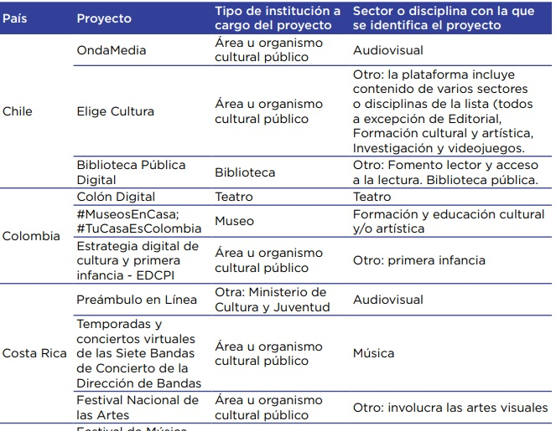
SICSUR, Cultural Information System of the South
Strategies for measuring the cultural consumption of public digital offerings in times of pandemic
Type of
cultural activity
Source: SICSUR (2021). Estrategias de Medición del consumo de la oferta cultural digital pública en tiempos de pandemia
Notes:
The first dimension inquired in the type of cultural activity offered, and the organization or institution involved.
The second aspect of the study inquired about the strategy of transmission of the content, whether it was through its own platform or YouTube channel, zoom or other.

Slide 21
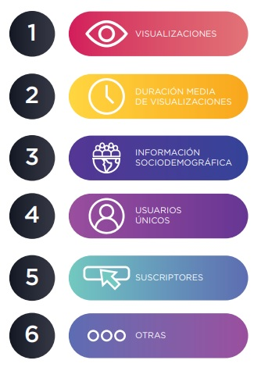
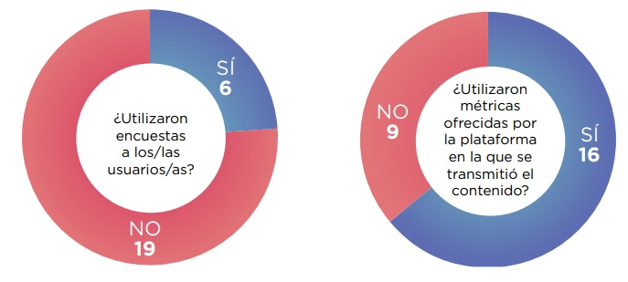
SICSUR, Cultural Information System of the South
Strategies for measuring the cultural consumption of public digital offerings in times of pandemic
Instruments and metrics to understand audiences and measure digital cultural consumption during the pandemic
Source: SICSUR (2021). Estrategias de Medición del consumo de la oferta cultural digital pública en tiempos de pandemia.
Notes:
And the third aspect of the study inquired about the metrics and instruments used to measure and understand digital audiences.
Some of the results of the study were that the metrics provided by the platform were used more than surveys to measure and characterize the audience. Views in first place, average duration of views, socio-demographic information.
The study also highlighted the difficulty in the access of detailed information when the platform is not owned.

Slide 22
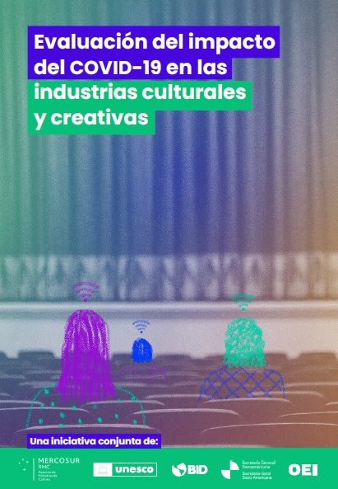
SICSUR, Cultural Information System of the South
Special projects
SICSUR participated in the Evaluation of COVID-19 Impact on Cultural and Creative Industries for the macroeconomic study. Publication carried out by the international organizations: MERCOSUR CULTURAL, UNESCO, BID, OEI, SEGIB.
Notes:
Finally, SICSUR participated in the Evaluation of COVID-19 Impact on Cultural and Creative Industries carried out by the international organizations. providing information and sharing methodologies for the macroeconomic study.

Slide 23
Some thoughts and challenges
Reconfiguration of the post-pandemic cultural and creative sector.
Acceleration of digitalization in cultural and creative industries.
Reconfiguration of the value chain and new business models.
Notes:
In closing, we can say that in the last two years we are going through a new post-pandemic context, which invites us to ask the following questions:
What is the reconfiguration of the cultural and creative industries? Which sectors are recovering more slowly? Which, on the contrary, have grown rapidly?
Digitalization: What role does it play in digital cultural consumption?

Slide 24
Some thoughts and challenges
Challenges in data collection for digital cultural offer (platforms) and consumption.
Importance of the use of new sources of information coming from platforms metrics complementary to traditional cultural statistics.
New technical capacities are required.
Generate current information for political decisions with based evidence.
Notes:
Challenges in data collection for digital cultural offer (platforms) and consumption.
Importance of the use of new sources of information coming from platforms metrics complementary to traditional cultural statistics.
New technical capacities are required. Generate current information for political decisions with based evidence.

Slide 25
Thank you!
Muchas gracias!

