Slide 1
THE CREATIVE SECTOR STIMULUS OF THE PRESIDENTIAL EMPLOYMENT STIMULUS
Author: Kwena Mabye

Slide 2
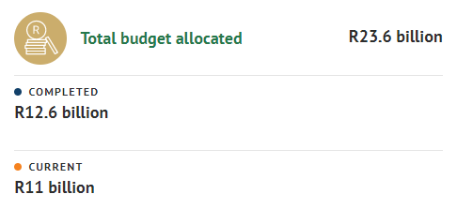
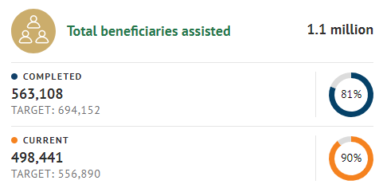
Presidential Employment Stimulus Programme (PESP)

Slide 3


Mandate from DSAC:
Stream 1: 7000 job retentions
Stream 2: 8000 new employment opportunities
Project implementation timelines: 1 January 2021 – 31 March 2021
Evaluation criteria
Stream 1: Job retention wage subsidy
1. Demonstration of job retention
2. Transformation
3. Sector experience and knowledge
Stream 2:Job creation
Innovation
Transformation
Sector experience
Budget and activity plan
Mandate from DSAC:
Stream 1 – Stream 3: 5000 new employment opportunities
Stream 4: 3000 job retentions
Project implementation timelines: 1 January 2021 – 31 March 2021
Evaluation criteria
1. Functionality
2. Price and Broad-based black economic empowerment (B-BBEE)
2.1. Cost to service ratio
2.2. BBBEE
3. Geographical spread
4. Scarce skills

Slide 4
PESP 1: Overview of funded projects**
Budget
Applications
Actual Expenditure
Reported Jobs
R300 million
R3,75 billion
R302 million
21 871
R140 million
R3,2 billion
R138 million
7 598
**See Annexures A and B for provincial allocation of the budget and reported number of jobs by race, youth and gender

Slide 5
RESEARCH METHODOLOGY
Simple random sampling method
Determining sample size
Sample included: male/female/non-binary; all provinces represented; age (18-35; 35-67)
Questionnaire consisted of structures and semi-structured questions.
Interviews with the NAC and NVF PESP application project leads

Slide 6
SURVEY RESPONSES
In what capacity did you make your proposal?

Slide 7

SURVEY RESPONSES
Before the pandemic, were you employing people in activities relevant to your PESP proposal?
No
20,34%
Yes
79,66%
How many people were you employing?
☺ 1 – 9 people (41,67%) ☺ 10-19 people (25,0%) ☺ 20-29 people (4,17%);
☺ 30-39 people (4,17%) ☺ 40-49 people (10.42%) ☺ ≥50 people (14,58%)

Slide 8


SURVEY RESPONSES
What forms of employment or work opportunities did the PESP funds support?**
Creation of jobs that you/your entity had not supported before
76,27%
Re-activation of jobs/work terminated because of the pandemic
49,15%
Retention of jobs/work
40,68%
**Beneficiaries could choose more than one answer that was applicable to them, hence the numbers do not sum to 100%
Of the jobs created from the PESP grant, have any become permanent, and how many?
☺ Average: 21; ☺ Minimum: 5; ☺ Maximum: 60
Yes
67,80%
No
32,20%

Slide 9
SURVEY RESPONSES
Did you have other funding with which to undertake the project?
If yes, what form of funding did this take?**
**Beneficiaries could choose more than one answer that was applicable to them, hence the numbers do not sum to 100%

Slide 10
SURVEY RESPONSES
If yes, can you give the rough ratio of PESP funds to total other funding?
If yes, did the PESP funds assist you to crowd in other funding?

Slide 11
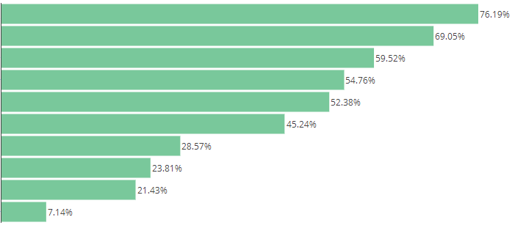
What challenges and opportunities were the PESP funds most useful for addressing?
Lack of funding for new work
Expansion into new areas of opportunity
Cashflow
Lack of work in the sector
Digitisation of work to access new markets
Lack of funding to complete existing work
Cancellation of contracts because of lockdown
Potential insolvency
Non-payment by creditors because they faced challenges in lockdown
Other
“
“
“
My film was awarded ‘Best Short Film’ at the New York African Film Festival. This helped me to secure distribution rights.
“
It has allowed me to complete a project, which has added to the slate of work done.
PESP funding allowed our business to participate in local, national and international exhibitions.
I was able to purchase digital equipment to run online streaming and content.
”
”
”
”

Slide 12
STIMULUS EFFECTS
Can you identity any ways in which your PESP grant contributed indirectly to the creation of work and/or to the support of other business, in or beyond the creative sector?

Slide 13

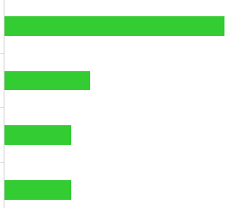
STIMULUS EFFECTS
Did your PESP project allow you to earn additional income that helped sustain your livelihood/business thereafter?
No
22,03%
Yes
77,97%
If yes, what kind of additional income did you earn?
Sales of work produced
50,0%
Tickets from performances
19,57%
Sales of rights
15,22%
Royalties
15,22%

Slide 14

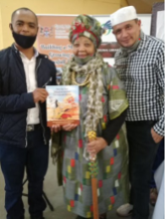

PESP: beneficiary impact
National Arts Council
National Arts Council
National Arts Council
“My Home Town is a play that gave voice to young creatives in Sasolburg to air out challenges such as GBV, unemployment and marginalization within our small mining town” – Kedibone Mothlasedi
Zingce Arts Festival is a fusion of Visual, Performing, Literary and Applied Arts created as a platform for encouraging and promoting the development of creative, business and entrepreneurial skills in the arts industry, for the citizens of the Eastern Cape.
Puku spearheaded the publication of the first-ever book in the N/uu language - a severely endangered language according to the UNESCO degree of endangerment. This earned them the prestigious 2021 UNESCO King Sejong Literary Prize.

Slide 15
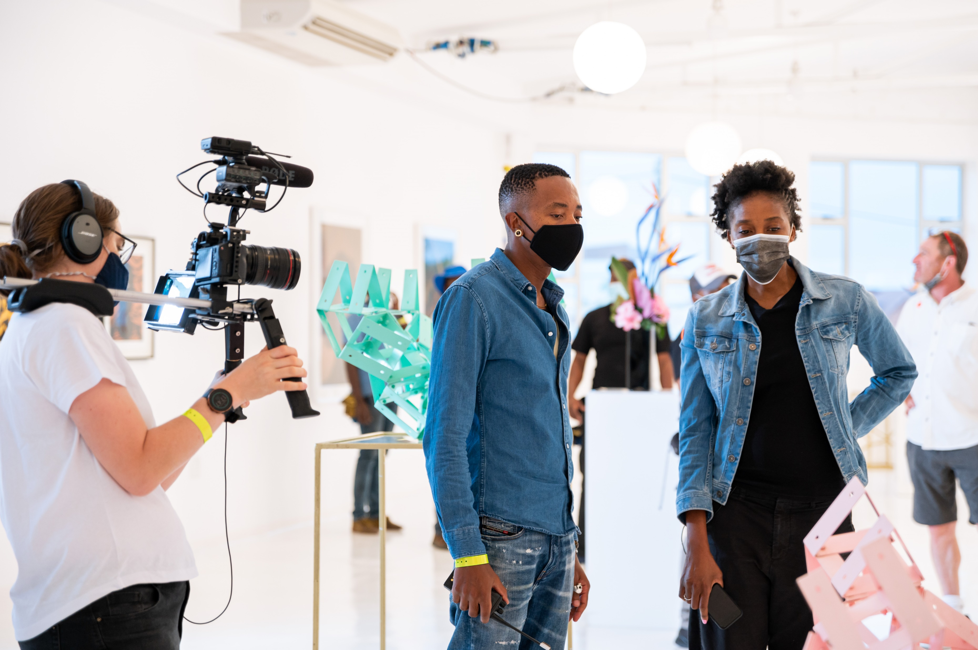
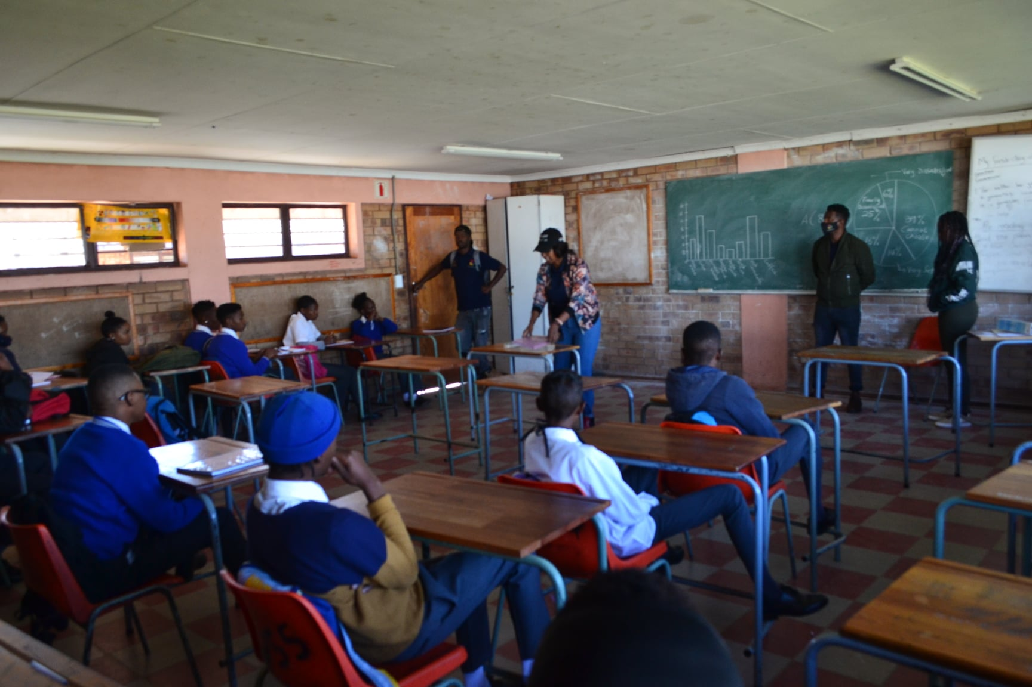

PESP: beneficiary impact
National Film and Video Foundation
National Film and Video Foundation
National Film and Video Foundation
“A total of seven mental health themed films were produced and screened on Mental Health Day. The films were created, scripted, produced and cast by grade ten students from selected areas where young people do not have access to movie theatres’’ – All Mshengus
“The PESP came at the right time and enabled me to go forth and make the sequel Happiness Ever After - now streaming on Netflix in 190 countries, to over 200 million subscribers” – Bongiwe Selane
“The purpose of the screening was to help develop an audience, while also celebrating the work put in by our youth-only cast and crew. We can proudly say that the film was well received by our target audience of youth and women” – Sinomtha Nduna

Slide 16
CONCLUSION
47,5% of the applications made were from companies, followed by self-employed individuals at 27,1% and non-profit organisations at 25,4%.
79.7% of the beneficiaries were employing people in activities relevant to their PESP proposals, prior to the pandemic. Just over 40% of the beneficiaries said they employed between one (1) and nine (9) people relevant to their proposals, before the pandemic.
The PESP funds mainly supported the creation of work/employment opportunities (76,27%), followed by re-activation (49,15%) and retention (40,68%) of work/employment opportunities.
68% of beneficiaries stated that the work/employment opportunities they created became permanent. The average number of permanent jobs created was 21.

Slide 17
conclusion
PESP funds were the main source of funding for projects. 64% of beneficiaries said they did not have other funds with which to undertake their proposed projects before the receipt of PESP funding.
For beneficiaries who did have other funding, this was largely in the form of grants (62%), followed by funding from family/friends (43%) and finally, loans (19%). The PESP funds comprised largely 51-75% of total funds.
Of beneficiaries who had other funding, over half (57%) stated that the PESP funds assisted them to raise this funding.
‘Lack of funding for new work’, ‘expansion into new areas of opportunity’ and ‘cashflow challenges’ were the top three cited challenges/opportunities that the PESP funds were most useful for addressing.

Slide 18
conclusion
The PESP funding created additional rounds of spending and work across various sectors in and beyond the creative sector.
The trade, catering and accommodation sector; transport, storage and communications sector as well as the finance, real estate and business sector were most frequently cited as sectors in which beneficiaries made their purchases or contracted their services from, for completion of their projects.
Within the creative sector, collaborations within beneficiaries respective fields as well as upskilling protégés to start their own business, contributed towards indirect job creation.
77% of beneficiaries earned additional incomes from their PESP projects – this was predominantly in the form of the sales from work produced.

Slide 19
ANNEXURE a
A1: Provincial budget allocation
A2: Allocation by discipline
A3:Reported jobs by race
A5:Reported jobs by gender
A4:Reported jobs by youth

Slide 20
ANNEXURE B
B1: Number of funded projects per province (%)
B2:Reported jobs by race
B3:Reported jobs by youth
B4: Reported jobs by gender

