Slide 1




Transformations of the Creative Economy
Andy C Pratt
Professor of Cultural Economy
UNESCO Chair of Global Creative Economy
Notes:
Transformations of the Creative Economy
This paper will examine the current status of the creative economy, its diverse character internationally, and in what ways it is changing both intrinsically and in response to multiple external shocks. I will highlight the embedded and organisational characteristics of the creative economy, and its non-reducibility to formal-informal, public-private, economic-cultural realms. I will further examine the challenges of local capacity building of both our knowledge and the support systems for the creative economy; of transversal policy making; and, global production networks.

Slide 2

0. Overview
1. International perspectives
  Growth
  Diversities
  inequalities
2. Shifting concepts
  Atomistic
  Relational
3. Beyond binaries
  Organisation
  Embedding
4. Governance and Capacity building
  Local
  International

Slide 3
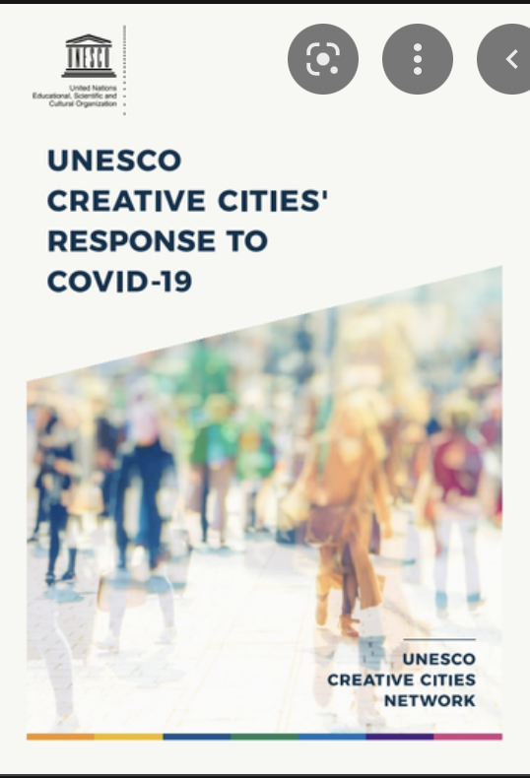
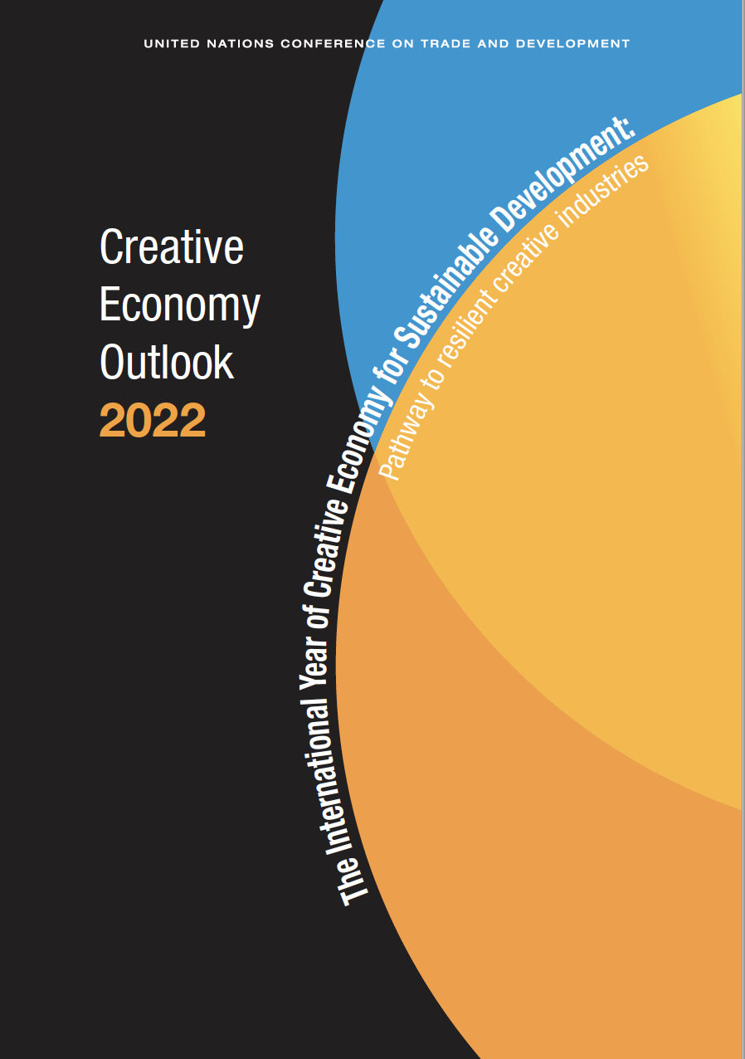
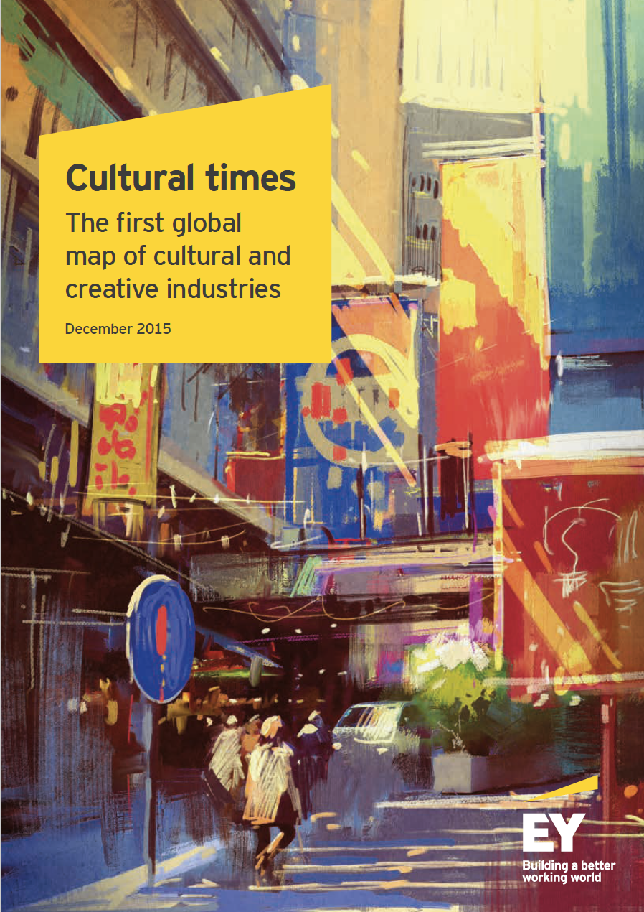
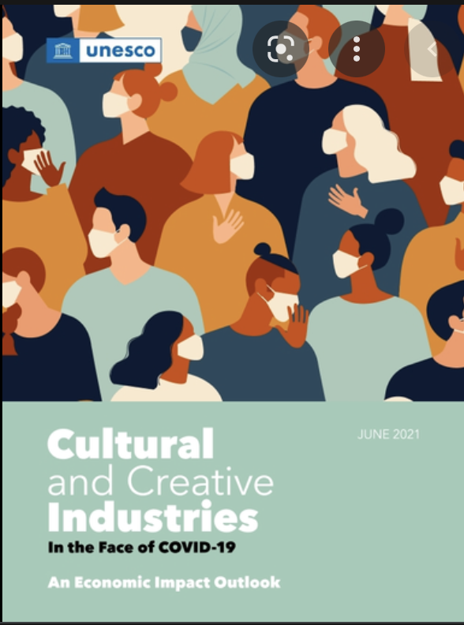
1.1. International perspectives
Trade Growth
  Exceeds most other industries
  Especially in the Global South
  Resilient 2008 recession
Scale of activities
  Growing
  Overall activity greater in the Global North
Under-/non- reporting of trade in services and IPR
Covid-19
  Live performance suffered massively
  Streaming and digital services grew significantly

Slide 4
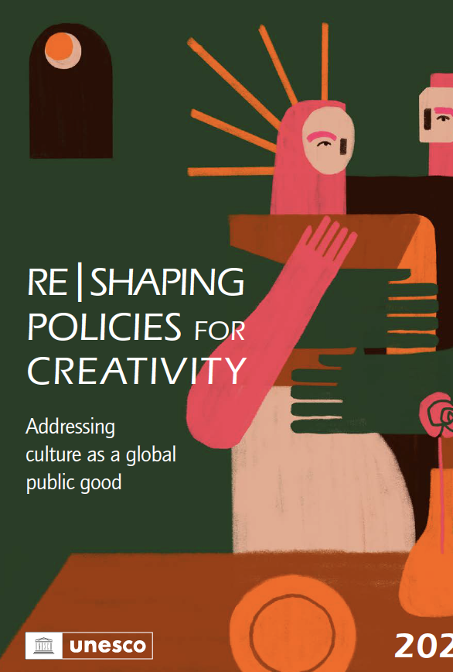
1.2 Intersectional challenges to ‘real diversity’
Digitalisation
Mobility of artists
Remuneration
Pensions/Sick pay
Gender
Ethnicity/Race
Age
Imbalance of trade (North –South)

Slide 5

1.3 Macro-challenges to the creative economy
State funding for culture: eternal reductions
  Short term
  Long term decline
Funding/Support for networks and intermediaries
  Agility/Fragility of the cultural ecosystem
  Vulnerable to ‘missing links’
  Economic and social sustainability
Asymmetries of trade, and access to/use of / distribution systems
  Historical/Colonial ‘lock out’ or ‘tax’ on participation
Environmental Sustainability
  Electronic and Fashion systems of waste production, and merchandising
    Use of Rare Earth minerals from conflict zones
  Vulnerability to weather and sea level changes: heritage
  Carbon footprint of travel to events: Live events
    Transportation of goods and people
    Cooling costs ‘the cloud’, and crypto-currency: hidden burden of the web

Slide 6
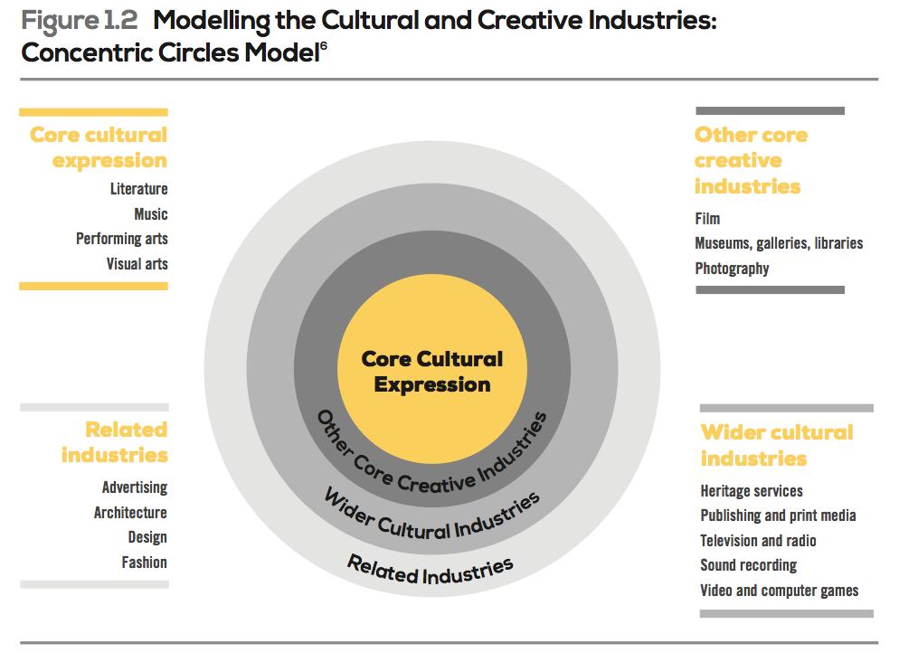
2.1 Shifting conceptualisations of the creative economy
Partiality
  The artist, separated from production and society
    Recent discovery of ‘cluster and co-location’ (as atomistic)
    Reduction of culture to space
  Focus on the (western) romantic concept of the artist
  The hierarchical divisions of (western) cultural value
Instead
  Relational concepts of the cultural/creative process
  Trans-local flows as constitutive of places and cultures
  Cyclical, heuristic, and re-cursive eco-systems of culture

Slide 7
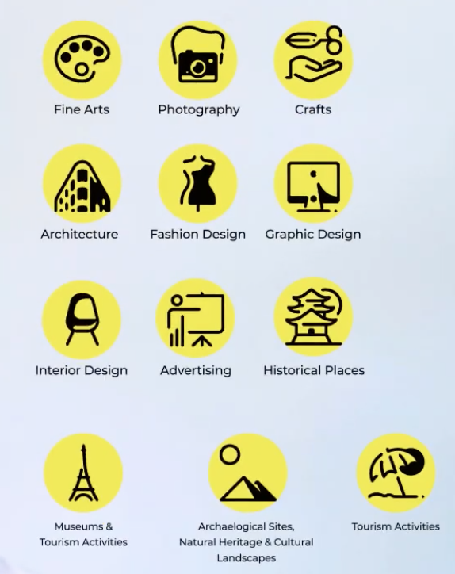
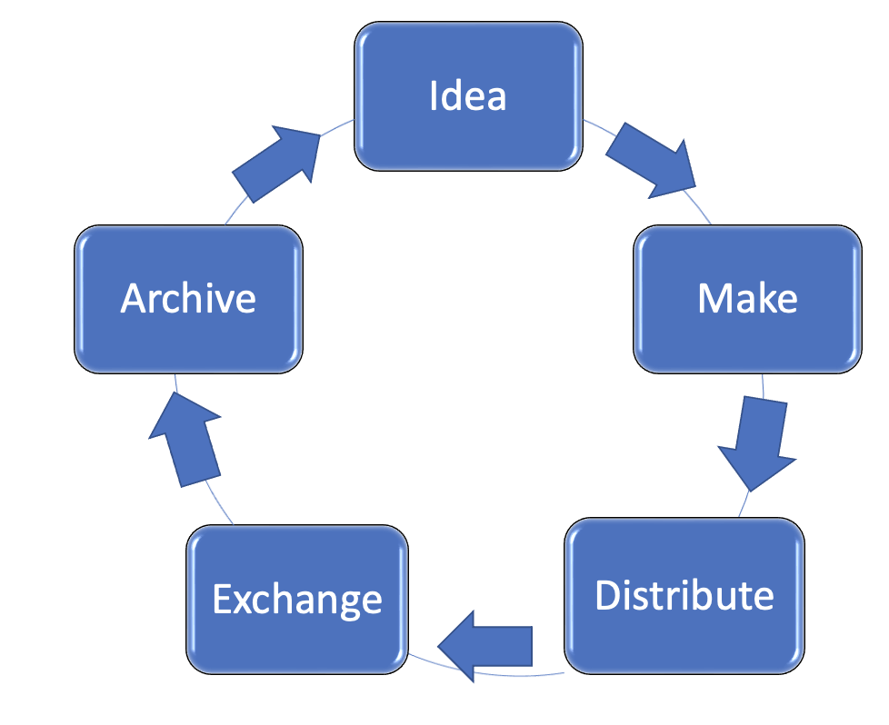
2.2 The expanding field of the creative economy
Cultural objects and services
  Lateral and horizontal linkages of process
  Instantiated /locale
Inter-woven networks of meaning and value making
  Art forms /Domains
  Functions
Justifying, relating and fixing value/s
  In society
Circular economy
Notes:
Statistical definitions relate to unhelpful conceptualisation based on reductivisms (micro & macro)

Slide 8
The practices of the Creative Economy of Music

Slide 9

23.1 New visibilities of power and control
Institutional. Perspectives
  Examining the market as a construct not a given
    Constructed of variable and unequal networks and hierarchies
    Prices are only one ‘signal’ (other values are at play)
    What is economic and what cultural?
  Supply and demand are structured and controlled
    Access limited by powerful actors
    Location of command and control
    Consequences of trans-local decisions
  Regulation is internal to the system
    Commonly limited to nation states or regions
  Variations across territory/space (and/or access to resources)

Slide 10

3.2 Organisation and operation of the creative economy: hybrids not dualisms
  Speed of turnover of ideas/products/fashion
    Risk: portfolio management (NOT individual)
  A few large/platform companies
    Many micro, or project-based enterprises & networks
  Importance of Reputation (horizontal integration)
    Links of formal and informal
  Differences between (creative) industries
    production processes
    values not just markets
  Cross-over
    Formal-informal
    For- profit – not for profit

Slide 11

3.3 Re-describing the creative economy: what becomes visible
Trans-local cultural production networks
  Across places/spaces
  Unequal inter-dependencies
  Flows of knowledge/ opportunities/not / for exchange
  Location of command and control of networks
  Invisibilities (with existing data and concepts)
Embedding in…
  Social and economic reproduction of ‘skill’ and ‘value’
    Communities of practice/ value
  Dimensions of unique environmental facilitation
    Ecological, social and artistic
  The ‘distribution’ (limits) of the cultural commons
    Informal everyday practices
  Tacit knowledge/learning and complex values

Slide 12
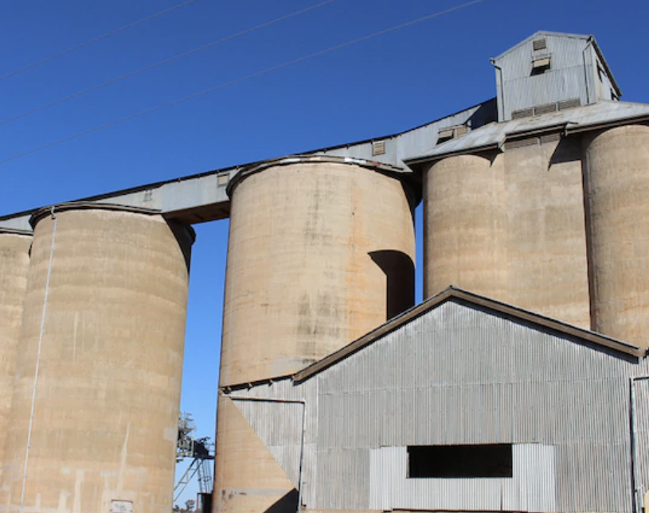
4.1 Responding to challenges of ‘new realities’ with new approaches to governance
Rejection of normative
  One size fits all
  Pick winners
  Best practice
  Silo-ed organisations/ governance
Attentive to the organisational forms, embedding and trans-local articulation
Price and unitary (market or social) value is an outcome not a cause
Institutions and networks need sustaining and maintaining
  (a parallel enabling infrastructure: a commons)

Slide 13
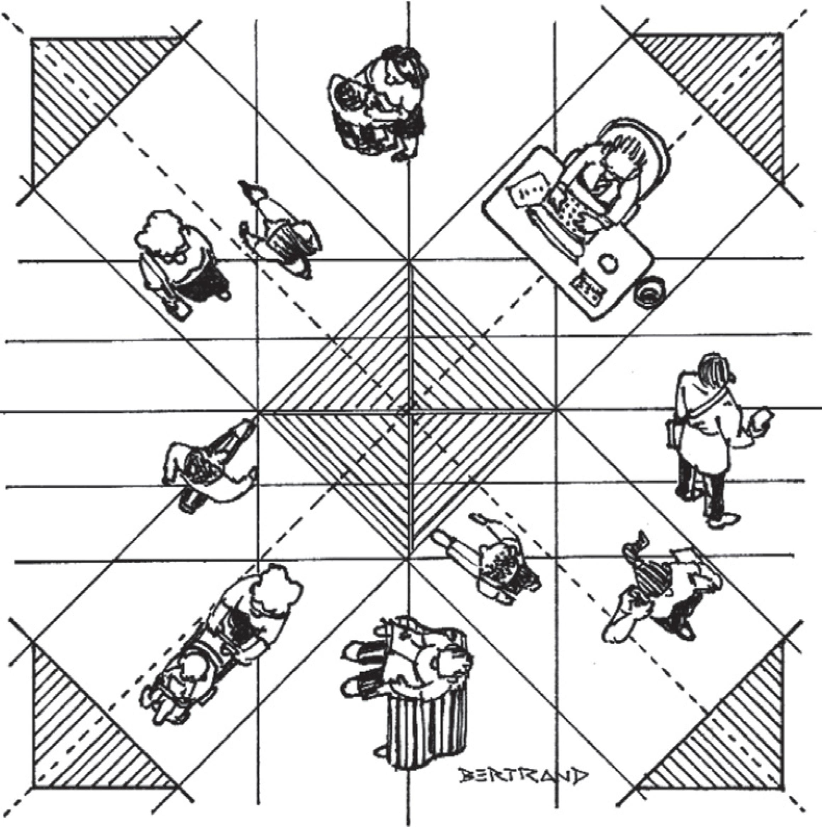
4.2 The new institutionalism for creative economy governance
Bifurcated or Monopolistic markets and organizational structures; as do project based systems
  Require (smart/nuanced) alternative organizational and governance responses
  Intermediation and support for cultural producers
  Support of strategic direction, and data analysis
  Capacity building in skills and training to offer strategic support
    Training cultural governance professionals
    Creating public data and observatories
  Developing trans-versal working practices
    Local, and international
    Lateral network linkages (boundary spanning)
  Beyond artists/creators
    Archiving as a commons resource
    Education of creators and audiences
  Knowledge exchange institutional forms (embedding and trans-local)
    Hubs/ Incubators/ Studio-Audience space
    Inter-section with ‘the rest of the economy’

Slide 14

5. Conclusions
Transformations in the creative economy
  Convergence and innovation: flux
  Material and organisational: how they are
  Conceptual: how we see them
Diversity of experiences
  Undermining sustainability
  Weakening diversity
New forms of capacity building and governance
  Education and Practice
  Nuanced strategic guidance
  Sustainable ecosystems of support

