Slide 1
The Future of the Cultural and Creative Industries – Business Models and Innovation
Raymond Ndhlovu
Jen Snowball

Slide 2
UNESCO definition used:
“culture is the set of distinctive spiritual, material, intellectual and emotional features of society or a social group, that encompasses, not only art and literature, but lifestyles, ways of living together, value systems, traditions and beliefs.” (UNESCO, 2009)
Intangible nature of culture seen from definition (beliefs and values can’t be directly measured) BUT possible to measure the associated behaviours that accompany the beliefs and values

Slide 3
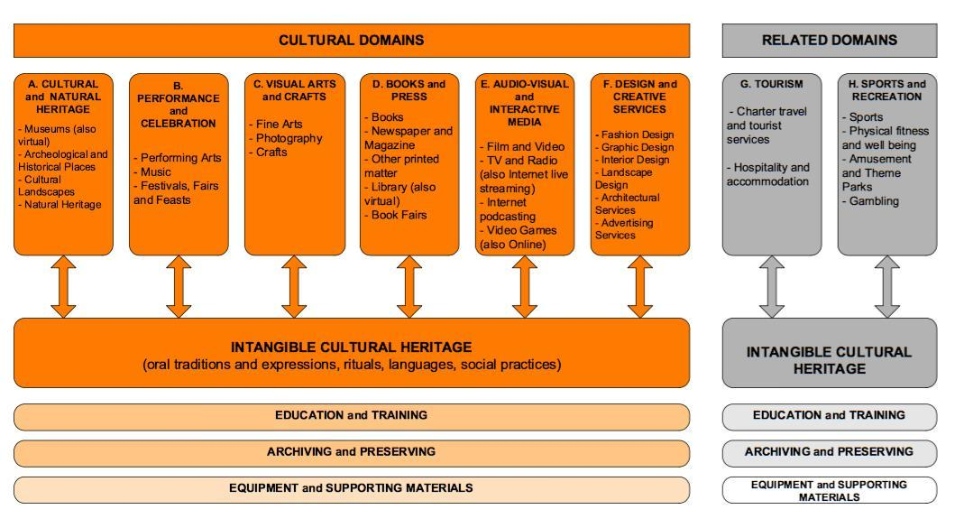
UNESCO Framework for Cultural Statistics (FCS)

Slide 4
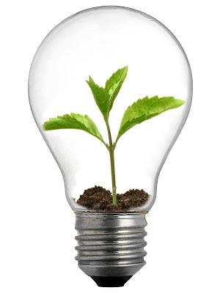
Context of
Research

Slide 5
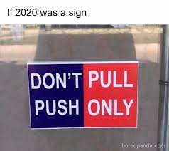
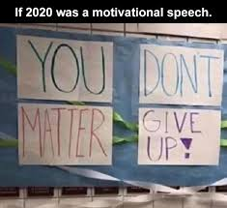
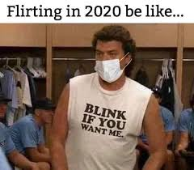
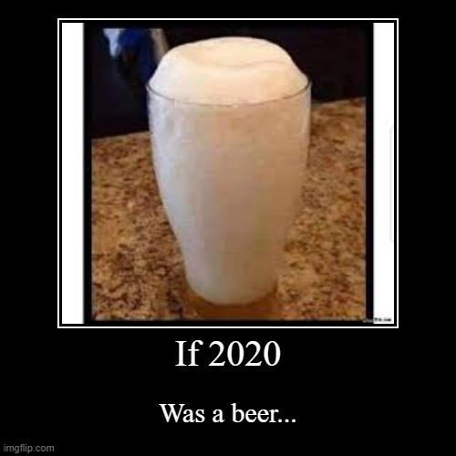
2020….

Slide 6
ONLY COOL PEOPLE ALLOWED – CHECK YOUR TEMPERATURE
Wear a mask or get the fork out of here
Practice #safesix – social distancing folks
Be wise sanitise

Slide 7
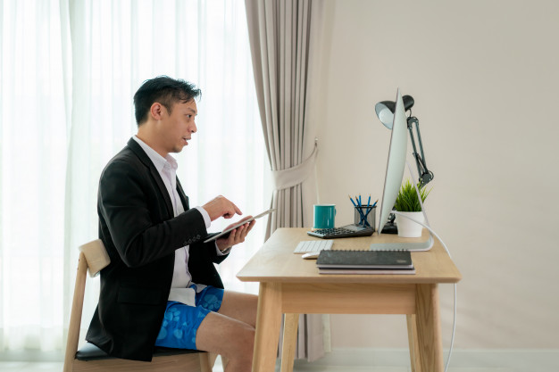
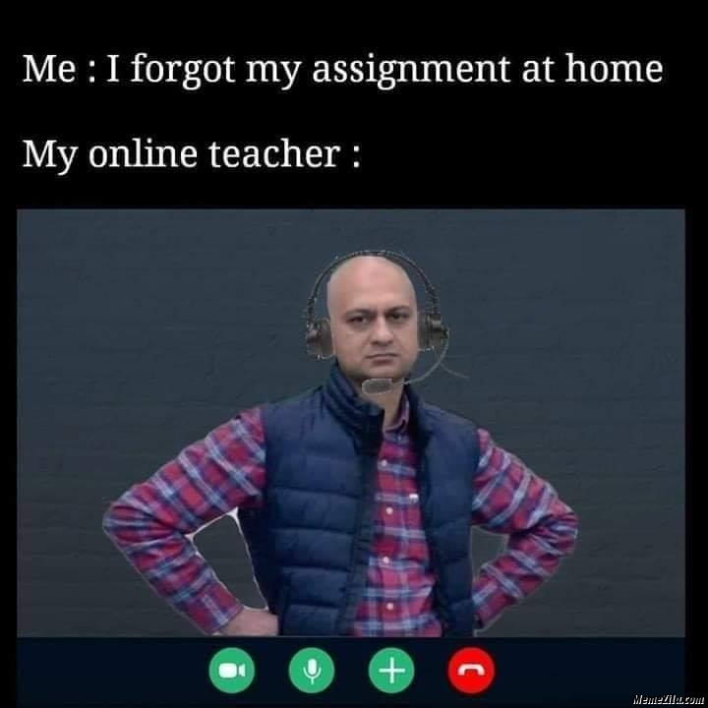
How did CCIs “survive” 2020/2021? (barely)
CCIs adopted one of three strategies;
1. Some CCIs (particularly festivals) completely cancelled the event for 2020/2021
2. Some went fully online
3. Towards the end of the period, some returned to live participation

Slide 8
Since then…
1. Continuation of live events, COVID protocols allowing
2. Continued utilization of online platforms
3. HYBRID FESTIVALS AND CCI EVENTS

Slide 9
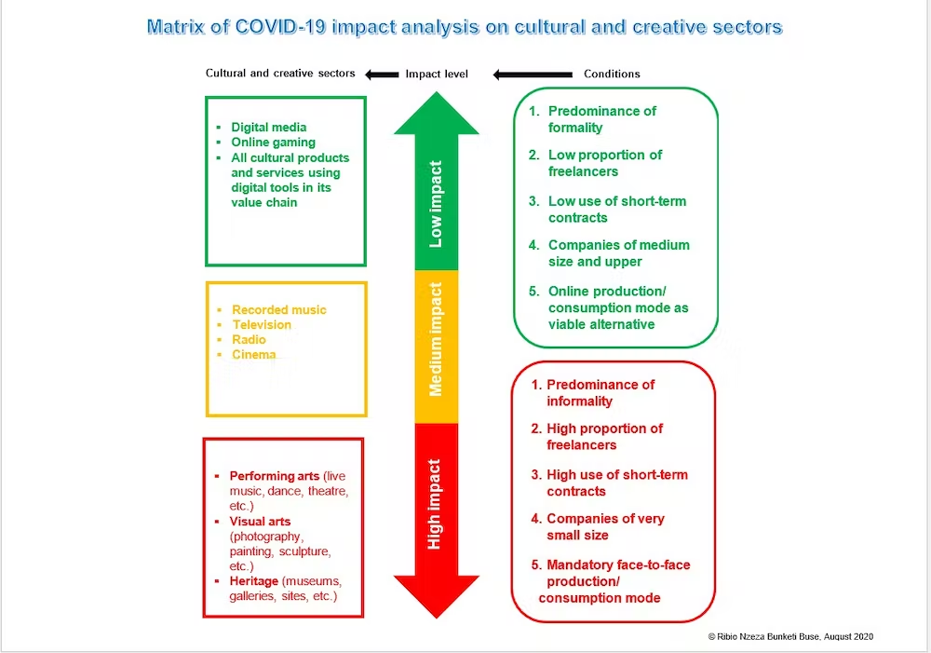

Slide 10
CCI Macro Contributions and Comparisons – South Africa and Zimbabwe
 | GDP | Employment | Internet Access
South Africa | 2.97% | 6% | 78.6%
Zimbabwe | 6.9% | N/A | 55.7%
Source: SACO, 2020; 2021, Creatives Unlocked, 2020
In 2020, decline of approximately 50% from the 2019 GDP contributions in South Africa

Slide 11
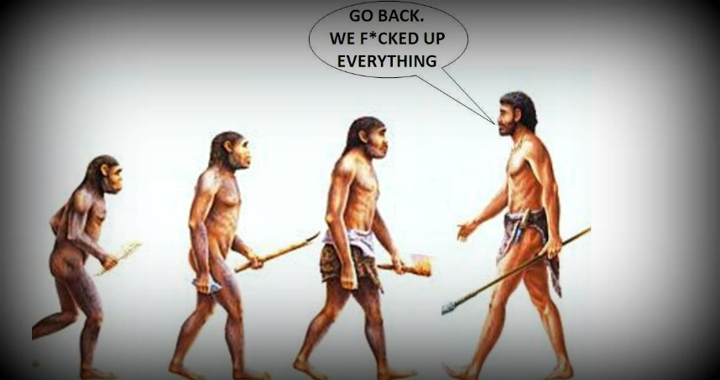
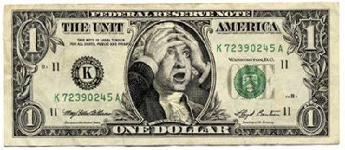
Arts and Cultural also vulnerable to shocks such as the the 2008 financial crisis
“It is indeed the arts and culture that are at the very root of economic development and act as a catalyst for economic growth” (Urbact, 2006)
Therefore, the impact of the arts and cultural sector on the economy; overall economic growth and development, must be analysed

Slide 12
Business models
The “concept” of business models encompasses:
value creation,
delivery of a value-processed goods to a market/market segments
Mechanisms of value capture employed by the firm
How all these elements are linked together

Slide 13
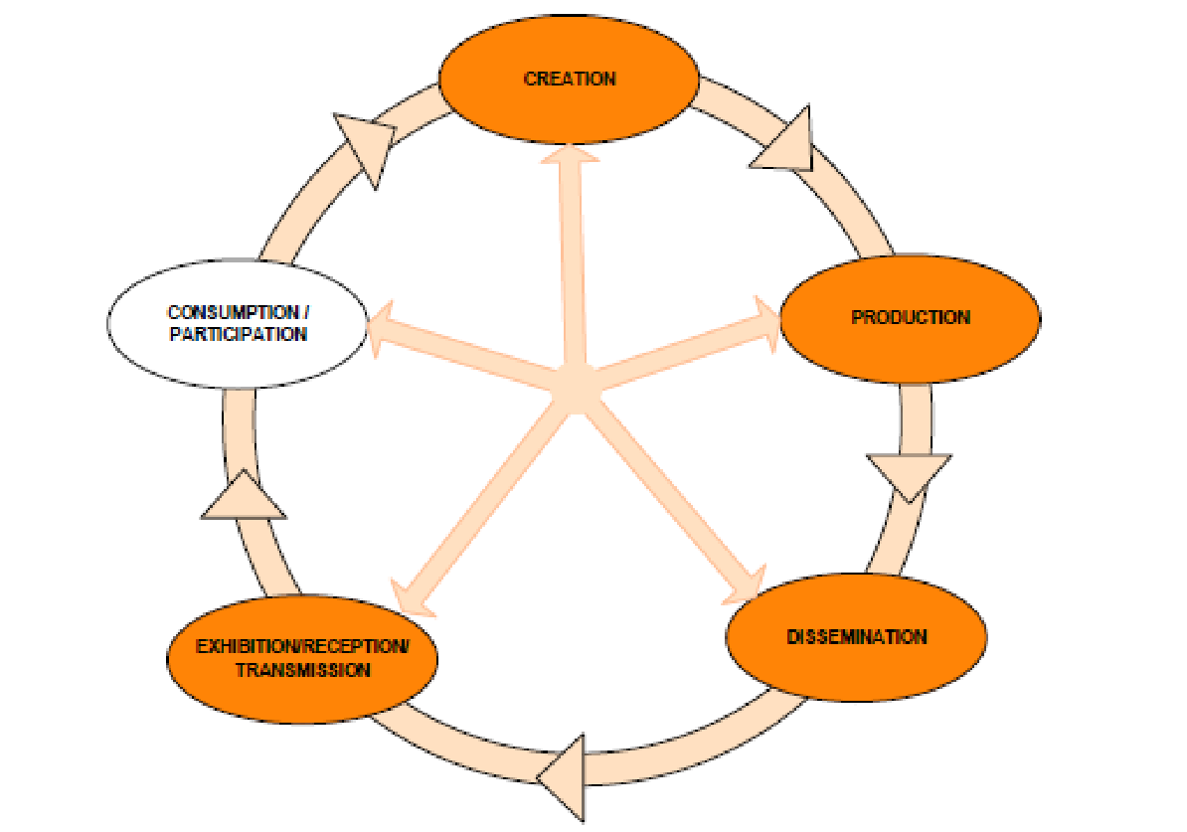
The Culture Cycle (aka The Value Chain)

Slide 14
Components of business models
What is the supply of cultural goods and services
How are these goods and services produced
By whom and by what means are relationships structured
How much income is generated

Slide 15
Sustainable Business Models
Sustainability in business models
Triple Bottom Line

Slide 16
Business model dynamics
Business model innovation
Business model adaptation
Business model evolution

Slide 17
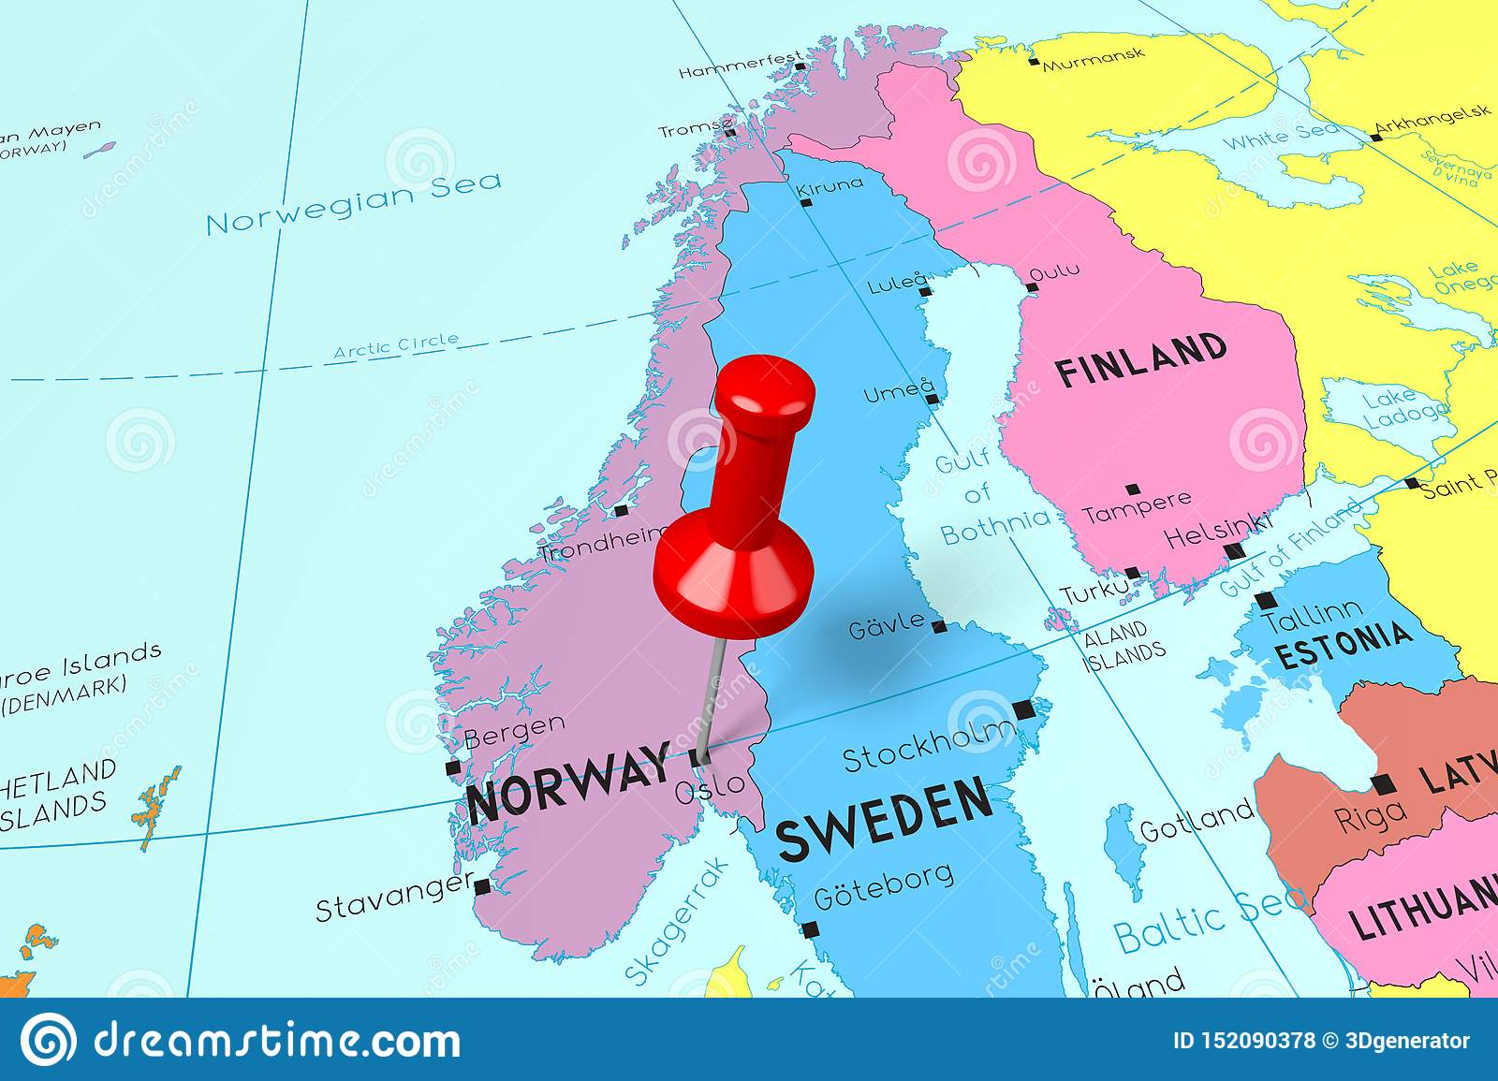
Business Model Innovation
Oslo Manual for measuring Innovation
Product Innovation
Process Innovation
Marketing Innovation
Organisational Innovation

Slide 18
Business Model Adaptation
Rigidity Theory
Path Dependency Theory

Slide 19
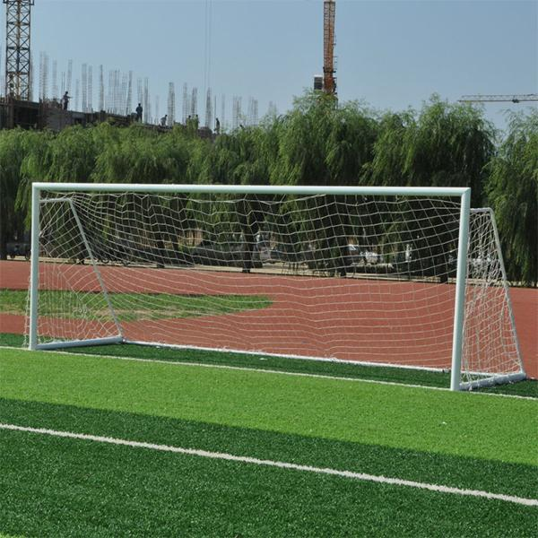
GOALS OF THE RESEARCH

Slide 20
Investigate business models and adaptation strategies that CCIs in a well-resourced country adopt, compared to those in a less-resourced country, when faced with external shocks
Investigate how SMMEs responded to COVID-19 in terms of business model innovation or consolidation
Analyse the innovations and adaptation strategies adopted immediately vs those adopted in the longer term
Compare the effects of COVID-19 on business operations, models and innovation processes of CCIs, in a well-resourced country, compared to those of a less resourced country, and the adaptation strategies that have been used in response to this shock
Analyse and determine the success of these adaptation strategies

Slide 21
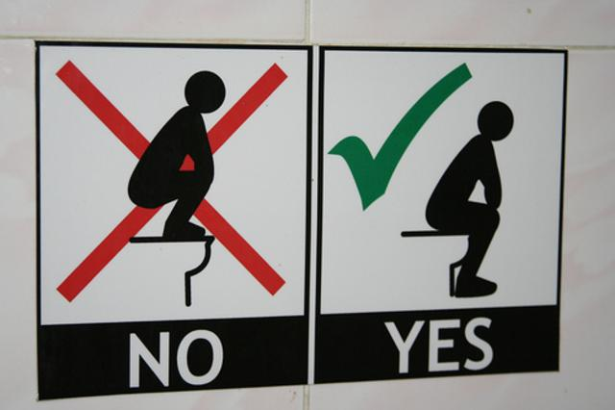
METHODS, PROCEDURES AND TECHNIQUES

Slide 22
Investigating the effects of COVID-19 on CCI businesses and models, and consequent adaptation strategies
Stakeholder Interviews:
  CCIs that are mostly reliant on in-person production and consumption
  CCIs that are not mostly reliant on in-person production and consumption
Thematic and categorical analysis, based on variables in BMI/BMA

Slide 23
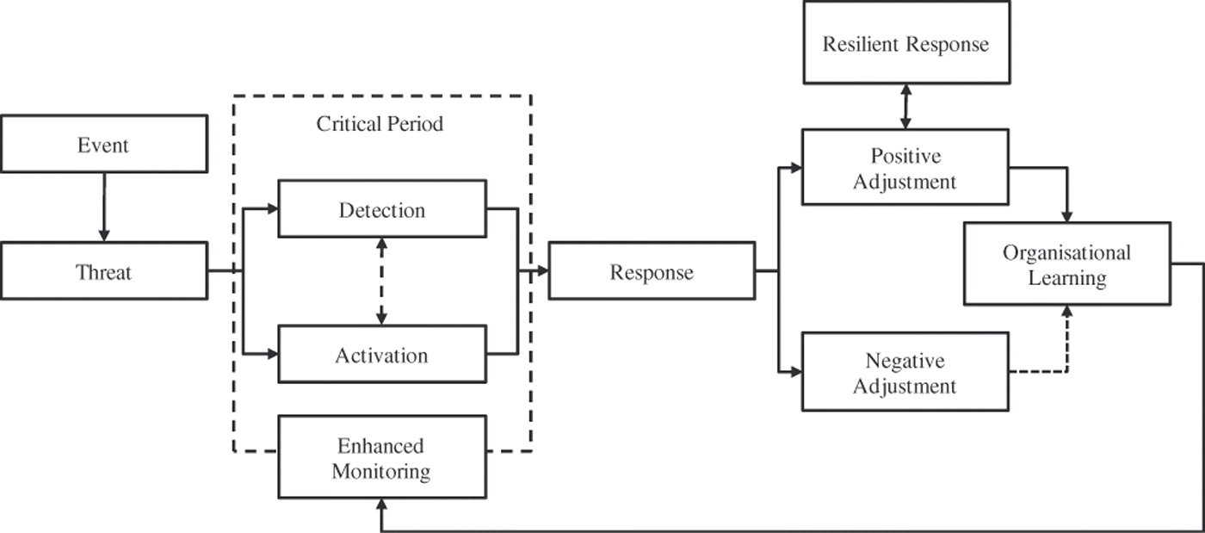
Framework for Organisational Resilience

Slide 24
