Slide 1


Slide 2






Mapping the Creative Industries
Using multi-dimensional measures to track development and recovery
Andre Gouws and Jen Snowball

Slide 3
CCI Mapping Study Results: Headline and Planning indicators
CCIs increasingly recognized as making a valuable contribution to economic growth and development in African countries (AU Agenda 2063; Creative Industries Masterplan).
Creative industries mapping study can help to provide justification for CCI investment and policy and industry relevant information
But there is a tendency to focus on “Headline” findings, without delving more deeply into equally relevant and important planning indicators.

Slide 4
The Contribution of the CCIs to South Africa’s Economy

Slide 5
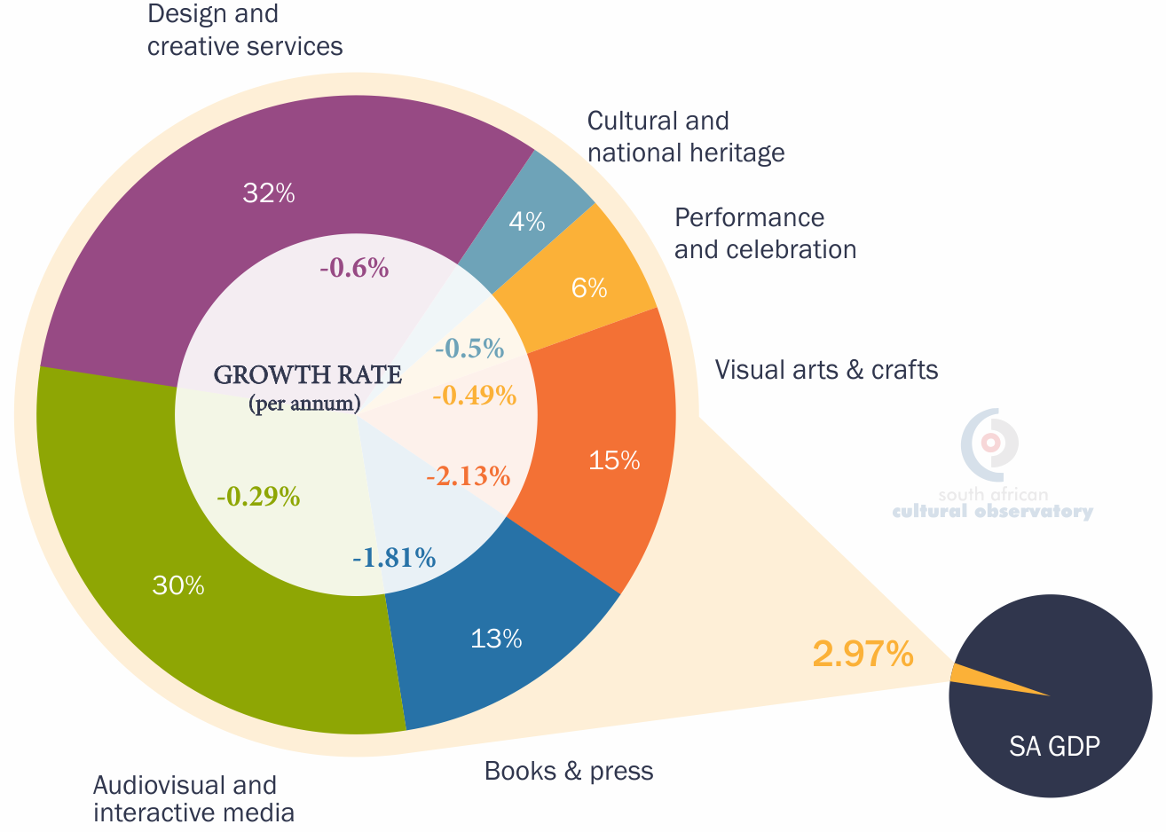
Headline Indicator: Contribution to GDP

Slide 6
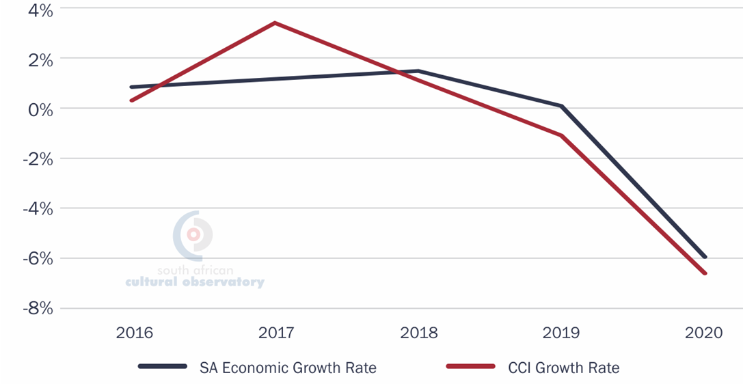
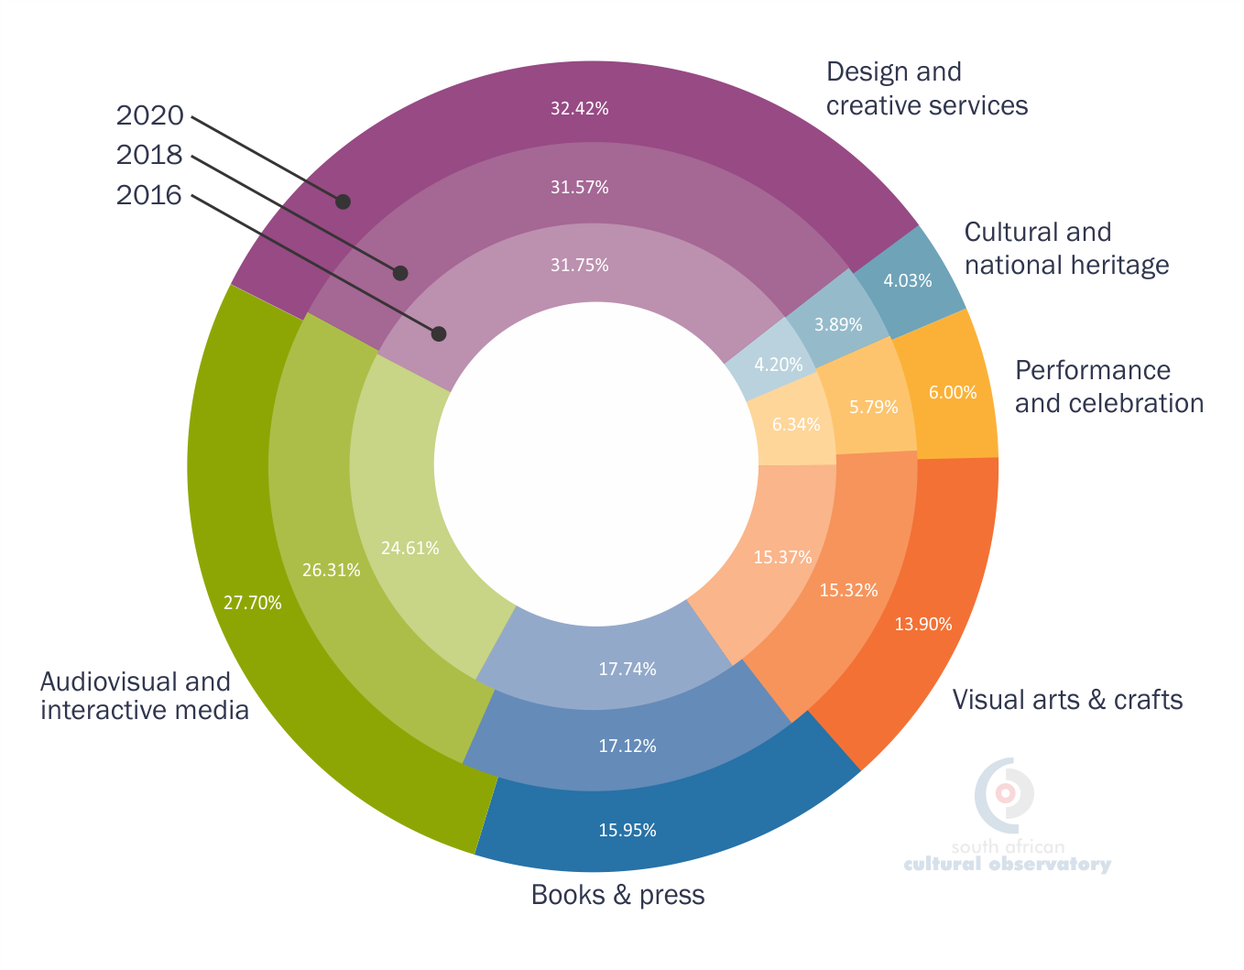
Planning Relevant indicator: Changes over time
Notes:
The Visual Arts and Crafts domain comprises just under 14% of South Africa’s CCI to the country’s GDP. However, the sector is shrinking, and the study found a drop from just over 15.4% in 2016 to 13.9% in 2020. Although part of the drop can be attributed to the COVID-19 induced recession, there are other factors. Although crafts play a small role in the CCI-economy and they may be underreported because of the informal nature of the sub-sector, they do have an important role in providing an income for people will lower levels of formal education.
The Books and Press domain too has been shrinking over the past few years. Part of this can be attributed to the fact that there has been a shift to digital books that are currently been imported. However, reading competes with many other forms of entertainment and therefore the demand for books has decreased. South Africa needs to develop a reading culture especially for South African stories.
The Audio-visual and Interactive Media domain has grown rapidly as CCI consumers tastes have changed and adapted to new technologies that are available. Design and Creative Services provides creative services mainly to the corporate sector. These are also the domains that have the greatest potential to benefit from digitisation, Design and Creative Services and Audio-visual and Interactive Media, have grown relative to the other domains. Books and Press, which has been suffering a steady downward trend over the past few years, shrank relative to the other domains from 17.7% in 2016 to just under 16% in 2020.
Analysis of changes in CCI domains over time showed three general groups: The first group , Cultural and Natural Heritage and Performance and Celebration, are relatively small in terms of their contribution to GDP but have strong roots and assets that have been built up over the years. They are growing slowly and must be preserved and supported to continue this growth in the future.
The second group includes the Visual Arts and Crafts and Books and Press domains which are in the middle both in the size of their contribution to GDP and their growth. A concern is that the GDP contributions of both these domains have fallen in recent times, even before the COVID-19 pandemic of 2020. The third group comprising of the Audio-visual and Interactive Media, and Design and Creative Services, are growing faster and are the two largest domains.

Slide 7
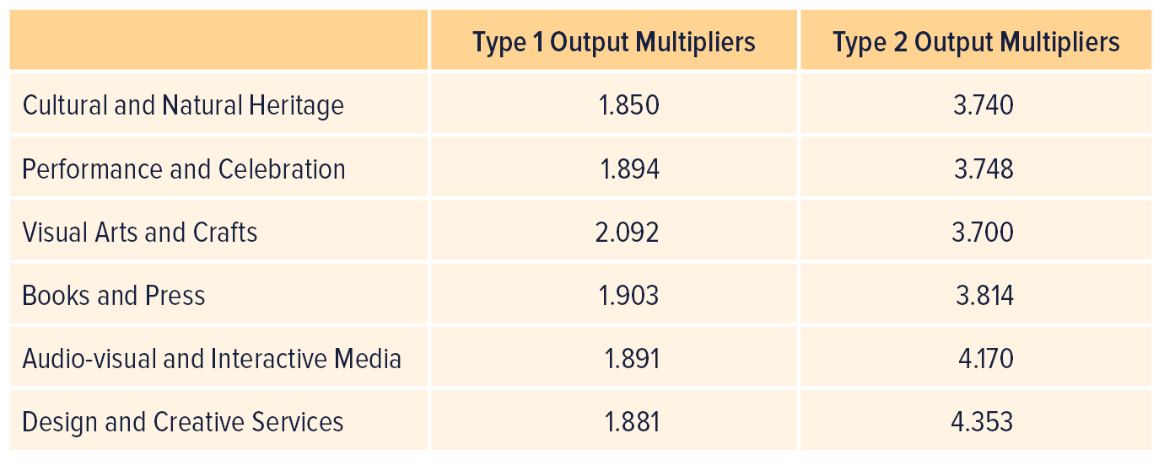
Planning relevant indicator: Multipliers

Slide 8
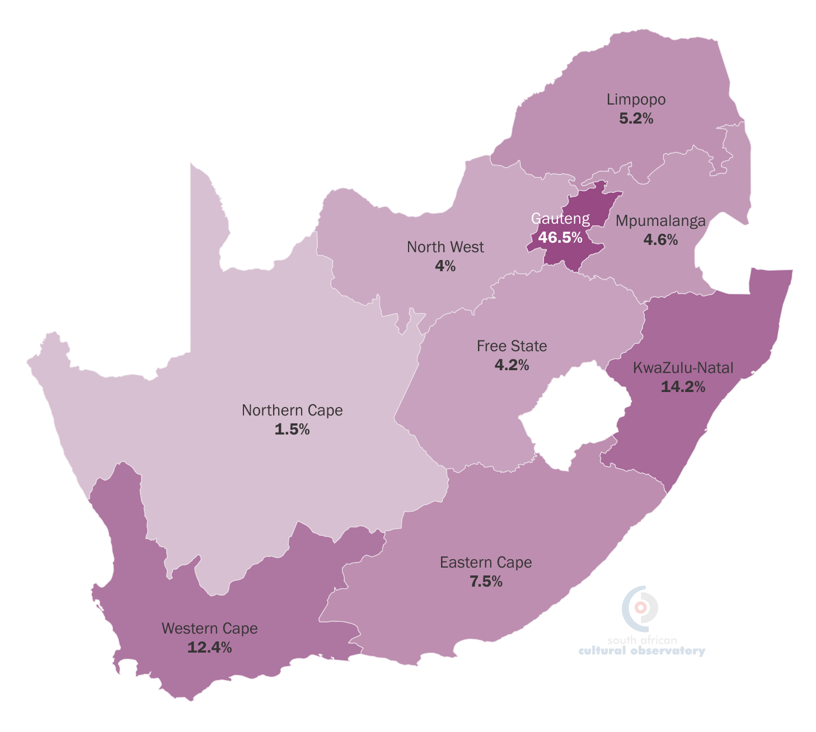
Planning relevant indicator: Geographic spread

Slide 9
Planning relevant indicator: Income distribution

Slide 10
CCI Employment and Transformation

Slide 11
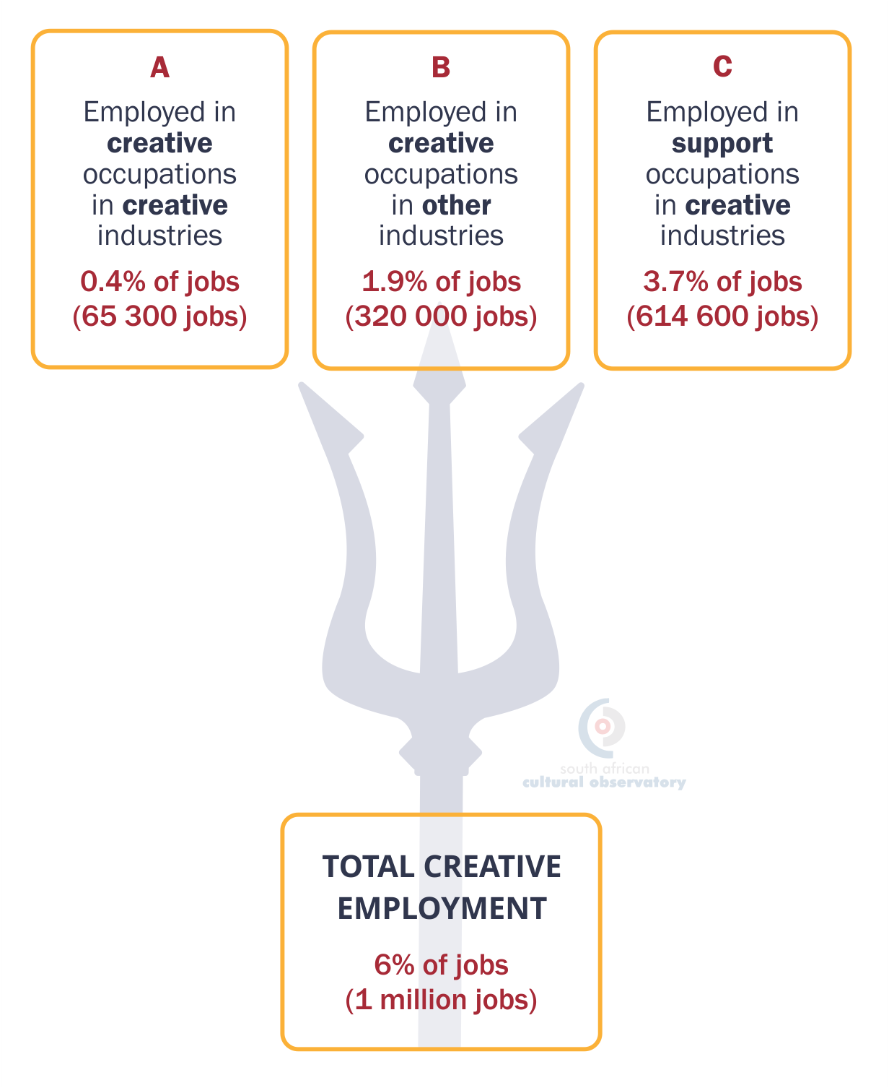
Headline indicator: Employment
Overall, the creative economy accounted for 6% of all jobs in South Africa, which translates into just over 1 million jobs. This is a slight increase from 2017, when the creative economy made up 5.9% of all jobs (approximately 965 000 jobs).

Slide 12
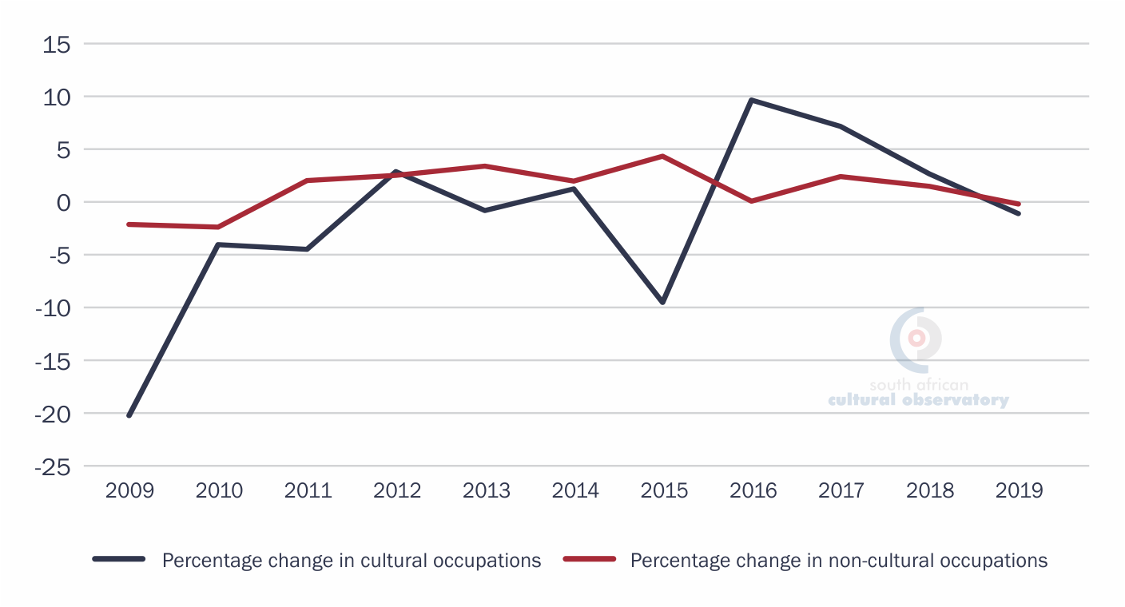

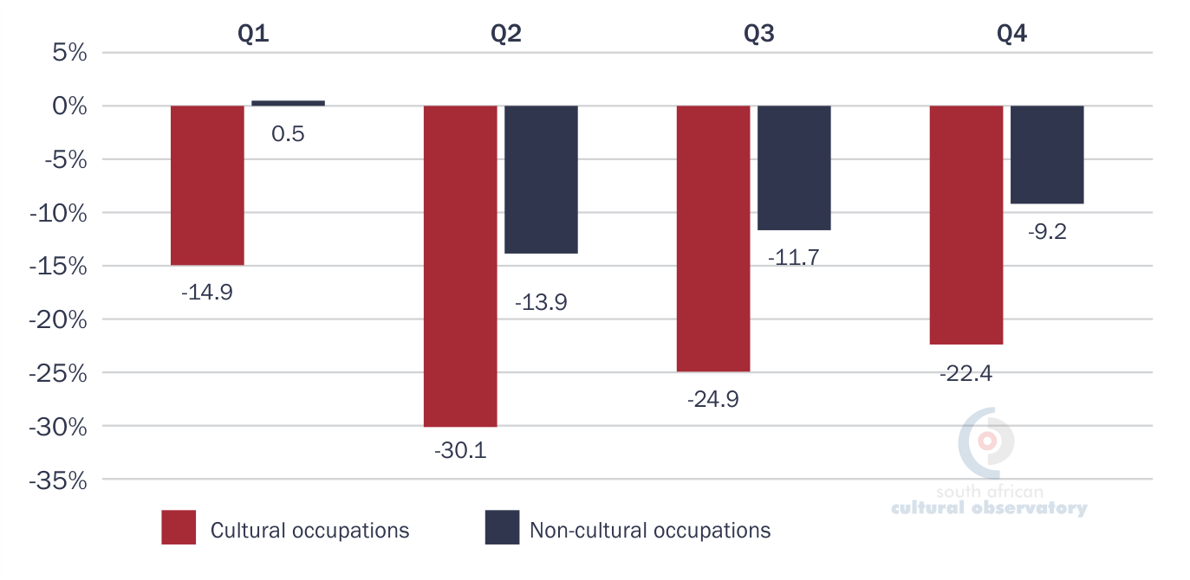
Planning relevant indicator: Cultural Occupations over time
The Impact of COVID-19 on Cultural Occupations and Industries
Cultural employment is more volatile than non-cultural sector jobs.
Source: en.wikipedia.org

Slide 13
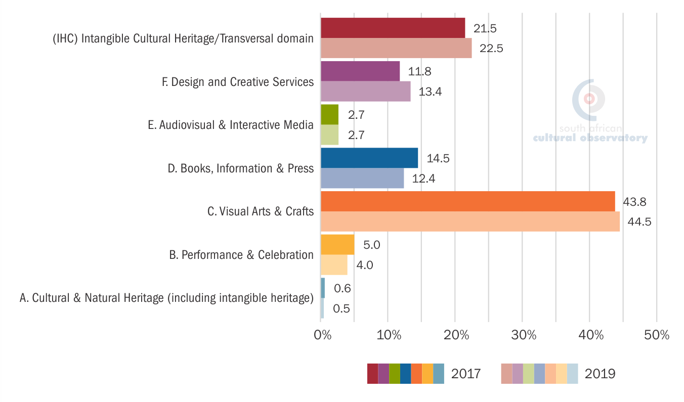
Planning relevant indicator: Employment by domain

Slide 14
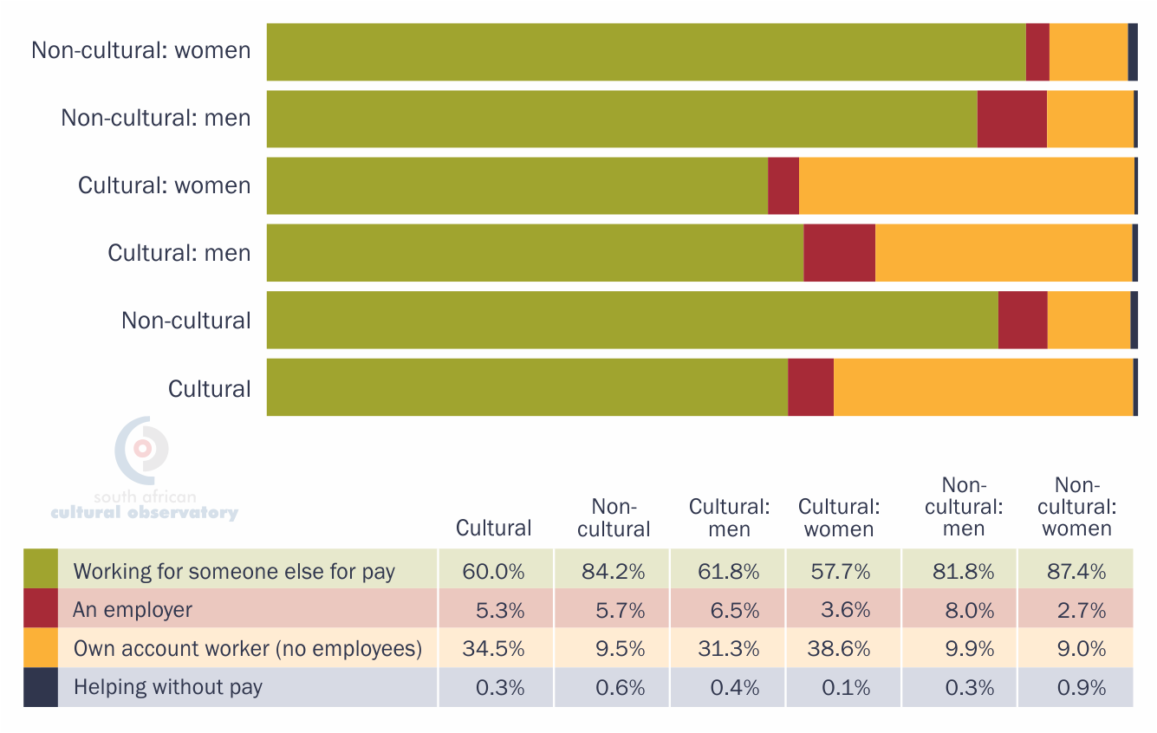
Planning relevant indicator: Employment Type

Slide 15
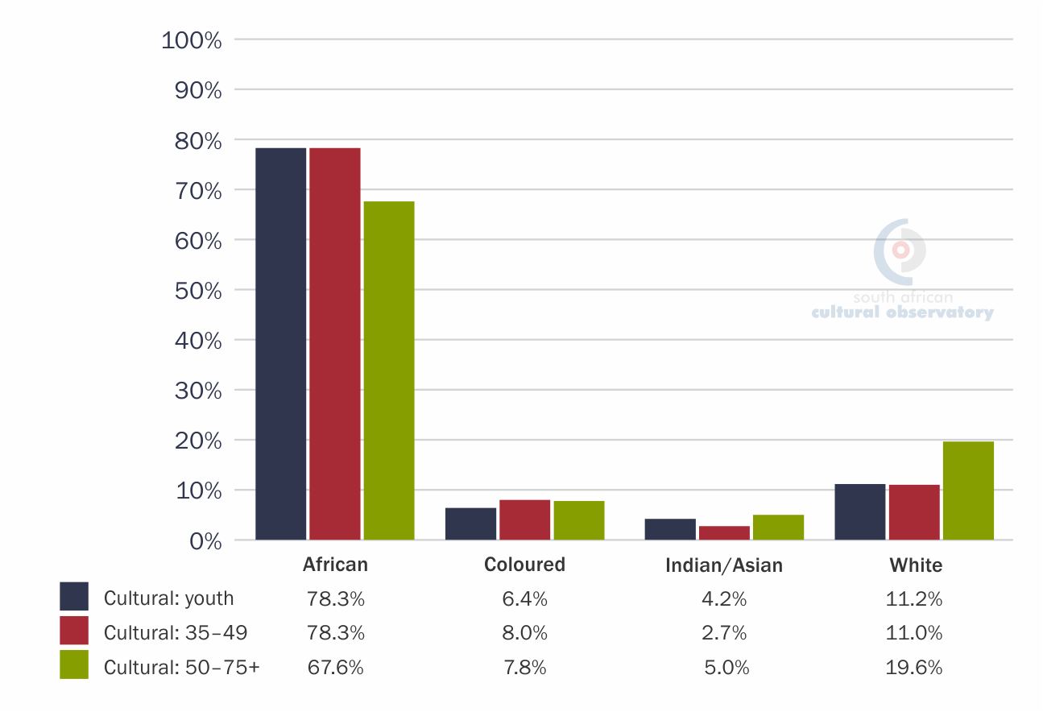
Planning relevant indicator: Transformation and gender

Slide 16
International trade

Slide 17
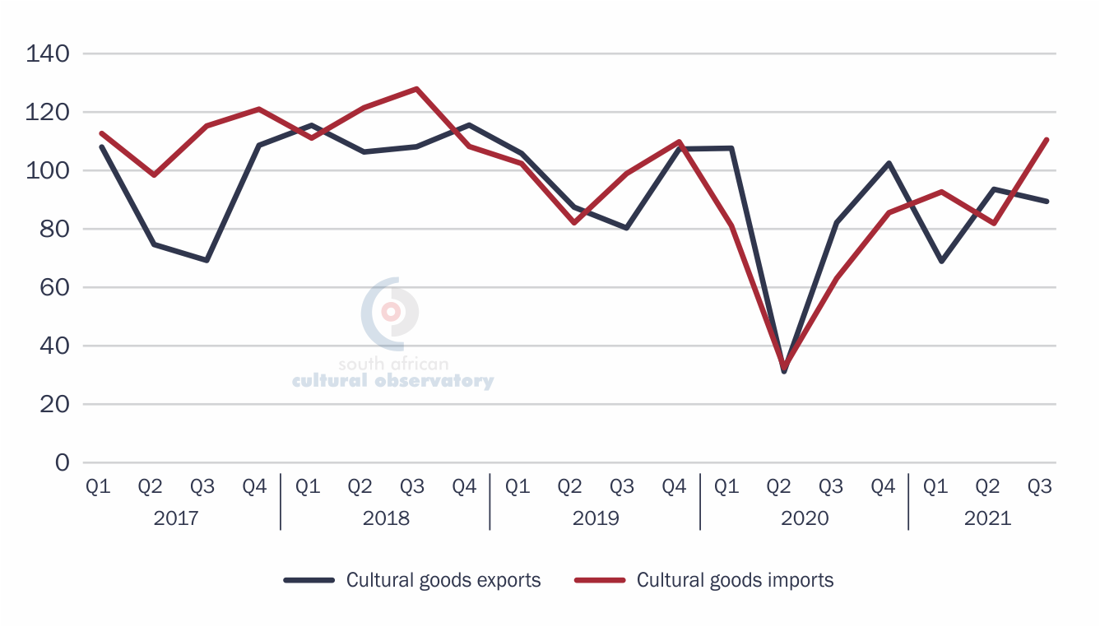
Headline Indicators: South Africa's cultural goods trade (current US$ millions)

Slide 18
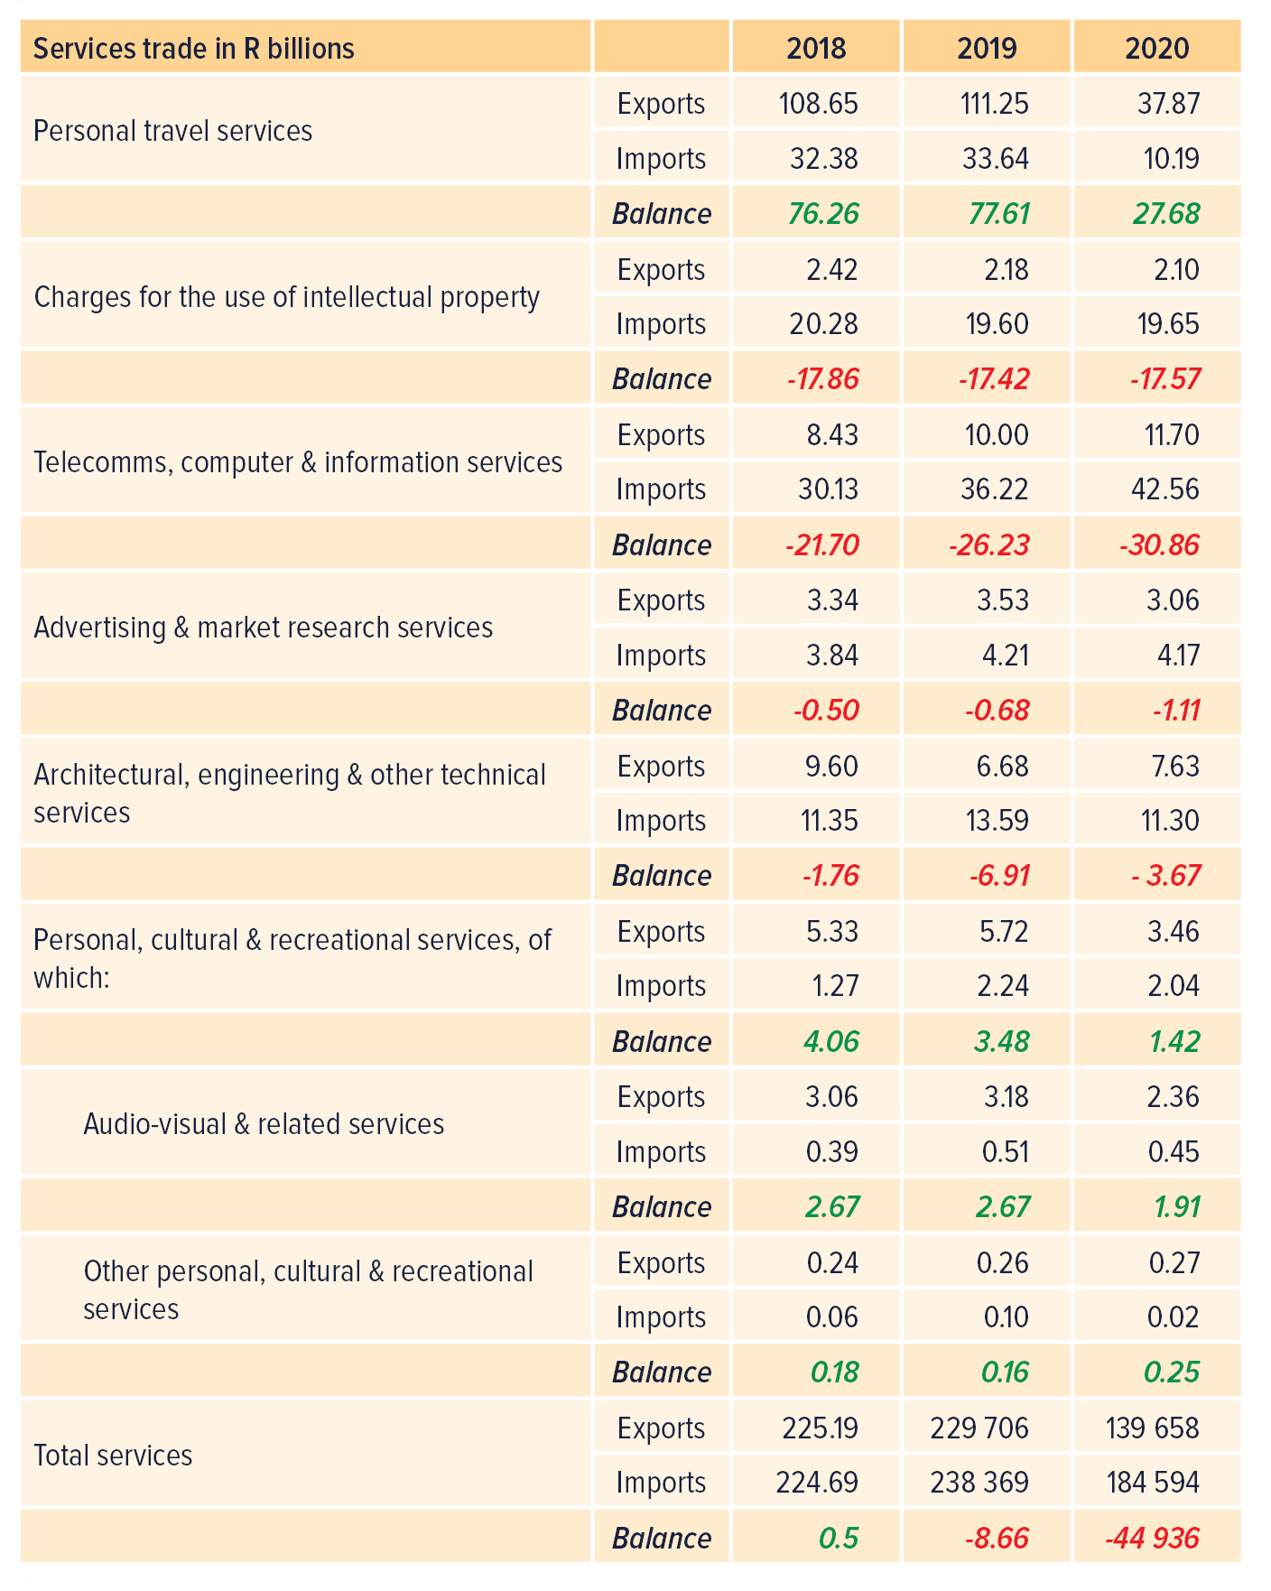
Headline indicators: Service trade

Slide 19
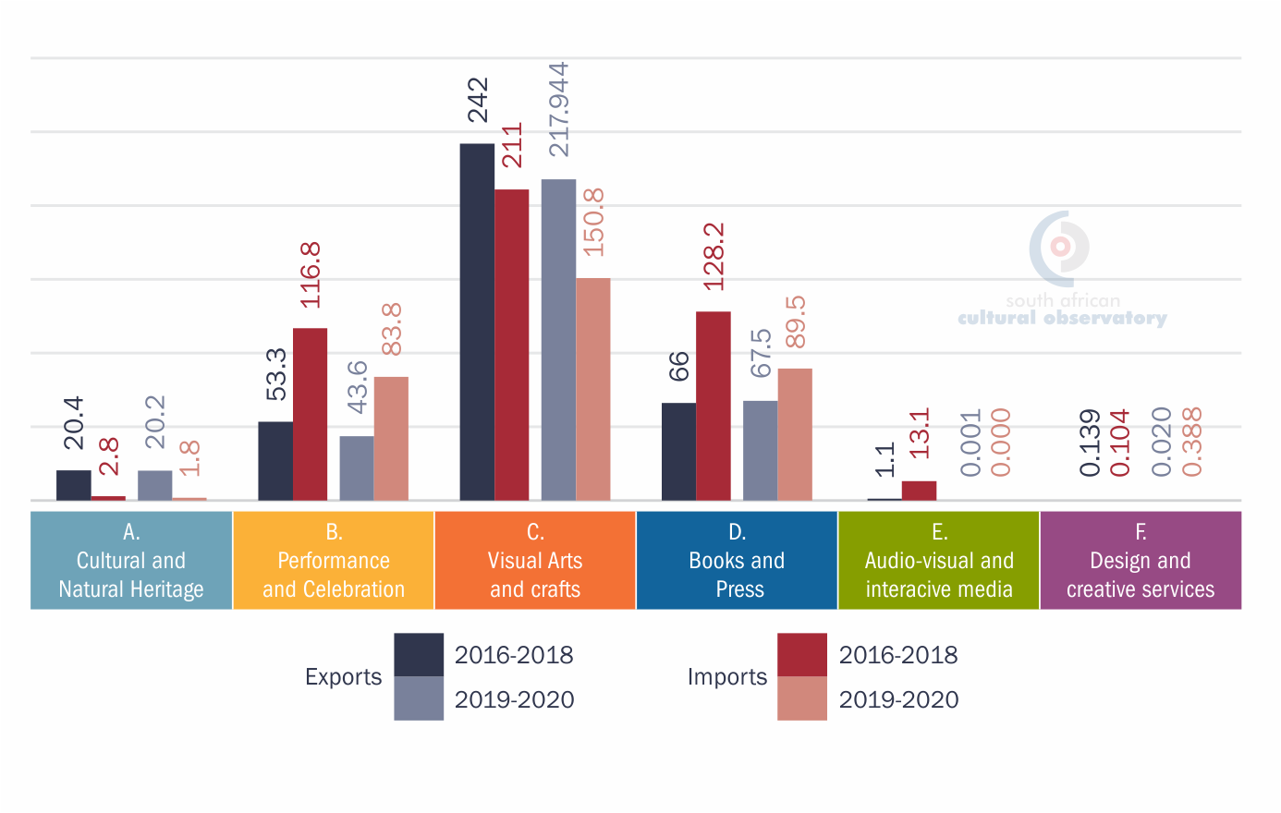
Planning indicator: CCI goods trade by domain
Notes:
Note that GOODS trade in Domains E and F does not represent the value of trade in these domains well, since most of this trade has dematerialized (become digital services).

Slide 20
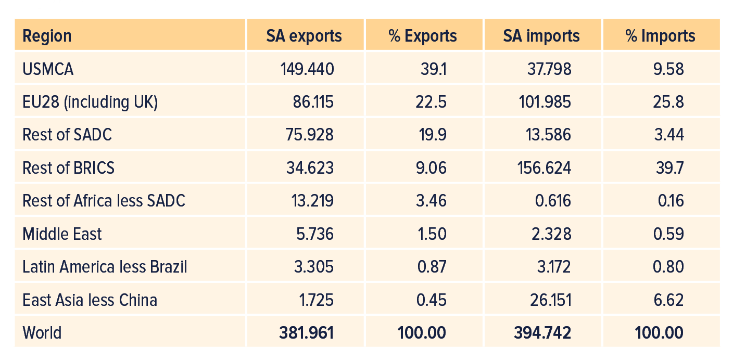
Planning indicator: Destination of CCI goods trade

Slide 21
Planning indicator: Trade complementarity indices (TCIs)
Trade complementarity indices (%) between South Africa and selected regions, 2019 | USMCA | SADC | EU
South Africa’s export TCI | 47.20 | 35.79 | 65.07
South Africa’s import TCI | 43.65 | 21.06 | 52.09
Used to assess the potential trade patterns between these partners in the event of further trade expansion. They do not rely on current bilateral trade flows between the partners themselves, but rather on the structure of each party’s trade with the rest of the world in the various cultural product trade categories.
Notes:
South Africa’s Export TCI with the USMCA (47.20%) exceeds that with SADC (35.79%) by nearly 12 percentage points. However, the country’s export TCI with the EU is even greater at 65.07%.
South Africa has a low Import TCI with SADC, which suggests that the region does not produce enough of the range of cultural products that South Africa imports. There is a need to build productive capacity in the CCIs in the SADC region, and to address non-tariff barriers, infrastructure constraints, transport costs, financing and information flows.

Slide 22
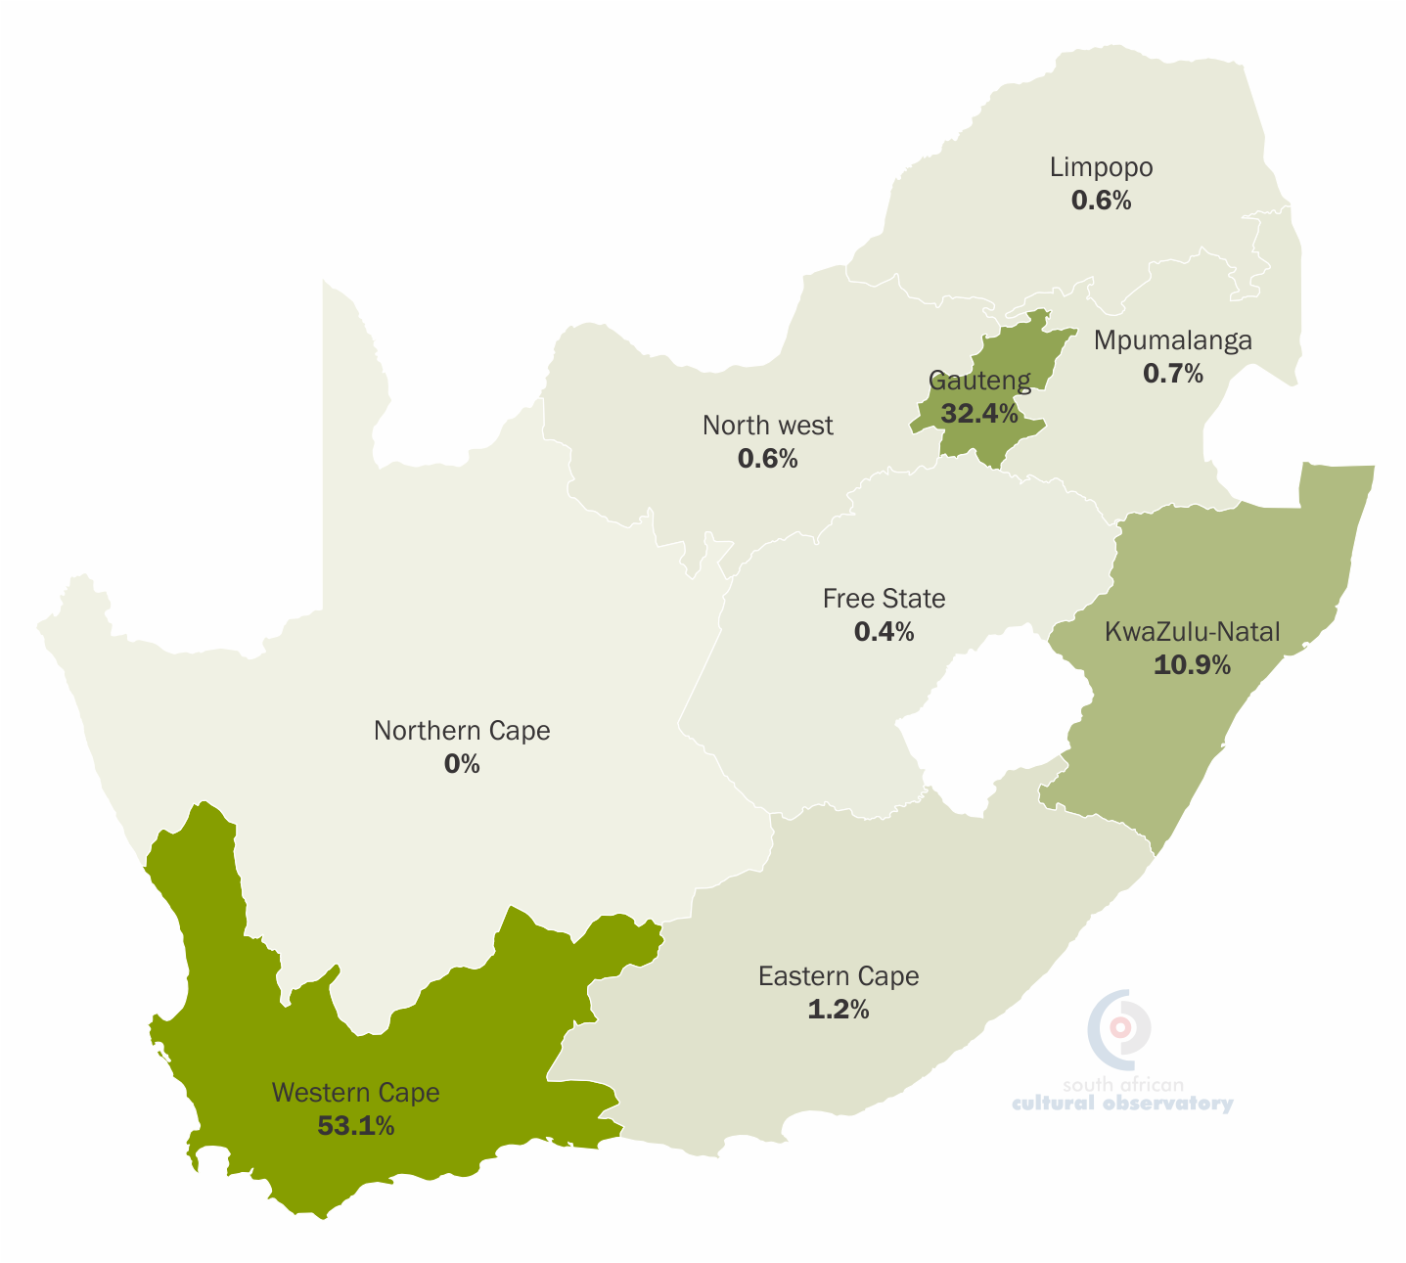
Geographic spread: CCI exports
The Western Cape is clearly dominant in terms of exports of CCIs in the country and contributes 53.1% to South Africa’s exports of CCI goods.
Gauteng Province (32.4%) and KwaZulu-Natal (10.9%) also have significant shares of South Africa’s CCI export basket.

Slide 23
Bringing it all together…

Slide 24
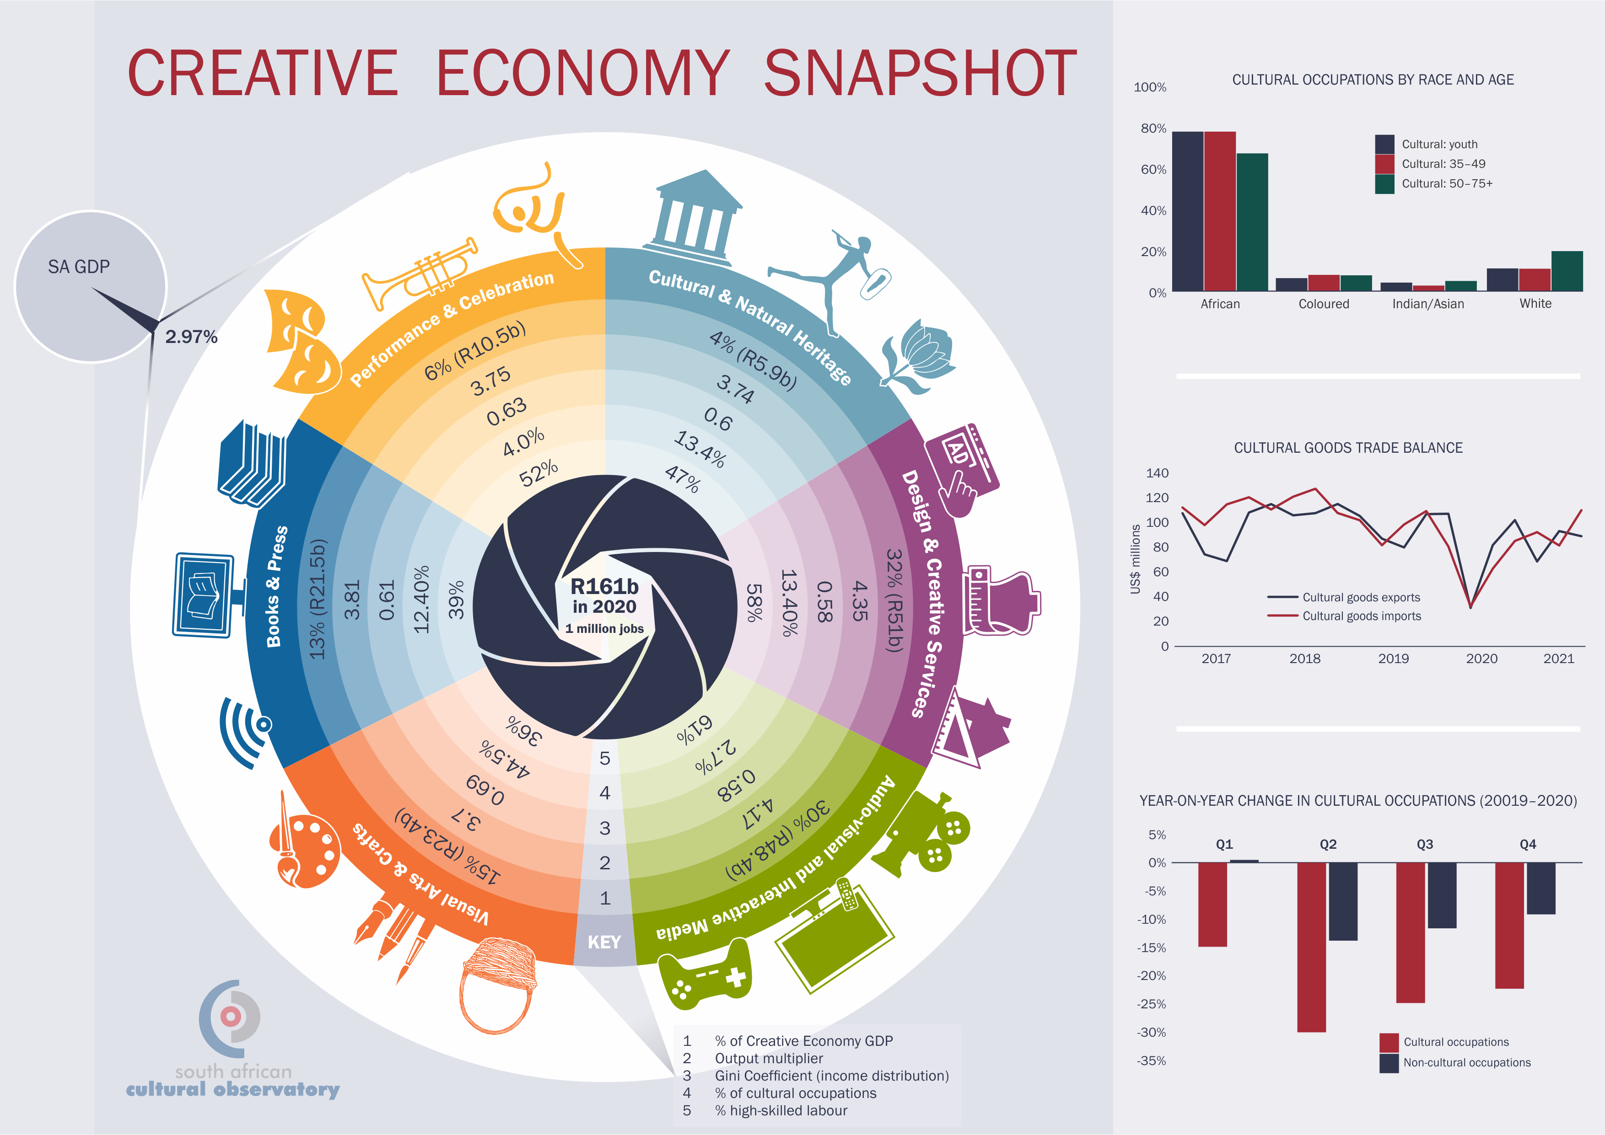
Find the full mapping study and the Capstone report at: https://www.southafricanculturalobservatory.org.za/

Slide 25
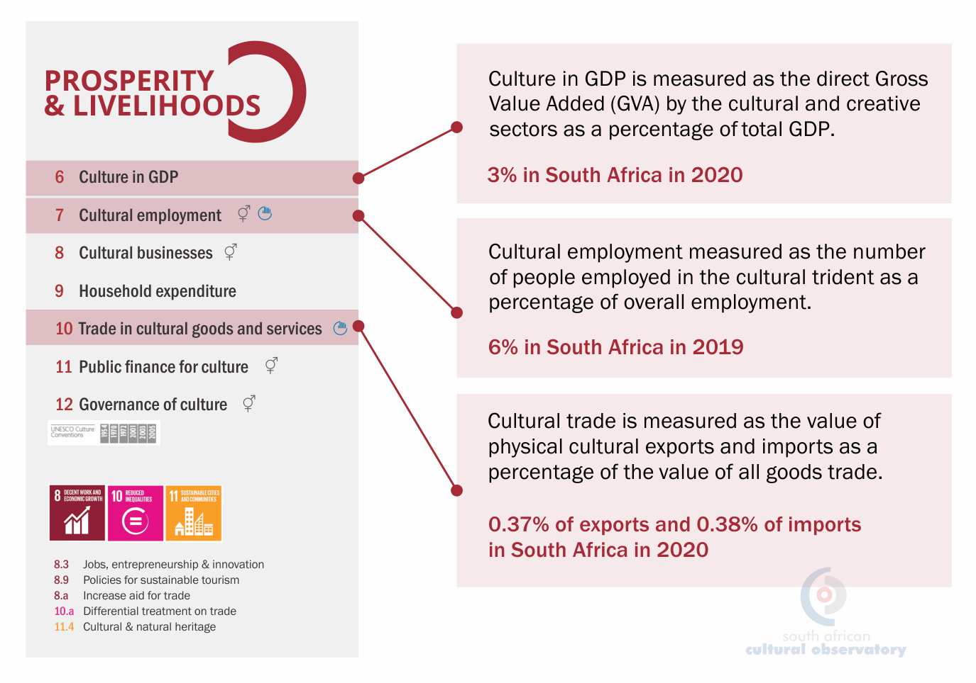
Concluding remarks
Headline indicators are important for:
  Attention: Demonstration the value and importance of the CCIs Overall
  Advocacy: Motivating for their inclusion in policy (Creative Industries Masterplan)
  Tracking high-level progress: M&E focused on impacts (not outputs or outcomes.
Planning indicators are important for:
  Identifying challenges and opportunities within the CCIs (policy & industry)
  Developing effective and sustainable domain-specific, and region-specific interventions

Slide 26


Slide 27
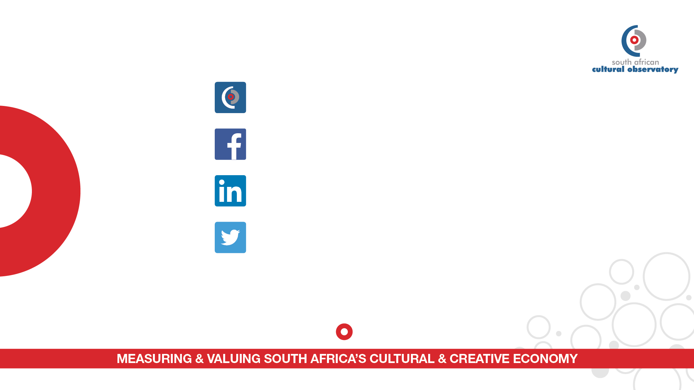
www.southafricanculturalobservatory.org.za
@SACulturalObservatory
https://www.linkedin.com/company-beta/10581051/
@SACulturalObs
T: +27 41 504 4930 E: info@southafricanculturalobservatory.org.za
21-23 Donkin Street, Central, Port Elizabeth, 6000, Eastern Cape, South Africa

