Slide 1






SACO PESP TRAINING FINANCIAL ACCOUNTING
GENERAL LEDGER, TRIAL BALANCE, VAT, MARK-UPS AND INTEREST CALCULATIONS

Slide 2
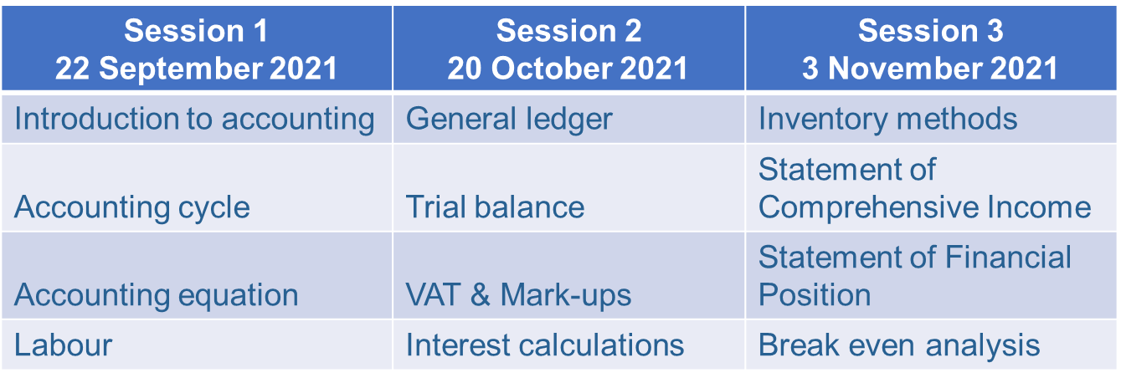
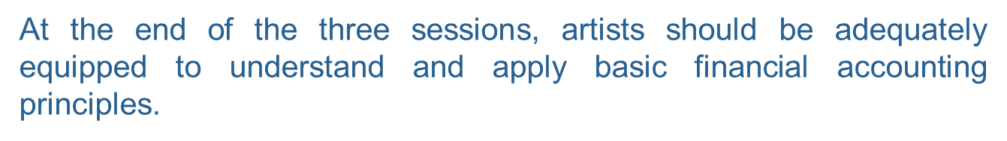
SESSIONS

Slide 3
OBJECTIVES
The objectives are to develop an understanding of the principles of accounting at a level that is logical and practical to artists. The sessions will enable artists to apply the various concepts and fundamental practices of accounting.
After this session artists should:
Understand the accounting cycle.
Understand the effects of transactions in the accounting equation (A=O+L).
Have sound knowledge of the double entry principle.
Understand the nature and function of salaries and wages including basic salary deductions and forms of payment.

Slide 4
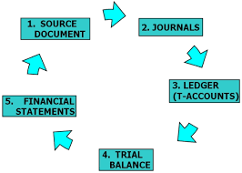
GENERAL LEDGER & TRIAL BALANCE
What are General Ledger accounts?
General ledger is a summary of all accounts of a business entity, which are totalled and balanced off at the end of each month.
A general ledger account is opened for every item whether it is an asset, liability, capital, drawings, income or expense. The purpose of general ledger accounts are to determine the balance of all balance sheet accounts and the totals of all nominal accounts.

Slide 5
GENERAL LEDGER & TRIAL BALANCE
What are Balance sheet and Nominal accounts?
Balance sheet accounts: are all your Assets, Liabilities, Capital and Drawings. These accounts are balanced off by calculating the difference between the debit and credit side of each account. balance c/d and balance b/d
Nominal accounts: are all your income and expenses, these accounts are not balanced off. However, they are totalled for a specific financial because they only represent one financial year and will then be closed off. All nominal accounts will be ZERO at the beginning of the financial year.

Slide 6
GENERAL LEDGER & TRIAL BALANCE Cont.
Example of a General Ledger Account
General ledger accounts are in the shape of a “T” with the name of the account at the top. All transactions relating to the specific account will be captured in the general ledger account in order to allow users to determine the balance or total at a specific period. NB. Always check if there are opening balances or totals to be captured in the general ledger accounts before recording other transactions.
DR ACCOUNT NAME CR
Month and year | Day | Account |  | Amount |  | Month and year | Day | Account |  | Amount

Slide 7
GENERAL LEDGER & TRIAL BALANCE Cont.
General Ledger account headings
Heading | Description
Year and Month | This represents the year and month that you are currently working in. E.g. (June 2021)
Day | The day of the month in which the transaction took place.
Contra Account/ Details | The contra account is the other account where an equal amount is recorded on the opposite side.
Amount | The monetary value either paid or received for the transaction.

Slide 8
GENERAL LEDGER & TRIAL BALANCE Cont.
Closing off general ledger accounts
Balance sheet accounts:
DR |  |  |  | Bank |  |  |  |  | CR
2021 | 3 | Capital |  | 20 000 | 2021 | 7 | Equipment |  | 10 000
Jan | 15 | Sales |  | 10 000 | Jan | 11 | Creditors |  | 5 000
 |  |  |  |  |  | 20 | Salaries |  | 1 000
 |  |  |  |  |  | 22 | Inventory |  | 6 000
 |  |  |  |  |  | 31 | Balance c/d |  | 8 000
 |  |  |  | 30 000 |  |  |  |  | 30 000
Feb | 1 | Balance b/d |  | 8000

Slide 9
GENERAL LEDGER & TRIAL BALANCE Cont.
Closing off general ledger accounts
Nominal accounts:
DR |  |  |  | Sales |  |  |  |  | N1 CR
 |  |  |  |  | 2021 | 7 | Accounts Receivable |  | 25000
 |  |  |  |  | Jan | 11 | Bank |  | 35000
 |  |  |  |  | Feb | 1 | Total | b/d | 60000

Slide 10
GENERAL LEDGER & TRIAL BALANCE Cont.
Trial balance
A trial balance contains a summary of all the balances of balance sheet accounts and the totals of all nominal accounts in the business entity.
A trial balance is usually prepared on a monthly basis, but it can be prepared at any time when needed. The purpose of a trial balance is to ensure that the double-entry principle has been correctly applied (for every debit there is a credit and vice versa)

Slide 11
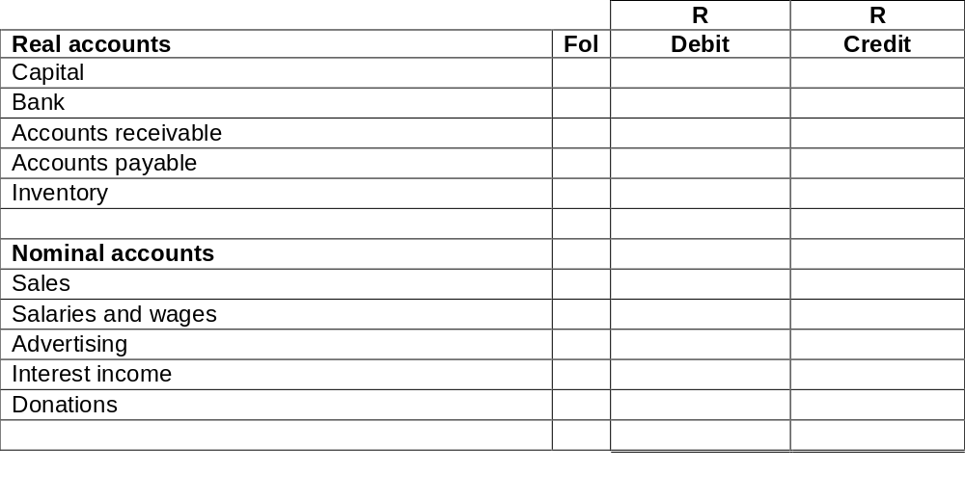
GENERAL LEDGER & TRIAL BALANCE Cont.
Trial balance

Slide 12
GENERAL LEDGER & TRIAL BALANCE Cont.
Example:
Ryan deposited R50 000 into the business bank account as his capital contribution.
Paid weekly wages R1 500.
14) Sold goods to a customer for cash R20 000, cost price R16 000.
25) Purchased inventory for cash R35 000 from Easy Stitch Ltd.

Slide 13
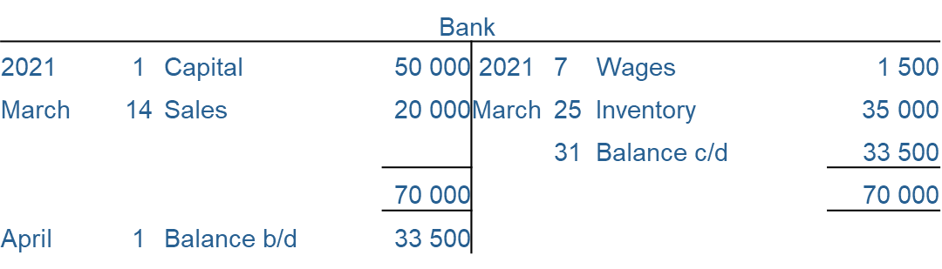
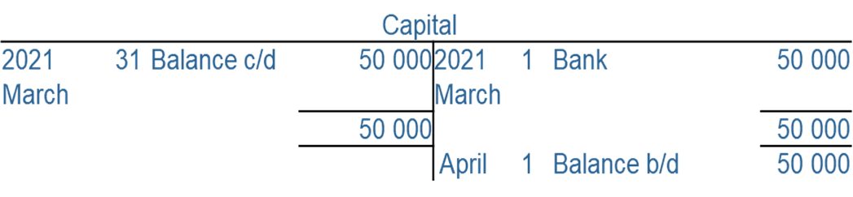
GENERAL LEDGER & TRIAL BALANCE Cont.
 |  |  |  | Sales
 |  |  |  |  | 2021
 |  |  |  |  | March | 14 | Bank |  | 20 000
 |  |  |  |  | April | 1 | Total b/d |  | 20 000

Slide 14
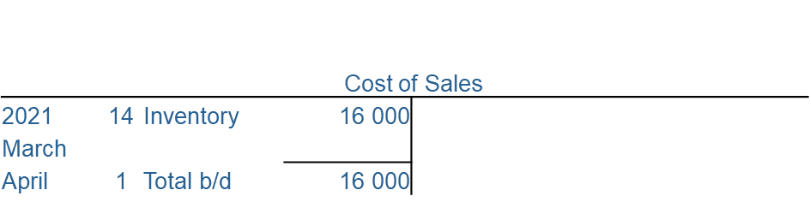
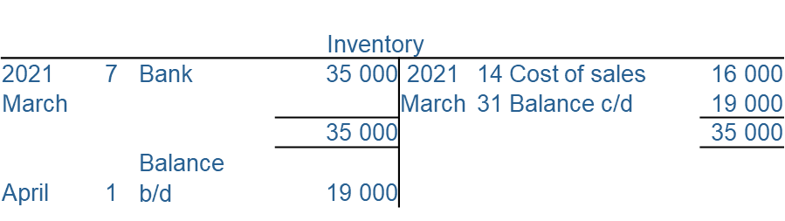
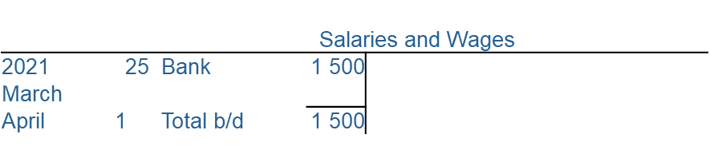
GENERAL LEDGER & TRIAL BALANCE Cont.

Slide 15
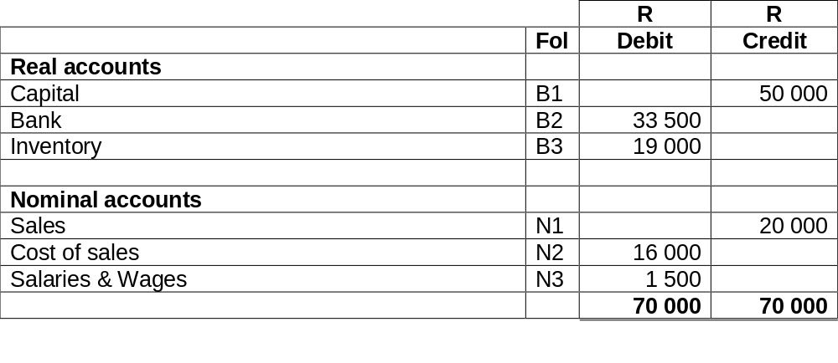
GENERAL LEDGER & TRIAL BALANCE Cont.

Slide 16
GENERAL LEDGER & TRIAL BALANCE PRACTICE QUESTION
The following transactions took place in the books of Happy Traders during March 2021.
1. The owner contributed R 600 000 into the bank account of Happy Traders
as a capital contribution.
2. Bought the following items cash:
Motor Vehicles R200 000
Inventory R200 000
Stationery R 5 000
5. Sold goods for cash R350 000 (cost price, R150 000).
7. Sold goods on credit R80 000 (cost price, R35 000).
8. Paid wages in cash R15 000.
12. Purchased office furniture on credit from Big Tree Furniture Ltd, R19 550.
17. Inventory purchased from ABC Wholesalers on credit, R727 000.
18. Sold goods to A. Baker R420 000 (cost price, R182 000) on credit.
REQUIRED:
Record the above transactions in the General Leger and Trial Balance of Happy Traders.

Slide 17


Slide 18
VAT AND MARK-UP CALCULATIONS
Important accounting terms
Term | Definition
SARS | South African Revenue Service.
VAT | Value added taxation.
Input VAT | VAT receivable from SARS goods or services purchased cash or on credit.
Output VAT | VAT payable to SARS from sales and services rendered cash or on credit.
VAT vendor | A business or individual that is registered for VAT.
Exempt supplies | Goods and services on which VAT is not charged.
Standard rated supplies | Goods and services on which VAT of 15% is charged.
Zero rated supplies | Goods and services on which VAT of 15% is claimable as input VAT but 0% is payable to SARS as output.
Gross profit | The difference between the selling and cost price of goods and services.
Sales price | The price at which goods and services are sold.

Slide 19
VAT AND MARK-UP CALCULATIONS Cont.
The basics of VAT
VAT VENDORS REGISTRATION:
A business entity MUST register as a VAT vendor with SARS if it earns (or expects to earn) R1 000 000 or more from the sale of taxable supplies in a 12-month period.
A business entity can VOLUNTARILY register as a VAT vendor with SARS if it earns between R50 000 and R1 000 000 from the sale of taxable supplies in a 12-month period.
A business entity MAY NOT register as a VAT vendor if it earns less than R50 000 from the sale of taxable supplies, in a 12-month period.

Slide 20
VAT AND MARK-UP CALCULATIONS Cont.
Supplies in South Africa can be categorised into three groups namely:
  Standard rated supplies: (input VAT of 15%; output VAT of 15%). Examples of such supplies include inventory, assets etc.
  Zero-rated supplies: (input VAT of 15%; output VAT of 0%). Example of such supplies include, exports, illuminating paraffin, international transport services, fruit and vegetables, brow bread, milk and eggs.
  Exempt supplies: (input VAT of 0% and output VAT of 0%). Examples of such supplies include non-fee-related financial services, educational services provided by an approved educational institution, residential rental accommodation and public road and rail transport.

Slide 21
VAT AND MARK-UP CALCULATIONS Cont.
Calculating VAT
N.B. Selling/purchase price exclusive of VAT + VAT = Selling/purchase price inclusive of VAT.
The following formulas can be used when calculating VAT:
Selling price exclusive of VAT x 15/100 = VAT amount
E.g. Calculate the VAT amount if the selling price exclusive of VAT is R200: (200 x 15/100)= R30
Selling price inclusive of VAT x 15/115= VAT amount
E.g. Calculate the VAT amount if the selling price inclusive of VAT is R230: (230 x 15/115)= R30

Slide 22
VAT AND MARK-UP CALCULATIONS Cont.
Input and Output VAT
Input VAT: This is the VAT/“tax” that the vendor himself has borne in respect of goods or services supplied to him.
Output VAT: This is the VAT/“tax” which the vendor charge when supplying goods or services.
VAT payable/refundable:
VAT charged on supplies sold or services rendered (Output VAT) XXXX
Less: VAT paid to suppliers (Input VAT) (XXXX)
VAT payable/refundable XXXX

Slide 23
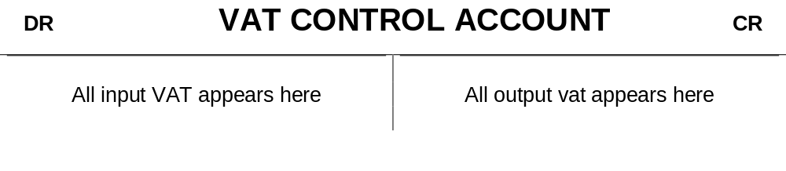
VAT AND MARK-UP CALCULATIONS Cont.
VAT control account

Slide 24
COST PRICE, SELLING PRICE AND MARK-UPS
Mark-up on cost price:
When the mark-up is on cost price, we assume that the base for mark-up calculation is the cost price. In other words, the cost price will be equivalent to 100%. To calculate the selling price, the mark-up percentage will be added to the cost price. E.g. if the mark-up on cost price is 70% then the following can be assumed:
Cost price + Mark-Up = Selling price
100% + 70% = 170%
E.g. Calculate the selling price if the cost price of inventory bought is R17 500.
Selling price = 17 500 x 170/100 = R29 750

Slide 25
COST PRICE, SELLING PRICE AND MARK-UPS
Mark-up on selling price:
When we deal with mark-up on selling price, it is similar to the mark-up on cost price, but the base for mark-up calculation is the selling price. In other words, the selling price will be equivalent to 100%. To calculate the cost price, the mark-up percentage must be subtracted from the selling price. E.g. if the mark-up on selling price is 70%, then the following can be assumed.
Cost price + Mark-Up = Selling price
30% + 70% = 100%
E.g. Calculate the selling price if the cost price of inventory bought is R17 500.
Selling price = 17 500 x 100/30 = R58 333.33

Slide 26
VAT AND MARK-UP CALCULATIONS Cont.
Example:
2) Bought balls and cricket equipment on credit from AB. Jonker for R37 858 (including VAT).
7) Sold goods for cash to H. Kallis R2 000 (excluding VAT), cost of sales R1 586.
9) Paid water and electricity R3 450.
VAT Refundable
 |  |  |  |  | VAT Control
2021 | 2 | Accounts payable |  |  | 4 938 | 2007 | 7 | Bank |  | 300
March | 9 | Bank |  |  | 450 | March
 |  |  |  |  |  |  | 30 | Balance c/d |  | 5 088
 |  |  |  |  | 5 388 |  |  |  |  | 5 388
April |  | Balance b/d |  |  | 5 088

Slide 27


Slide 28
SIMPLE AND COMPOUND INTEREST
Every business at some time will borrow or invest money. If you wish to borrow money you must pay for the use of that money (interest expense). If you invest money you will earn income on the money invested (interest income), because you are giving up the right to use that money for a certain period.
After this section, you should be able to:
  Understand the difference between simple and compound interest
  Calculate the different simple and compound interest formulae

Slide 29
SIMPLE AND COMPOUND INTEREST Cont.
Simple interest
All investments and borrowings earn interest at a specific rate. Simple interest is used when a loan or investment is repaid in one lump sum and is usually used for short-term loans or investments. The formula used to calculate simple interest is:
i = P x r x t
I= INTEREST
P= PRINCIPAL INVESTED
R= RATE OF INVESTMENT (MUST ALWAYS BE EXPRESSED AT A %)
T=TIME THE INVESTMENT WAS HELD (MUST ALWAYS BE SHOWN AS A YEAR FIGURE)

Slide 30
SIMPLE AND COMPOUND INTEREST Cont.
Example 1
Find the simple interest on R600 for 4 years at 2% per annum.
i = P x r x t
= R600 x 2% x 4
= R48

Slide 31
SIMPLE AND COMPOUND INTEREST Cont.
Example 2
Find the simple interest on R10 000 invested for 9 months at 15% p.a..
i = P x r x t
= R10 000 x 15% x
= R1 125
Note: Time (t) is always expressed in terms of a year, therefore 9/12

Slide 32
SIMPLE AND COMPOUND INTEREST Cont.
Example 3
Find the simple interest on R350.60 for 82 days at 5% p.a.
i = P x r x t
= R350.60 x 5% x 82/365
= R3.94
Note: Time (t or n) is always expressed in terms of a year, therefore 82/365

Slide 33
SIMPLE AND COMPOUND INTEREST Cont.
Compound interest
When money is invested at simple interest rate, the investor draws the interest due to him at the end of each year. Therefore, the interest for the following year is again calculated on the same capital. Some investors, however, prefer to re-invest that interest so that the principal for the following year may be greater. This means: interest is added to the initial investment (or loan) and interest for the following period is calculated on the initial amount plus interest earned in the previous period. The interest has been compounded.

Slide 34
SIMPLE AND COMPOUND INTEREST Cont.
Compound interest cont.
When money is borrowed for longer periods the interest is compounded, meaning interest is calculated more than once during the term of the loan/investment and this interest is added to the original principal. The new amount then becomes the principal for the next calculation of interest.
With this method you pay/earn interest on interest.

Slide 35
SIMPLE AND COMPOUND INTEREST Cont.
Example 1
Find the compound interest on R150.40 for 2 years at 6% per annum.
Principal/Present value at beginning of 1st year R150.40
Interest = R150.40 x 6% R 9.02
Principal/Present value at beginning of 2nd year R159.42
Interest = R159.42 x 6% R 9.57
Amount/Future value (at end of 2 years) R168.99
Compound interest for the 2 years (Fv – Pv) = (R168.99 – R150.40) R 18.59

Slide 36


Slide 37


